Slide 1
Hello! We will start at 4 pm.

Slide 2
Building community in remote courses
Victoria Bhavsar,
Cal Poly Pomona Faculty Center

Slide 3
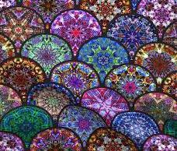
Community: A feeling of fellowship with others, as a result of sharing common attitudes, interests, and goals.
We need to build our courses thinking about how students interact with one another and with us, thinking about activities beyond the screen that extend the lessons of the course.
We need to think about what we offer --curiosity, imagination, knowledge, power --that are antidotes to trauma.
We offer ways that one can learn how to become accomplished, an expert, successful -- especially in the face of uncertainty.
https://www.hastac.org/blogs/cathy-davidson/

Slide 4
Purpose
Example
Plan
Environment

Slide 5
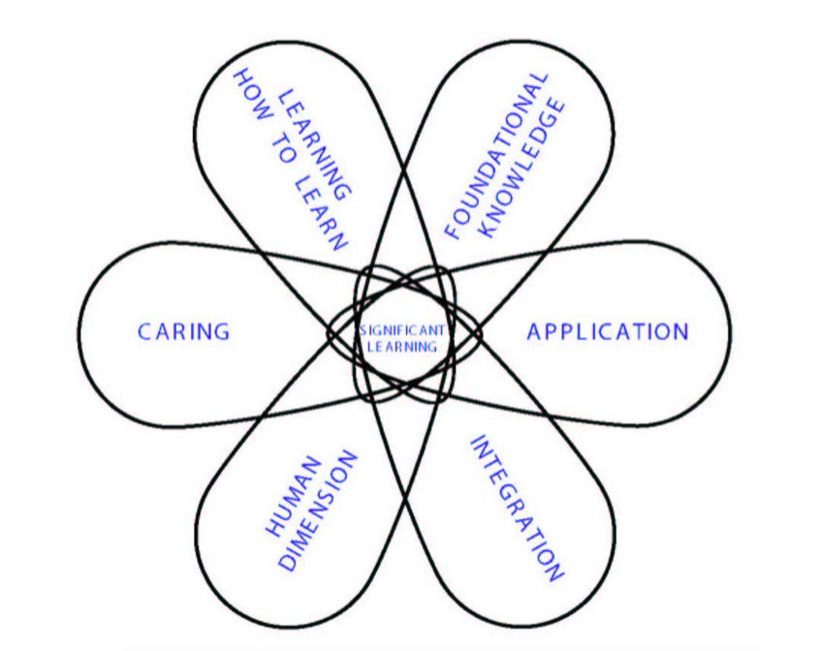
Types of learning outcomes

Slide 6
Ten strategies, easy to hard
Regular but not too often “personal” emails (use mail merge)
Keep connected with CPP, remind students of news and events from campus at large
Required Zoom “office visits” -- give students a template for the conversation
Require participation in discussion boards, etc., with your “weekly roundup”. Encourage Flipgrid, Instagram, and other visuals on the discussion board
Facebook or Piazza pages for the class
Let students lead synchronous meetings – prep by reading/watching ahead of time
Extra credit learning communities
Groups in Blackboard, with rotating student leadership
Micro-extra-credit for students helping each other out
Collaborative group projects

Slide 7
Managing the workload of building community
Invest in course design up front
Train students to help each other first
Calendar your teaching time even when it’s asynchronous
Plan your communication
Set and respect your own time boundaries!

Slide 8
Resources
https://www.facultyfocus.com/articles/online-education/five-ways-to-build-community-in-online-classrooms/
http://blog.online.colostate.edu/blog/online-education/the-importance-of-building-online-learning-communities/
https://rtalbert.org/steps-toward-excellence-planning-communications/, and the previous five posts as well

