Slide 1
Range Elevation Workshop
Office of Faculty Affairs
Presented by:
George Tejadilla, Executive Director for Academic Personnel
Grace Santos, Faculty Affairs Analyst
February 11, 2021

Slide 2
What is Range Elevation?
Range Elevation is the increase in salary by movement from one range to the next, Range A to B, B to C, C to D. If granted, a Range Elevation brings a salary increase of at least 5%. [Original]
Starting in Fall 2017, for those eligible, Range Elevation shall be accompanied by a salary increase of at least 5%, or more in order to reach at least the minimum of the next range. [Full-Time Adjusted Service (FTAS)]

Slide 3
Original Range Elevation
Range elevation represents a minimum 5% increase in salary and movement from one range to the next.
To be eligible for a range elevation you must be at or above the SSI max for your current range and have been in that range for at least 5 years. (stagnant)
3

Slide 4
Effective Date for Increases
Ra n g e elevation, as well as applicable salary increase, shall take effect at the beginning of the first appointment in the academic year following review.

Slide 5
Policy 1332 – Temporary Faculty Range Elevation
Applications shall be accepted between December 15 and January 31 of each year.
Any lecturer who by the end of the academic year will have met the eligibility criteria should apply during this period.
The “application” shall consist of a written letter or memorandum clearly stating the applicant's request.
This shall be accompanied by a CV and a description of professional development in support of lecturer work assignments, both updated from the initial appointment or last range elevation, whichever is more recent.

Slide 6
Policy 1332 – Temporary Faculty Range Elevation
4. Criteria for Range Elevation
Whereas (a) good teaching is of fundamental importance in the evaluation of all faculty members, and (b) in order to ensure good teaching, it is essential that faculty remain competent in the fields in which they teach, it is necessary that continued competence be demonstrated in evaluations for range elevations. At advanced levels of academia, competence is assessed via scholarship in the field. It is recognized that scholarship is broadly defined at Cal Poly Pomona, and includes the scholarship of teaching.
In addition to teaching and demonstration of continued competence, lecturers shall be evaluated on other assigned duties that are contained either in their contract or letter of appointment. No lecturer shall be required to perform service if service is not an assigned duty.
Departments shall establish their own guidelines for range elevation decisions, subject to approval by the Associate Vice President for Faculty Affairs. The committee that deals with range elevation requests may make use of existing annual evaluations to the extent that they feel they are adequate.

Slide 7
FTAS Determination of Eligibility
Full-time adjusted service (FTAS) shall be established as of the beginning of the 2017/18 academic year. For each academic or fiscal year, FTAS is defined as the average timebase over the academic or fiscal year, divided by 0.8 up to a maximum of 1.0 for the year, within a single department.
Examples: (a) if a lecturer’s average timebase over an AY was 0.4 [12 WTUs], then the FTAS for that year is 0.4/0.8 = 0.5. (b) if their average timebase was 0.8 [24 WTUs], the FTAS for the AY is 0.8/0.8 = 1.0 (c) if their average timebase was 1.0 (full-time) [30 WTUs], then their FTAS for the AY is 1.0, the maximum allowed (1.0/0.8 = 1.25)

Slide 8
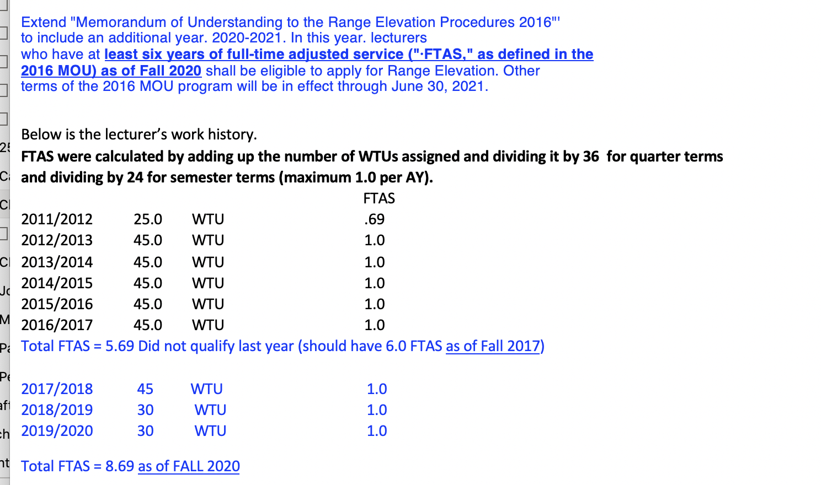
Sample of Full-Time Adjusted Service (FTAS) Calculation

Slide 9
FTAS: What is the Percentage of Increase?
Range elevation shall be accompanied by a salary increase of at least 5% or whatever percentage increase is required to reach at least the minimum of the next range, whichever is greater.
Example: An eligible Lecturer in Range A has a full-time base salary of $4300 per month (which is above the Range A minimum of $4,229). Movement to Range B takes them to the minimum of $5,046 monthly, a 17.35% increase!
Under Original Range Elevation, the increase would be 5% ($4,440); but only after being at or above the SSI max for your current range and have been in that range for at least 5 years.

Slide 10
Summary of Salary Schedule

Slide 11
Sample Range 2 Lecturer

Slide 12
Sample Range 3 Lecturer

Slide 13
Sample Range 4 Lecturer

Slide 14
2021 Range Elevation Calendar
November 16 Department Chair: Submits criteria for lecturer range elevations to Associate
Vice President for Faculty Affairs
November 30 AVP for Faculty Affairs: Notifies lecturers eligible for a range elevation.
January 31 Candidate for Range Elevation: Submits application to Department Chair.
February 15 Department Chair: Provides applications from candidates to Department Review Committee consisting of at least 3 tenured faculty members.
February 15 – Mar 1 Department Review Committee: Evaluates candidates for range elevation.
February 15 – Mar 1 Department Chair: If the Department Chair is not on the Department Review Committee, the Department Chair may evaluate candidates for range elevation.
March 1 Department Review Committee: Recommendations from the committee goes through the Department Chair.
The recommendation is to be in memo format, addressed to the Dean.
The evaluation/recommendation from the Department Chair (if separate from the committee) is also due on this date

Slide 15
2021 Range Elevation Calendar
March 1 – 11 Candidate: Reviews recommendations from Department Review Committee and Department Chair. The candidate has ten calendar days to write a response if desired.
March 11 Department Chair: Forwards recommendations and candidate’s responses, if any, to the Dean.
March 11 – March 25 Dean: Reviews recommendations from Department Review Committee and Department Chair and evaluates candidate for range elevation.
March 25 Dean: Provides a copy of his/her evaluation and recommendation to the candidate. The recommendation is to be in memo format, addressed to the Provost.
March 25 – April 8 Candidate: Reviews evaluation/recommendation from the Dean. The candidate has ten calendar days to write a response if desired.
April 8 Dean: Forwards recommendations (Dean’s and department’s) and candidate’s responses, if any, to the AVP for APPFA.
April 8 – April 22 Provost: Reviews recommendations and evaluates the application.
April 22 Provost: Informs candidate of decision.
May 3 Candidate: May submit an appeal of a negative decision to the AVP for APPFA.

Slide 16
Q & A
Thank YOU!

