Slide 1
Sound Lesson 1b
How Can We Tell If Something Is Making a Sound?

Slide 2
Unit Central Question
Why do we hear sound?

Slide 3
Today’s Focus Question
How can we tell if something is making a sound?

Slide 4
Review: What Is Evidence?
Evidence is what we find out or understand that helps us know something.
Hearing a sound with our ears is evidence that something is making a sound!
Scientists are like detectives because they use evidence to figure out how the world works.
We’re detectives, too, because we’re gathering evidence to figure out why we hear sound!

Slide 5
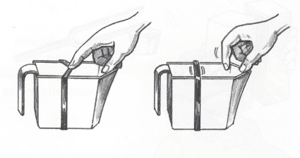
A New Soundmaker
Courtesy of BSCS

Slide 6
What Do You Predict?
How will you know if our new soundmaker is making a sound? What evidence do you think you’ll find?
Talk about these questions with an elbow partner.
Then write your ideas in your science notebook.
Be prepared to share your predictions!

Slide 7
An Important Science Word
Vibrate is an important science word we learned last time.
If something is moving back and forth quickly, we say that it’s vibrating.
During today’s investigation, look for evidence of something vibrating.

Slide 8
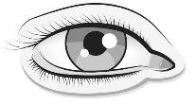
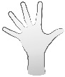
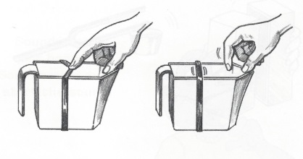
Soundmakers Data Table
My Evidence of Sound Is That … | I Hear … | I See … | I Feel …
Pull on a rubber band stretched across a plastic container and then let go.
Courtesy of BSCS

Slide 9
Rubber-Band Investigation
Pairs: Take turns making sounds with your rubber-band soundmaker just like I did. (You can look at the picture and instructions on the handout too.)
Use your ears, eyes, and hands to find evidence that the soundmaker is making a sound.
Talk with your partner about what you hear, see, and feel.
Record your evidence on your data table.

Slide 10
What Did Your Senses Tell You?
What did you hear when you plucked the rubber band?
What did you see?
What did you feel?

Slide 11
What Evidence Did You Find?
My Evidence of Sound Is That … | I Hear … | I See … | I Feel …
Pull on a rubber band stretched across a plastic container and then let go.
Courtesy of BSCS

Slide 12
Let’s Summarize!
Our focus question: How can we tell if something is making a sound?
Think about our investigations with the ruler and the rubber band.
What are some ways we can tell whether something is making a sound?

Slide 13
Let’s Compare Our Evidence!
Compare the evidence you recorded on your both of your data tables (handouts 1.1 and 1.2).
What evidence of sound did you find with your ears, eyes, and hands?
How are both soundmakers the same or different?

Slide 14
Key Science Ideas
Our senses help us find evidence that objects are making sounds.
We can hear sounds with our ears.
We can see vibrations with eyes.
We can feel vibrations with our hands.
Courtesy of BSCS

Slide 15
Next Time
So far we’ve learned that some objects vibrate when they make sounds.
But do you think all soundmakers vibrate?
We’ll find out next time when we explore some new soundmakers. One of these new soundmakers is YOU!
Do you think you vibrate when you make a sound?

