Slide 1
Sound Lesson 2a
Do Soundmakers Always Vibrate? What Is Our Evidence?

Slide 2
Let’s Review Our Evidence
What evidence did you find that the ruler was making a sound?
Turn and Talk: Share one piece of evidence with an elbow partner. Be prepared to share with the class.
What evidence did you find that the rubber band was making a sound? Share your evidence with the class.

Slide 3
Think about This Question
Can we always see vibrations when objects make sounds?

Slide 4
Today’s Focus Questions
Do soundmakers always vibrate? What is our evidence?

Slide 5
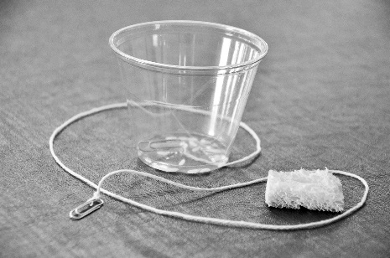
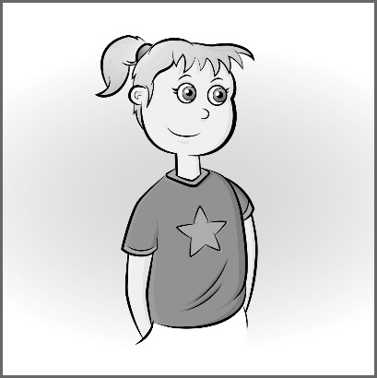
Two New Soundmakers
One of the soundmakers we’ll explore today is called a clucker.
The other soundmaker is you!
Photo courtesy of BSCS
Photo courtesy of BSCS

Slide 6
What Evidence Could We Look For?
What kinds of evidence could we look for that would tell us whether our new soundmakers vibrate when they make sounds?
Photo courtesy of BSCS
Photo courtesy of BSCS

Slide 7
Soundmakers Data Table
A | B | C | D
Soundmaker | Prediction: Will It Vibrate? | Evidence | Result: Did It Vibrate?
Courtesy of BSCS
Photo courtesy of BSCS

Slide 8
Share Your Predictions
Do you think you’ll vibrate when you make a sound?
Sentence starter to use: I predict that I [will/won’t] vibrate when I make a sound.
Do you think the clucker will vibrate when it makes a sound?
Sentence starter to use: I predict that the clucker [will/won’t] vibrate when it makes a sound.

Slide 9
Investigation 1: Do You Vibrate?
Take turns humming.
While one partner hums, the other partner should look carefully to see if something is vibrating.
Think about these questions:
What part of the body is the sound coming from?
Can you see any vibrations there?
Courtesy of Pixabay.com

Slide 10
Can You Feel Any Vibrations?
Place your hand on your throat and then begin humming.
What do you feel?
Is this evidence that your throat is vibrating?
Record your evidence on the data table under column C on the row with the picture of the student.

Slide 11
Soundmakers Data Table
A | B | C | D
Soundmaker | Prediction: Will It Vibrate? | Evidence | Result: Did It Vibrate?
Photo courtesy of BSCS
Photo courtesy of BSCS

Slide 12
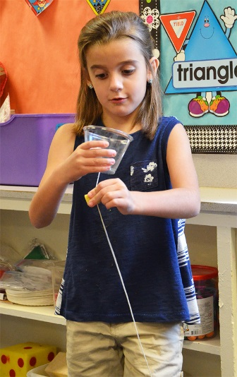
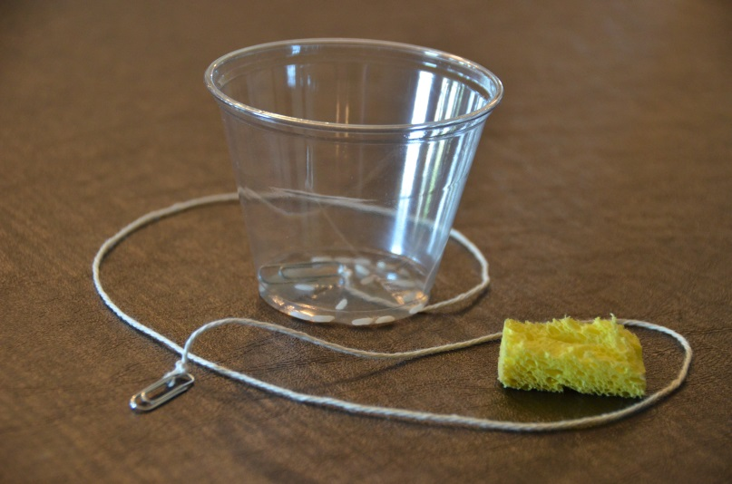
Investigation 2: Do Cluckers Vibrate?
Photo courtesy of BSCS
Photo courtesy of BSCS

Slide 13
Investigation 2: Do Cluckers Vibrate?
Take turns making sounds with your clucker.
Do you see anything vibrating?
Gently touch the cup and the string on the clucker while your partner is making a sound.
Do you feel anything vibrating?
Record your evidence on your data table under column C on the row with the picture of the clucker.

Slide 14
Soundmakers Data Table
A | B | C | D
Soundmaker | Prediction: Will It Vibrate? | Evidence | Result: Did It Vibrate?
Photo courtesy of BSCS
Photo courtesy of BSCS

Slide 15
Did the Soundmakers Vibrate?
Use the evidence in column C on your data table to answer the question for column D.
Did the soundmakers vibrate when they made sounds? How do you know?
If a soundmaker vibrated, write yes under column D on the row for that soundmaker. If it didn’t vibrate, write no.

Slide 16
Soundmakers Data Table
A | B | C | D
Soundmaker | Prediction: Will It Vibrate? | Evidence | Result: Did It Vibrate?
Photo courtesy of BSCS
Photo courtesy of BSCS

Slide 17
Let’s Summarize!
Our focus questions: Do soundmakers always vibrate? What is our evidence?
So far we’ve gathered evidence that the ruler, the rubber band, the clucker, and you vibrate when making a sound.
Based on this evidence, do you think all soundmakers vibrate when they make sounds?
To help us answer this question, let’s name some things that make sound.

Slide 18
Key Science Ideas
Objects make sounds by vibrating or moving back and forth quickly.
We can detect these vibrations using our senses (hearing, seeing, feeling).
Even if we can’t see an object vibrating, we may be able to feel the vibrations or see other objects move when the soundmaker touches them.

Slide 19
Next Time
In our next lesson, we’ll investigate another soundmaker.
Do you think this new soundmaker will vibrate when it makes a sound?

