Slide 1
Sound Lesson 2b
Do Soundmakers Always Vibrate? What Is Our Evidence?

Slide 2
Let’s Review Our Evidence
What evidence did you find that the clucker vibrated when it made a sound?
Turn and Talk: Share one piece of evidence with an elbow partner. Be prepared to share with the class.
What evidence did you find that you and your partner vibrated when you hummed? Share your evidence with the class.

Slide 3
Think about This Question
Can we always feel objects vibrating when they make sounds, even if we can’t see the vibrations?

Slide 4
Today’s Focus Questions
Do soundmakers always vibrate? What is our evidence?

Slide 5
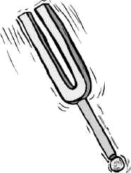
Our New Soundmaker
The soundmaker we’ll investigate today is called a tuning fork.
People use a tuning fork to make a sound that tells them whether a piano is playing the correct notes.
A tuning fork also helps the person tuning the piano fix the keys if they’re playing the wrong notes.
Courtesy of BSCS

Slide 6
What Evidence Could We Look For?
What kinds of evidence could we look for that would tell us whether a tuning fork vibrates when it makes a sound?
Courtesy of BSCS

Slide 7
Soundmakers Data Table
A | B | C | D
Soundmaker | Prediction: Will It Vibrate? | Evidence | Result: Did It Vibrate?
Courtesy of BSCS

Slide 8
Share Your Predictions
Do you think the tuning fork will vibrate when it makes a sound?
Sentence starter: I predict that the tuning fork [will/won’t] vibrate when it makes a sound.

Slide 9
How to Use a Tuning Fork
Photography by Wesley Fryer/ Flickr

Slide 10
Investigation: Does It Vibrate?
Take turns making a sound with the tuning fork by tapping it on your shoe the way I did.
First, look carefully to see if something is vibrating. Then see if you can feel something vibrating.
Work together. Have one partner make a sound with the tuning fork. Have the other partner touch the ends of the tuning fork very gently. Then switch roles.
Then make a sound with the tuning fork and hold it against a desk. What do you see and hear? Can you feel the tuning fork vibrating?

Slide 11
Soundmakers Data Table
A | B | C | D
Soundmaker | Prediction: Will It Vibrate? | Evidence | Result: Did It Vibrate?
Courtesy of BSCS

Slide 12
Did the Soundmaker Vibrate?
Use the evidence in column C on your data table to answer the question for column D.
Did the tuning fork vibrate when it made a sound? How do you know?
If it vibrated, write yes in column D. If it didn’t vibrate, write no.

Slide 13
Soundmakers Data Table
A | B | C | D
Soundmaker | Prediction: Will It Vibrate? | Evidence | Result: Did It Vibrate?
Courtesy of BSCS

Slide 14
Let’s Summarize!
Our focus questions: Do soundmakers always vibrate? What is our evidence?
So far we’ve gathered evidence that these soundmakers vibrate when they make sounds:
A ruler
A rubber band stretched across a plastic container
Each of you when you hummed
A clucker
A tuning fork

Slide 15
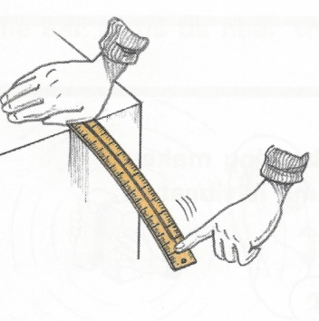
Let’s Summarize!
Raise your hand if you think the ruler vibrated when it made a sound.
How do you know? What evidence do you have?
Courtesy of BSCS

Slide 16
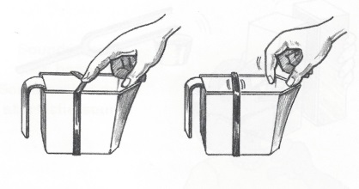
Let’s Summarize!
Raise your hand if you think the rubber band vibrated when it made a sound.
How do you know? What evidence do you have?
Courtesy of BSCS

Slide 17
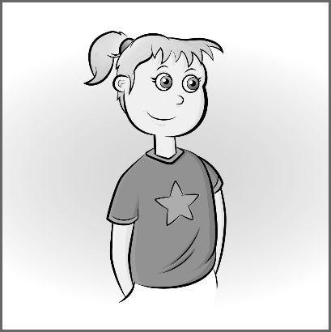
Let’s Summarize!
Raise your hand if you think you vibrated when you made a sound.
How do you know? What evidence do you have?
Courtesy of BSCS

Slide 18
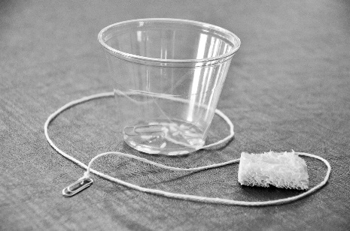
Let’s Summarize!
Raise your hand if you think the clucker vibrated when it made a sound.
How do you know? What evidence do you have?
Courtesy of BSCS

Slide 19
Let’s Summarize!
Raise your hand if you think the tuning fork vibrated when it made a sound.
How do you know? What evidence do you have?
Courtesy of BSCS

Slide 20
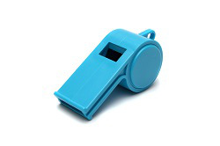
Other Kinds of Soundmakers
Do you think that objects like a trumpet, a whistle, or a cell phone vibrate when they makes sounds?
Photos courtesy of BSCS

Slide 21
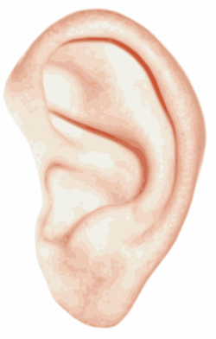
Our Unit Central Question
Why do we hear sound?
What ideas do you have now?
Courtesy of BSCS

Slide 22
Next Time
We know that objects make sounds because we can see, hear, or feel them vibrate.
But how can we hear the sounds that vibrating objects make?
How does the sound get to our ears?
We’ll talk more about these ideas next time!

