Slide 1
Sound Lesson 4b
How Does Sound Move from a Soundmaker to Our Ears? What Is Our Evidence?

Slide 2
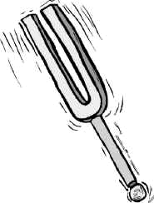
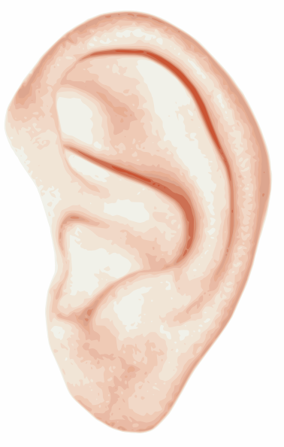
Review: How Does Sound Move?
What is the tuning fork doing?
How does the sound move from the tuning fork to our ears?
Images courtesy of BSCS

Slide 3
Review: What Is in the Space?
What is in the space between the tuning fork and our ears? What did we find out?
What is in this space?
Images courtesy of BSCS

Slide 4
Today’s Focus Questions
How does sound move from a soundmaker to our ears? What is our evidence?

Slide 5
Turn and Talk
Do you think the air between the tuning fork and our ears is vibrating? Why or why not?
Is the air vibrating?
Images courtesy of BSCS

Slide 6
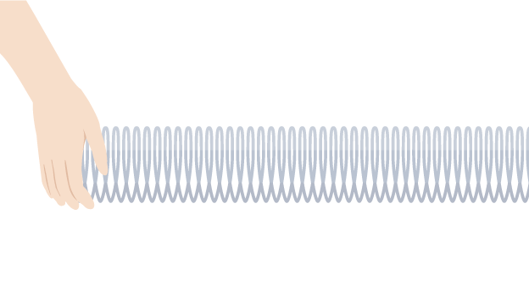
Remember Our Slinky Model?
Today we’ll learn about another model that will help us understand how sound moves from a soundmaker to our ears.
Image courtesy of BSCS

Slide 7
A New Model
Scientists created a model to find out whether air vibrates when a soundmaker makes a sound. Let’s watch a video to see what they discovered!
Is the air vibrating?
Images courtesy of BSCS

Slide 8
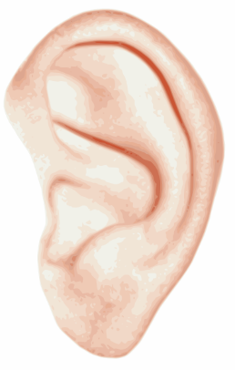
A New Model
When a tuning fork vibrates, can it make the air vibrate too?
Do you think the vibrations travel through the air?
Do you think the vibrations can reach our ears so we hear sound?
Air
Images courtesy of BSCS

Slide 9
Our Focus Questions
How does sound move from a soundmaker to our ears? What is our evidence?
Share your ideas with an elbow partner using what you’ve learned about air in today’s lesson.
Write your answers in your science notebook.
Try to use the words vibrate and vibrations in your explanations.
Be prepared to share your ideas with the class.

Slide 10
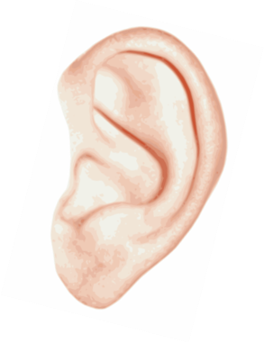
Let’s Review Our Drawings
What happens here?
Images courtesy of BSCS

Slide 11
Let’s Revise Our Drawings
What’s missing from your drawing?
What would you change or add to make it better?
Images courtesy of BSCS

Slide 12
Key Science Ideas
All soundmakers vibrate. These vibrations move through the air, and when they reach our ears, we hear sound.
In the video clip, we saw how vibrations from a soundmaker cause air molecules to push into each other. These collisions cause the air to vibrate.
The vibrations travel through the air in waves to our ears.
Then our eardrums send a message to our brains, and we hear sound.

Slide 13
Next Time
Where does sound go? Does it only go straight to our ears, or does it move in different directions?
That’s what we’ll explore next time!
Air
Images courtesy of BSCS

