Slide 1
Sound Lesson 5a
When Something Makes a Sound, Where Does the Sound Go? What Is Our Evidence?

Slide 2
A New Soundmaker
Courtesy of BSCS

Slide 3
Today’s Focus Questions
When something makes a sound, where does the sound go? What is our evidence?

Slide 4
Draw Your Prediction
When a bell rings, where do you think the sounds will go?
Courtesy of BSCS

Slide 5
What Did You Predict?
When a bell rings, where do you think the sound will start?
Where do you think the sound will go?
Courtesy of BSCS

Slide 6
What Happened?
Did everyone hear the bell ring?
Where did the sound start?
Where did the sound go?
Courtesy of BSCS

Slide 7
What Happened?
Courtesy of BSCS

Slide 8
Let’s Revise Our Drawings
What’s missing from your drawing?
What would you change or add to make it better?
Courtesy of BSCS

Slide 9
Let’s Summarize!
Our focus questions: When something makes a sound, where does the sound go? What is our evidence?
Share your ideas with an elbow partner. Then write your answers in your science notebook.
Use this sentence starter:
When something makes a sound, the sound goes ________. My evidence is _________.
Be prepared to share your ideas and evidence with the class.

Slide 10
Key Science Ideas
All soundmakers vibrate and make the air around them vibrate.
These vibrations move in waves through the air to our ears.
Our eardrums send a message to our brains, and we hear sound.
Sound travels in all directions. It doesn’t just travel from a soundmaker to one person’s ears.
We all heard the bell ring even though we were in different positions around the circle.

Slide 11
Our Unit Central Question
Why do we hear sound?

Slide 12
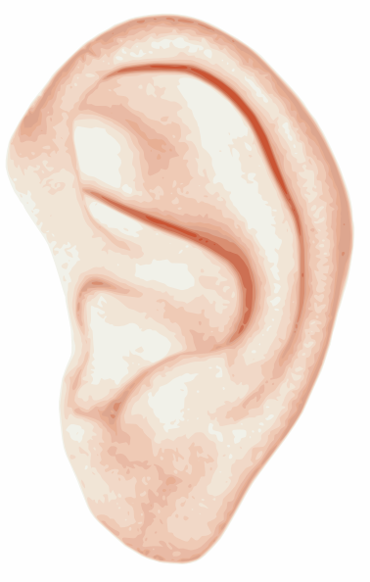
Next Time
In our next lesson, we’ll do some more testing to see where the sound goes when the bell rings.
We’ll also find out whether the sound stops moving when someone hears it.
Courtesy of BSCS
Courtesy of BSCS

