Slide 1
Sound Lesson 7a
Why Do We Hear Sound?

Slide 2
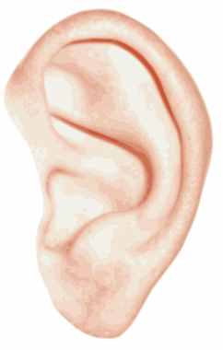
Our Unit Central Question
Why do we hear sound?
Images courtesy of BSCS

Slide 3
Why Do We Hear Sound?
What happens when Dingy rings her bell? How does the sound reach our ears?
Turn and Talk: Share your ideas with a partner.
Use complete sentences and include these words:
Vibrate
Air
Eardrum
Courtesy of BSCS

Slide 4
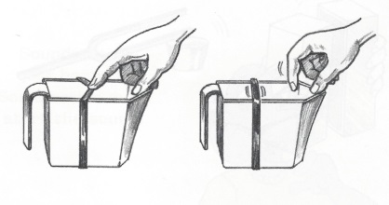
Build Your Own Soundmaker
In our final lesson, you’ll build your own soundmaker.
Look at all the different materials in the bin that you could use to build your soundmaker.
When I hold up an object, describe how you might use it to build a soundmaker.
Courtesy of BSCS

Slide 5
Choose Your Materials
Look at each object in the bin that you could use to build your soundmaker.
Test different objects to see how they might vibrate and make a sound.
Then choose two objects to use for building your soundmaker.
Place the objects in the plastic bag I give you. Then write your name on the bag.

Slide 6
How Will You Build Your Soundmaker?
Describe your ideas for building your own soundmaker.
Which materials did you choose?
How can you use these materials to build your soundmaker?
How will you make a sound with your soundmaker?
What will vibrate in your soundmaker?
How will the sound get to your ears?

Slide 7
Next Time
In our final lesson on sound, you’ll build your soundmakers and try them out.
Then you’ll use your soundmakers to explain how we hear sound.
Get ready to make a lot of new sounds!

