Slide 1
Variations in plants and animals Lesson 1a
How Are Birds Alike? What Traits Do They Share?

Slide 2
Unit Central Question
How do differences (variations) in plants or animals of the same kind help them survive so they can produce young (babies or seeds)?

Slide 3
Today’s Focus Questions
How are birds alike? What traits do they share?

Slide 4
How Are People Alike?
Courtesy of Openclipart.org
Notes:
Source: https://openclipart.org/detail/192642/children-holding-hands

Slide 5
How Are People Alike?
Courtesy of Openclipart.org
People share many of the same characteristics. We call these characteristics traits.
Notes:
Source: https://openclipart.org/detail/192642/children-holding-hands

Slide 6
How Are People Alike?
Courtesy of Openclipart.org
Think of one way that people are alike. What is one trait people share?
Notes:
Source: https://openclipart.org/detail/192642/children-holding-hands

Slide 7
What Kind of Animal Is This?
Photo courtesy of U.S. Fish and Wildlife Service

Slide 8
Bird Traits
Pairs:
Look at the pictures of your birds.
How are these two birds alike?
What traits do both birds have in common?
Write these traits in your science notebook.
Be ready to share your ideas with the other pair of students at your table.

Slide 9
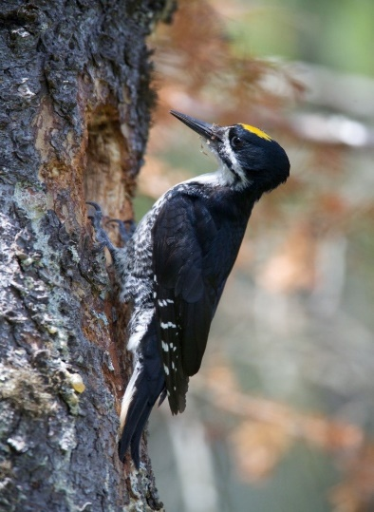
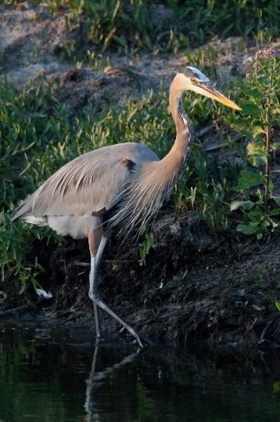
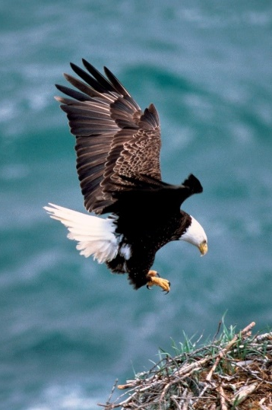
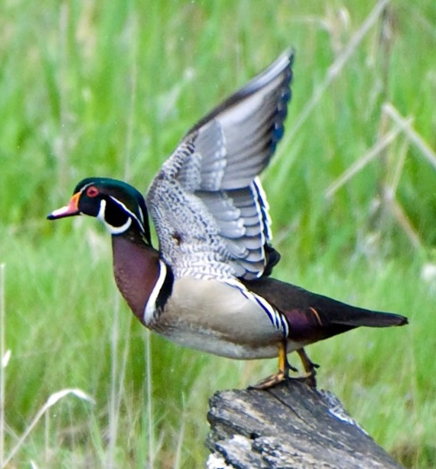
What Traits Did You Find?
Share your pictures and observations with the other pair in your group.
Tell them about the traits you found in both birds. How are the birds alike?
Use this sentence starter: Both our birds …
All photographs courtesy of U.S. Fish and Wildlife Service

Slide 10
Our Focus Questions
How are birds alike? What traits do they share?
Think about the birds we learned about today.
How are all these birds alike? What traits do they share?
Sentence starter:
A trait that all of the birds have is ______.

Slide 11
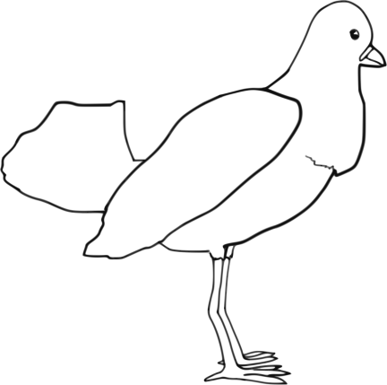
Let’s Summarize!
Look at the bird traits on our class chart.
Pick one bird trait to write about on your handout.
My bird trait is ________________________.
Birds use this trait to ___________________.

Slide 12
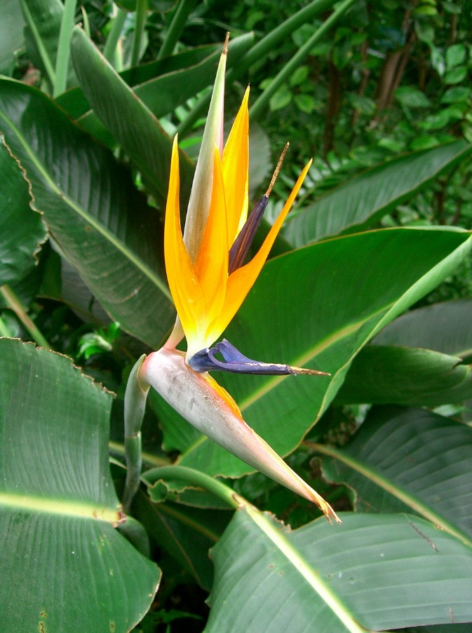
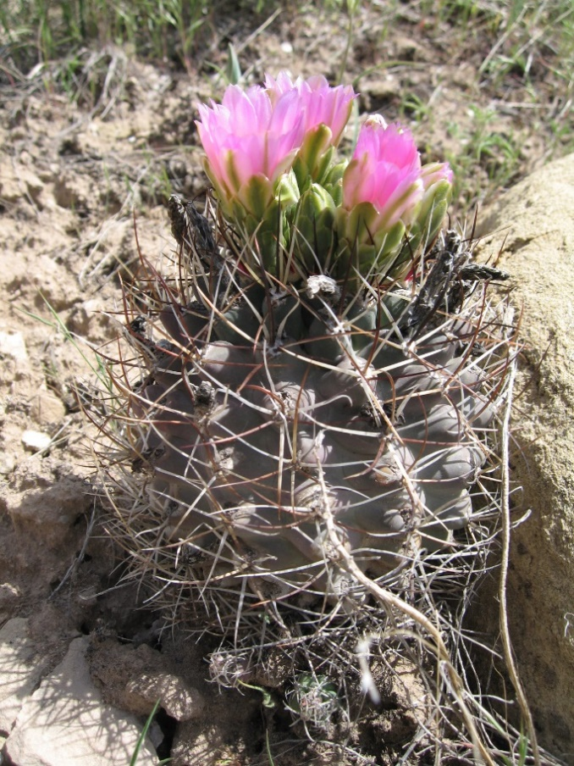
Next Time
How are plants alike? What traits do they share?
Photo courtesy of Pixabay.com
Photo courtesy of Pixnio.com

