Slide 1
Variations in plants and animals Lesson 1d
How Are Plants Alike and Different? What Differences in a Trait Can They Have?

Slide 2
Let’s Review What We’ve Learned!
What do we call the characteristics that living things of the same kind share?
What do we call differences in those characteristics?

Slide 3
Review: Bird Traits and Variations
How are birds alike? What traits do they share?
How are birds different? What is one variation in a bird trait?
How do variations in certain traits help birds survive where they live?

Slide 4
Unit Central Question
How do differences (variations) in plants or animals of the same kind help them survive so they can produce young (babies or seeds)?

Slide 5
Today’s Focus Questions
How are plants alike and different? What differences in a trait can they have?

Slide 6
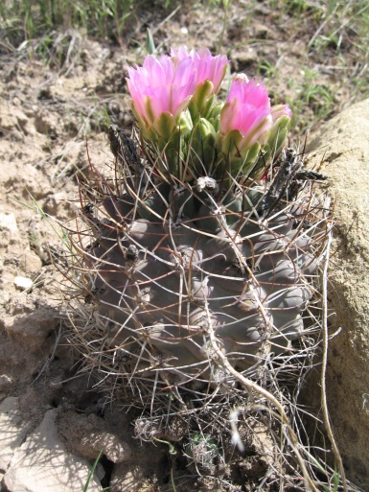
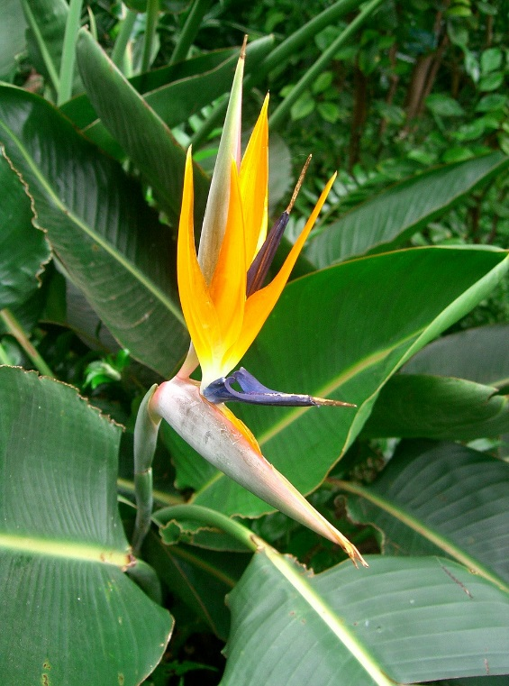
How Are Plants Alike and Different?
How do we know these are plants? What traits do they share?
What differences do you notice?
Photo courtesy of Pixnio.com
Photo courtesy of Pixabay.com

Slide 7
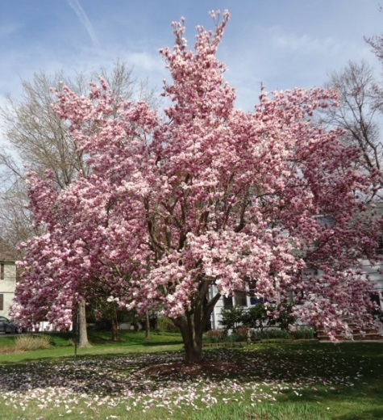
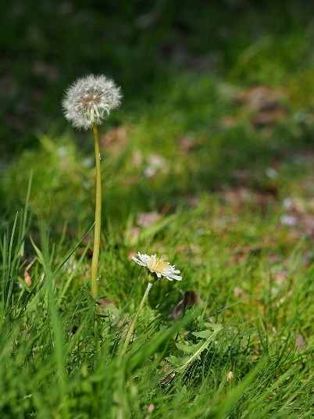
Plant Traits
Pairs:
Look at your two plant photos and talk about how these plants are different from each other.
What variations do they have for the same traits?
Record these differences in your notebook.
Courtesy of Pixnio.com
Courtesy of Tomwsulcer/Wikimedia Commons
Courtesy of Pixabay.com
Courtesy of Greg Peterson/Wikimedia Commons

Slide 8
What Variations Did You Find?
Share your pictures and observations with the other pair in your group.
Tell them about the differences or variations you noticed in the plants’ traits.
Courtesy of Pixnio.com
Courtesy of Tomwsulcer/Wikimedia Commons
Courtesy of Pixabay.com
Courtesy of Greg Peterson/Wikimedia Commons

Slide 9
Plant Traits and Variations
Let’s review the traits and variations we found in our plant investigation.
Think about this question: How might differences or variations in traits help plants survive where they live?
Courtesy of Pixnio.com
Courtesy of Tomwsulcer/Wikimedia Commons
Courtesy of Pixabay.com
Courtesy of Greg Peterson/Wikimedia Commons

Slide 10
Let’s Summarize!
Our focus questions: How are plants alike and different? What differences in a trait can they have?
Think about what you learned from our plant investigation today.
How are plants alike? How are they different?
What differences in traits can they have?

Slide 11
Let’s Summarize!
Look at the plant traits on our class chart and pick one trait. Write that trait on your handout.
Then choose two variations of that trait to write about.
You can also draw pictures to show your ideas.
Courtesy of Pixnio.com

Slide 12
Let’s Summarize!
A trait that plants have: flower color
Two variations of that trait:
Yellow flowers
Pink flowers
Courtesy of Pixabay.com
Courtesy of Pixnio.com

Slide 13
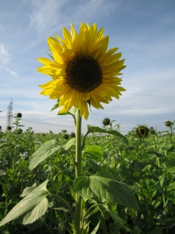
Next Time
How are sunflowers alike and different?
Photo courtesy of AnRo0002/Wikimedia Commons
Photo courtesy of Pixabay.com

