Slide 1
Variations in plants and animals Lesson 3a
Will Bigger or Smaller Cottonwood-Tree Seeds Be More Likely to Survive and Grow When the Wind Carries Them Away? Why Do You Think So?

Slide 2
Review: Sunflower Traits and Variations
What traits did we observe in sunflowers? How are all sunflowers alike?
How are sunflowers different from each other? What variations in traits do they have?
Photo courtesy of Pixabay.com

Slide 3
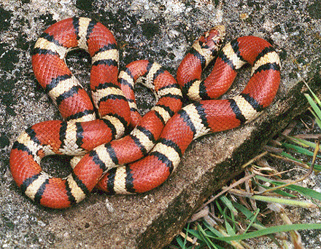
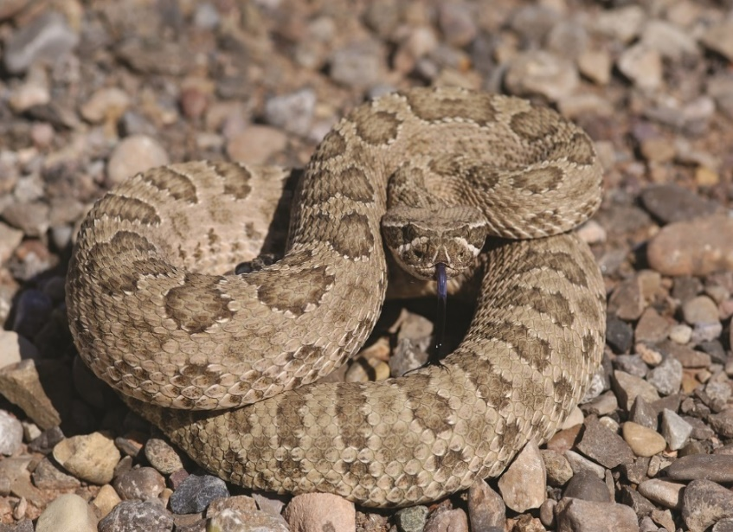
Review: Snake Traits and Variations
How are all snakes alike? What traits do they share?
How are snakes different from each other? What variations in traits do they have?
Photograph by Mike Pingleton/Wikimedia Commons
Photo courtesy of Pixabay.com

Slide 4
Today’s Focus Questions
Will bigger or smaller cottonwood-tree seeds be more likely to survive and grow after the wind carries them away? Why do you think so?

Slide 5
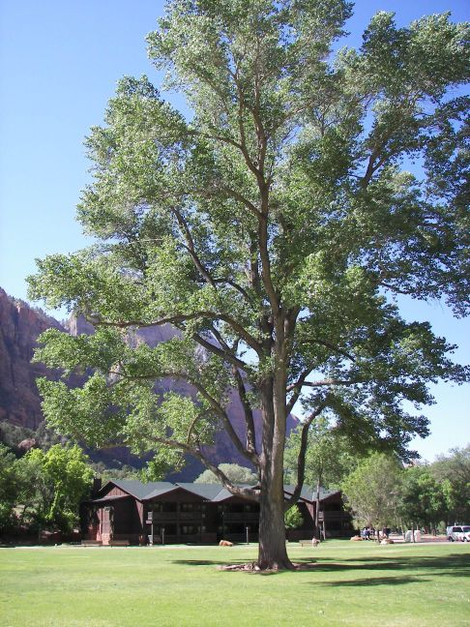
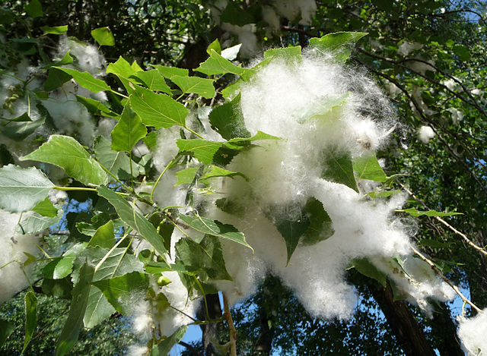
What Is a Cottonwood Tree?
Photograph by George Chernilevsky/Wikimedia Commons
Photograph by Amy Gaiennie/Wikimedia Commons

Slide 6
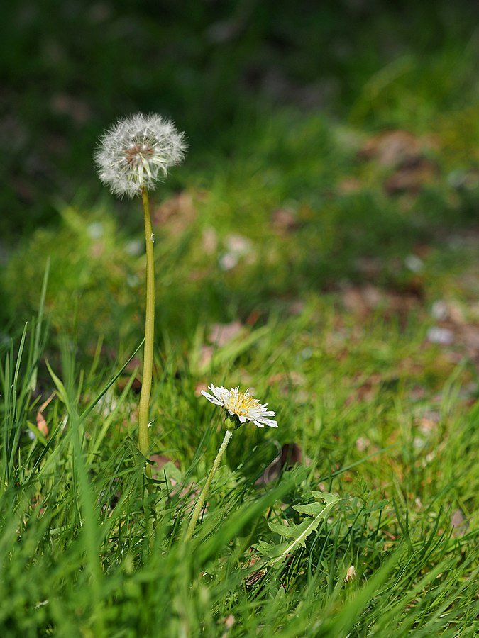
A Dandelion’s Life
In our story A Dandelion’s Life, what helped the dandelion seed survive (live and grow)?
Photo courtesy of Greg Peterson/Wikimedia Commons

Slide 7
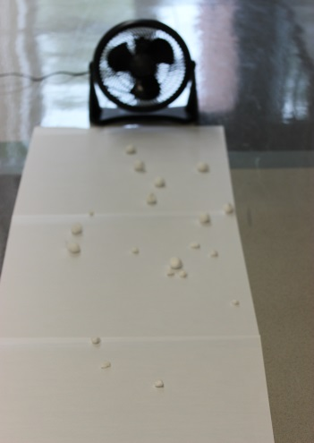
Our Cottonwood-Seed Model
What does the fan represent?
What does the line on the paper marked “Tree” represent?
What does the paper on the floor represent?
What do the cotton balls represent?
Photo courtesy of BSCS

Slide 8
Our Cottonwood-Seed Model
What real-life things will our model help us study?
What trait of cottonwood seeds are we looking at?
What variations in the size of the seeds are we testing with our model?
What questions are we trying to answer?
Photo courtesy of BSCS

Slide 9
Our Cottonwood-Seed Model
Our model can help us find out which cottonwood seeds will travel farther when the wind blows them.
It can also help us figure out which seeds will be more likely to survive and grow.
Photo courtesy of BSCS

Slide 10
Our Cottonwood-Seed Model
Will a cottonwood seed have a better chance of surviving if it travels farther from the tree?
What does a seed need to survive and grow?
Would a cottonwood seed get more or less sunlight and rain if it’s farther away from the tree?
Photo courtesy of BSCS

Slide 11
Our Focus Questions
Will bigger or smaller cottonwood-tree seeds be more likely to survive and grow after the wind carries them away? Why do you think so?

Slide 12
What Do You Think Will Happen?
Will the bigger or smaller cotton balls (cottonwood seeds) travel farther when the wind blows them? Why do you think so?
Write your predictions on the handout using this sentence starter:
I predict the [bigger or smaller] cotton balls will travel farther on the wind because …

Slide 13
Next Time
In our next lesson, we’ll use our model to test our predictions about how far the cotton balls will fly on the wind.
The data we gather will help us figure out which cottonwood seeds are more likely to survive and grow.
Photograph by George Chernilevsky/Wikimedia Commons

