Slide 1
Earth’s Changing Surface Lesson 3b
Do Landforms Ever Change? What Evidence Do We Have?

Slide 2
Our Evidence
So far we’ve gathered two important pieces of evidence (clues) to help us think about whether the Grand Canyon is changing.
The Grand Canyon is 2 centimeters deeper than it was 50 years ago.
The Colorado River carries loose soil and rocks with it as it flows through the canyon.

Slide 3
Today’s Focus Questions
Today we’ll continue thinking about our focus questions from last time:
Do landforms ever change? What evidence do we have?
What do you think so far?

Slide 4
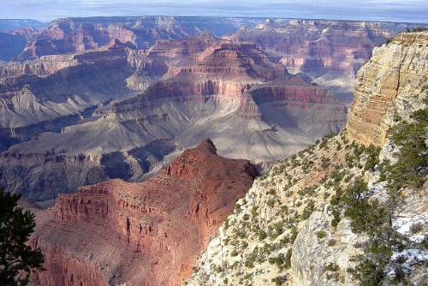
Our Virtual Trip to the Grand Canyon
What do you notice about this picture now? Do you see anything new that you didn’t notice last time?
Photo courtesy of NPS.gov

Slide 5
Our Virtual Trip to the Grand Canyon
Let’s continue our exploration of the Grand Canyon!
Photo courtesy of NPS.gov

Slide 6
Is the Grand Canyon Changing?
Work with an elbow partner to answer question 2 on the handout. Use this sentence starter:
We think the Grand Canyon [is/is not] changing because _______________.
Make sure to include evidence from our three clues in your explanation.

Slide 7
Is the Grand Canyon Changing?
Answer question 3 on your handout using this sentence starter:
I think _________________ is causing the Grand Canyon to change.
For now, just write down your ideas based on our clues.
In our next lesson, we’ll gather some evidence to help us answer this question.

Slide 8
Our Focus Questions
Do landforms ever change? What evidence do we have?
How would you answer the first focus question now?
Think about all of the evidence we gathered during our trip to the Grand Canyon!

Slide 9
Key Science Ideas
The Grand Canyon is 2 centimeters deeper than it was 50 years ago.
The Colorado River carries loose soil and rock with it as it flows through the canyon.
The soil and rock from the canyon are carried to Lake Mead and are slowly filling up the lake.

Slide 10
Let’s Summarize!
Based on our evidence, do we all agree with these conclusions?
Landforms like the Grand Canyon and Lake Mead can change over time.
These changes can happen very slowly.

Slide 11
Next Time
We know that landforms like the Grand Canyon can change, but what causes them to change?
We’ll investigate this next time!

