Slide 1
Earth’s Changing Surface Lesson 5b
How Quickly or Slowly Do Landforms Change? How Do We Know?

Slide 2
Review: What Is a Delta?
Photo courtesy of Arthur Belala/Wikimedia Commons

Slide 3
Review: How Scientists Collect Data
Scientists collect all kinds of data to figure out how slowly or quickly landforms are changing.
They can measure landforms and compare the measurements to see if they’re different.
They can also take pictures to see whether a landform has changed over time.

Slide 4
Today’s Focus Questions
How quickly or slowly do landforms change over time? How do we know?

Slide 5
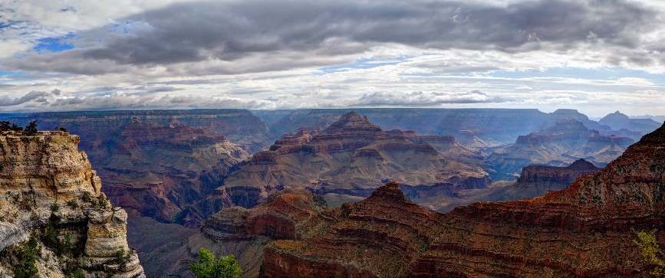
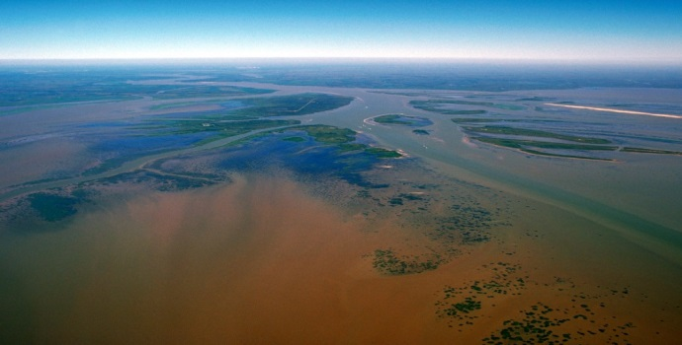
Our Landform Examples from Last Time
Is the Grand Canyon changing slowly or quickly? How do you know?
How long did it take the Mississippi River delta to form? Is this landform changing slowly or quickly?
Photo courtesy of W. Tyson Joyce/NPS
Photo courtesy of Arthur Belala/Wikimedia Commons

Slide 6
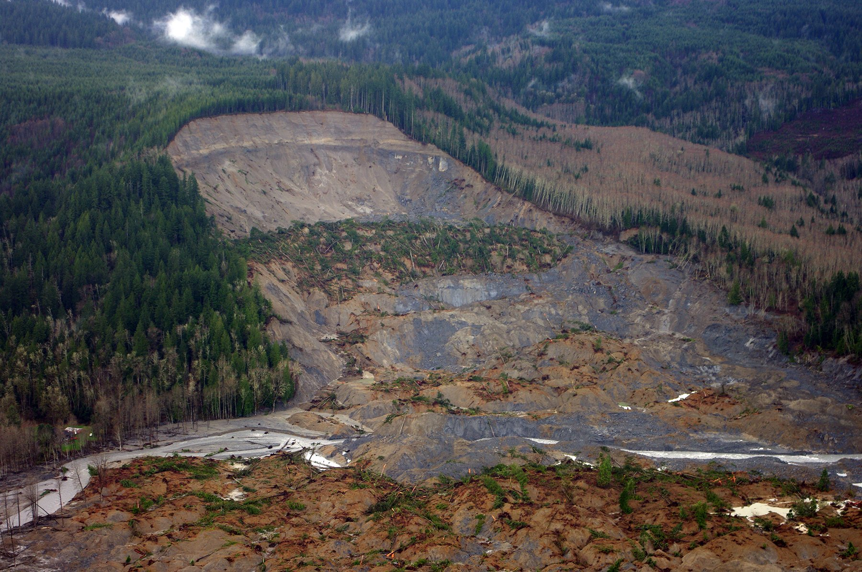
What Is Happening in this Photo?
Photo courtesy of Jonathan Godt/USGS

Slide 7
What Causes Landslides?
Photo courtesy of Jonathan Godt/USGS

Slide 8
How Fast or Slow Do Landforms Change?
Work with your partner from last time and read about landslides on the handout. Then study the photo.
Compare the landslide example with the Grand Canyon and delta examples from last time. Decide how fast or slow the land changes.
Arrange your landform examples in order from the slowest change to the fastest change.
Look for evidence in the readings to support your decisions.

Slide 9
How Fast or Slow Do Landforms Change?
Slowest
Fastest
Place the slowest-changing landform on the left side of your desk.
Place the fastest-changing landform on the right side of your desk.
In the middle of your desk, place the landform that changes slowly but isn’t the slowest.

Slide 10
How Fast or Slow Do Landforms Change?
Slowest
Fastest
Which landform example shows the slowest change? What’s your evidence?
Which landform changes slowly but isn’t the slowest? What’s your evidence?
Which landform example shows the fastest change? What’s your evidence?

Slide 11
What’s the Same and What’s Different?
Think about our three landform examples:
The Grand Canyon
Deltas
Landslides
What’s the same about these examples? What do all of them have in common?
What’s different about these examples?

Slide 12
What’s the Same?
All three examples show landforms changing.
Water caused the changes in all of these examples.

Slide 13
What’s Different?
All three examples show different kinds of landforms that change at different speeds.
It took millions of years for the Colorado River to carve out the Grand Canyon.
The Mississippi River delta took thousands of years to form.
Landslides take only minutes to change the land.

Slide 14
Key Science Ideas
Landforms can change very slowly, like the Grand Canyon and the Mississippi River delta.
Landforms can also change very quickly, like during a flood or a landslide.
Landforms can change quickly or slowly depending on certain conditions, such as how much water is flowing in a river or how much rain is falling.
Landslides can change the land slowly or quickly. So can rivers!

Slide 15
Our Focus Questions
How quickly or slowly do landforms change over time? How do we know?

Slide 16
Let’s Summarize!
Our focus questions: How quickly or slowly do landforms change over time? How do we know?
Answer these questions in your notebook using this sentence starter:
I think landforms change [slowly/quickly/both]. My evidence is ________.
Circle one of the options (slowly, quickly, or both). Make sure to use evidence from all three landform examples to support your ideas.

Slide 17
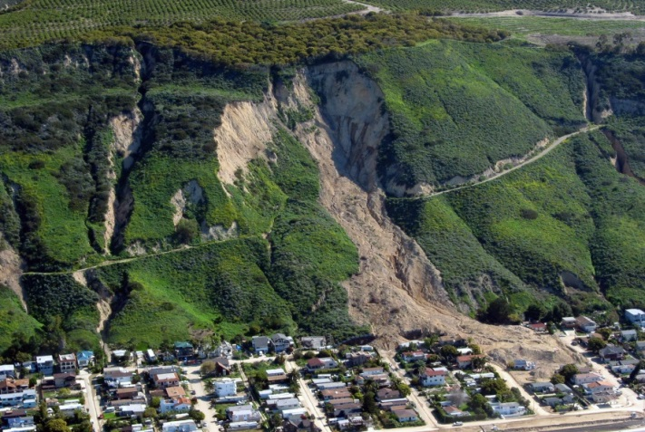
Key Science Ideas
Landforms change over time.
Some changes happen quickly, like during a flood or a landslide. We can see these changes happen.
Some changes happen very slowly over time, like when deltas or canyons form. We can’t always see them happen.
Photo courtesy of W. Tyson Joyce/NPS
Photo courtesy of Arthur Belala/Wikimedia Commons
Photo courtesy of Mark Reid/USGS

Slide 18
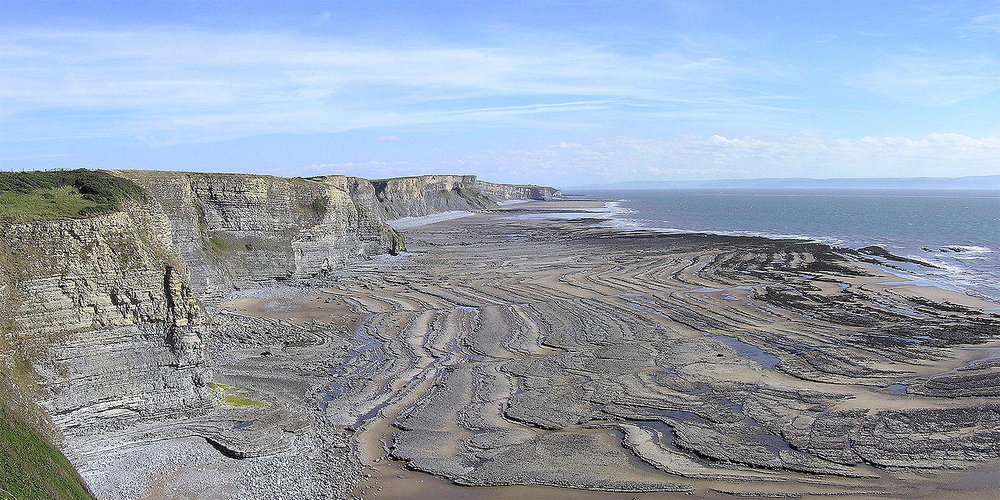
Next Time
How can we use what we’ve learned about landforms to explain changes that happen in the world around us? We’ll find out next time!
Photo courtesy of Yummifruitbat/Wikimedia Commons

