Slide 1
Earth’s Changing Surface Lesson 6a
Can We Explain How Landforms Change in Our Area?

Slide 2
Let’s Review What We’ve Learned!
What have we learned about landforms in this unit on Earth’s changing surface?

Slide 3
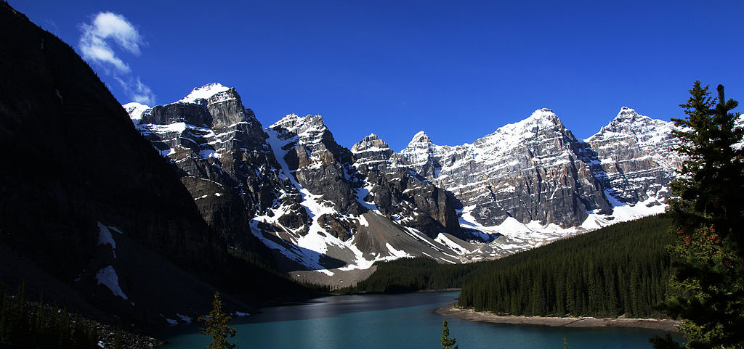
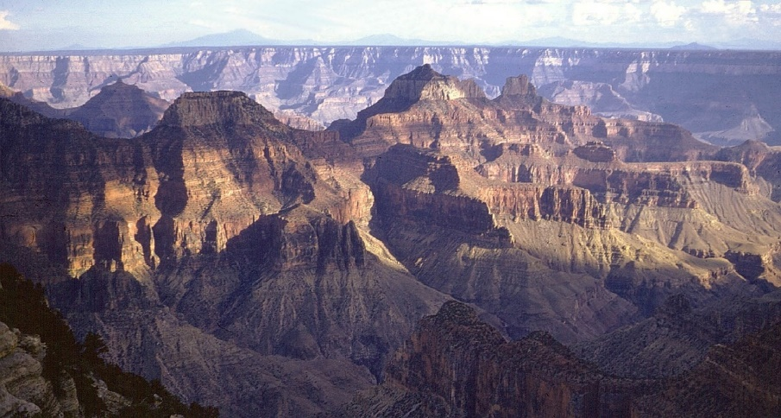
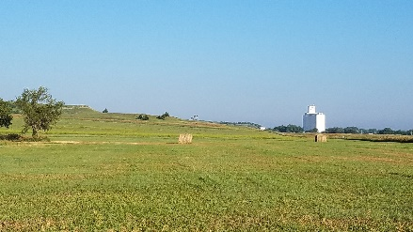
Let’s Review What We’ve Learned!
Earth’s surface has many types of landforms. What types of landforms do you see below?
Photo courtesy of Bede735/Wikimedia Commons
Photo courtesy of Pixabay.com
Photo courtesy of IveGoneAway/Wikimedia Commons

Slide 4
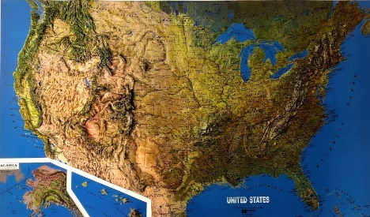
Let’s Review What We’ve Learned!
Landforms in one place can be different from landforms in another place. What helped us identify landforms in different places?
Photo courtesy of Cal Poly Pomona
Notes:
Hold up relief map.

Slide 5
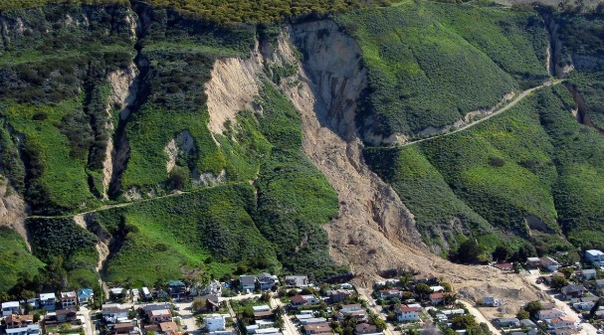
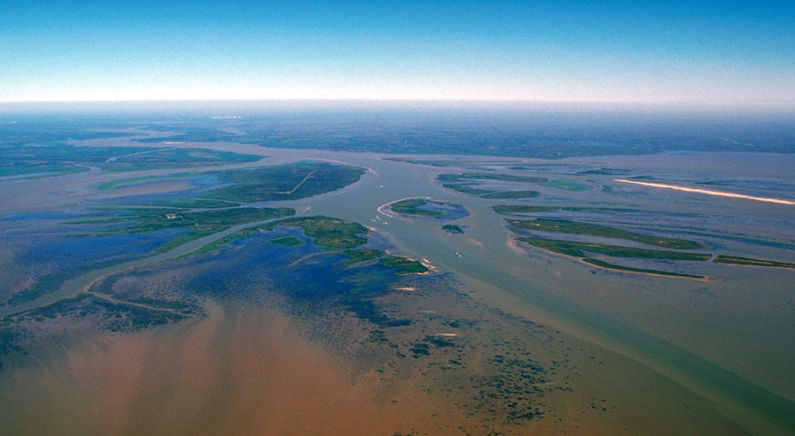
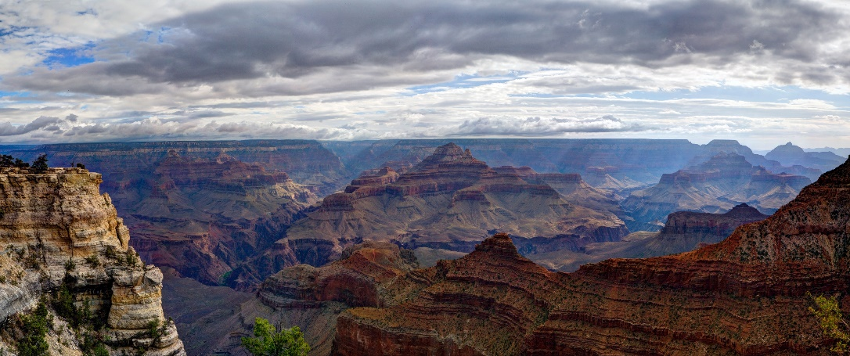
Let’s Review What We’ve Learned!
Landforms change over time. What’s one example of a landform that’s changing?
Photo courtesy of Mark Reid/USGS
Photo courtesy of Arthur Belala/Wikimedia Commons
Photo courtesy of W. Tyson Joye/NPS

Slide 6
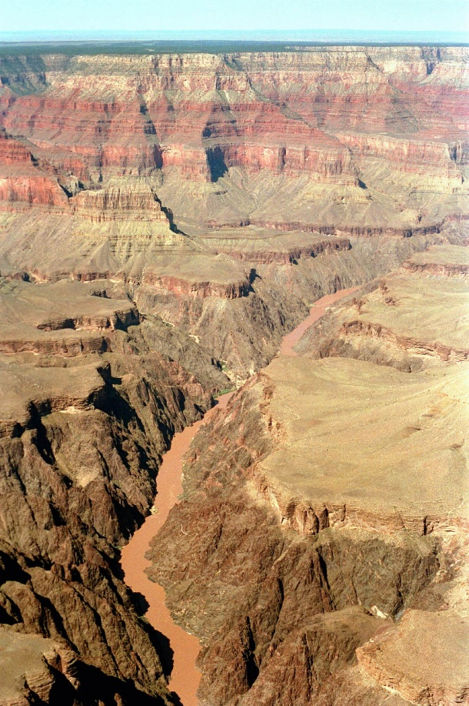
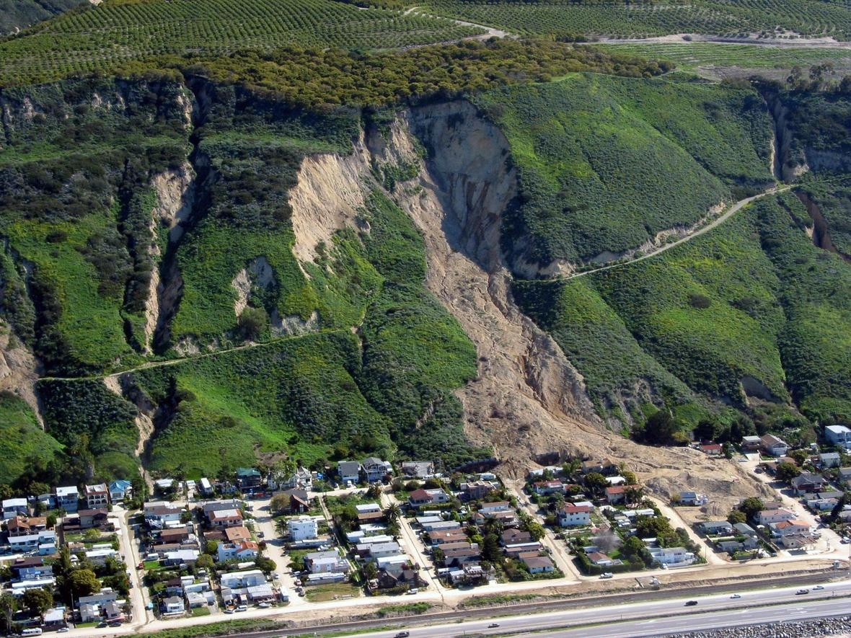
Let’s Review What We’ve Learned!
How long can it take for landform changes to happen?
Photo courtesy of NPS.gov
Photo courtesy of Mark Reid/USGS

Slide 7
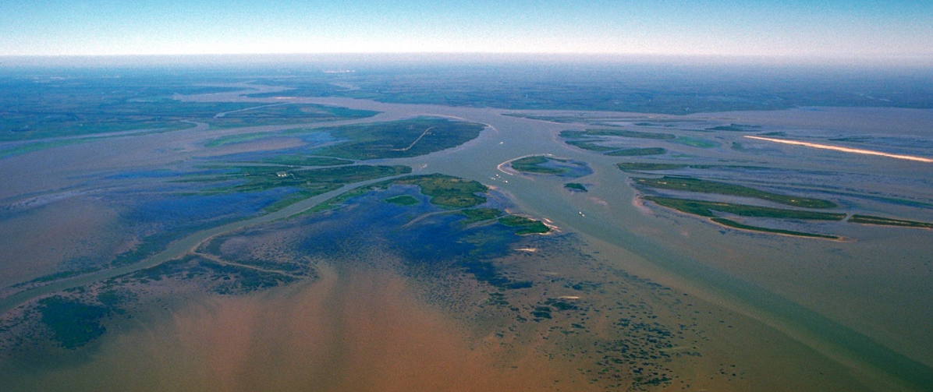
Let’s Review What We’ve Learned!
What causes landforms to change?
Photo courtesy of W. Tyson Joye/NPS
Photo courtesy of Mark Reid/USGS
Photo courtesy of Arthur Belala/Wikimedia Commons

Slide 8
Today’s Focus Question
Can we explain how landforms change in our area?

Slide 9
Landform Changes in Our Area
Do you think we can explain how landforms are changing in our area?
Have you seen any evidence that the land is changing here in Pomona or nearby?

Slide 10
Key Science Ideas
Earths surface has many types of landforms.
The landforms in one place can be different from the landforms in another place.
Landforms change over time.
Some changes happen very slowly, like when canyons or deltas form, and other changes happen quickly, like during floods or landslides.
Flowing water can change landforms by moving rocks and soil from one place to another.

Slide 11
What Landforms Do You See?
Photo courtesy of Yummifruitbat/Wikimedia Commons

Slide 12
Landform Challenge
Pair up and read the information on the handout. Then study the photo and read the questions.
Share your ideas about why the cliffs in the picture look the way they do.
Answer the questions on the handout:
Do you think the cliffs are changing or staying the same? Why or why not?
If changes are happening, what do you think is causing them?
Decide who will share your ideas and evidence to with the class.

Slide 13
Let’s Share Our Ideas!
Questions | Your Ideas | Evidence
Do you think the cliffs are changing or staying the same? Why or why not?
If changes are happening, what do you think is causing them?

Slide 14
Summarizing Our Ideas
We think that the cliffs are changing.
We think a few different things could be causing these changes:
Ocean waves are hitting the cliffs.
The cliffs are drying out and crumbling.
Pieces of the cliffs are breaking off and falling onto the beach, where they become part of the sand.

Slide 15
Will the Cliffs Keep Changing?
Do you think the cliffs will keep changing or stay the way they look right now? Why do you think so?

Slide 16
Let’s Summarize!
Our focus question: Can we explain how landforms change in our area?
Write your ideas in your science notebook.
Support your ideas with evidence from today’s landform challenge.

Slide 17
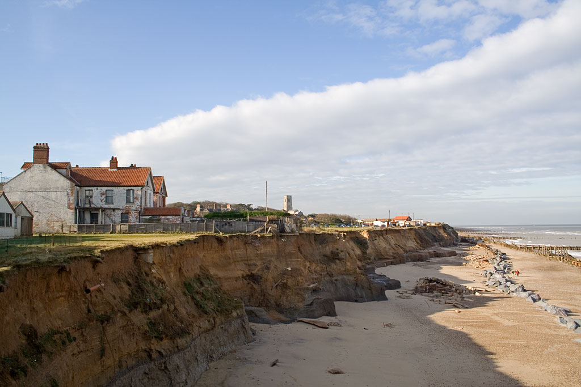
Next Time
In our final lesson, we’ll use everything we’ve learned to predict and explain what will happen in another landform challenge.
Photo courtesy of Andrew Dunn/Wikimedia Commons

