Slide 1
Earth’s Changing Surface Lesson 6b
Can We Predict and Explain How Landforms Might Be Changing in Our Area?

Slide 2
Review: Our Landform Challenge
What new landforms did we learn about last time?
What do you think is causing the cliffs along the beach to break apart and fall onto the beach?
Do you think these changes are happening quickly or slowly (or both)?
Do you think the cliffs will keep changing or stay the same in the future?

Slide 3
Key Science Ideas
Earths surface has many types of landforms.
The landforms in one place can be different from the landforms in another place.
Landforms change over time.
Some changes happen very slowly, like when canyons or deltas form, and other changes happen quickly, like during floods or landslides.
Flowing water can change landforms by moving rocks and soil from one place to another.

Slide 4
Today’s Focus Question
Can we predict and explain how landforms might be changing in our area?

Slide 5
Have You Ever Been to a Beach Like This?
Photo courtesy of Yummifruitbat/Wikimedia Commons

Slide 6
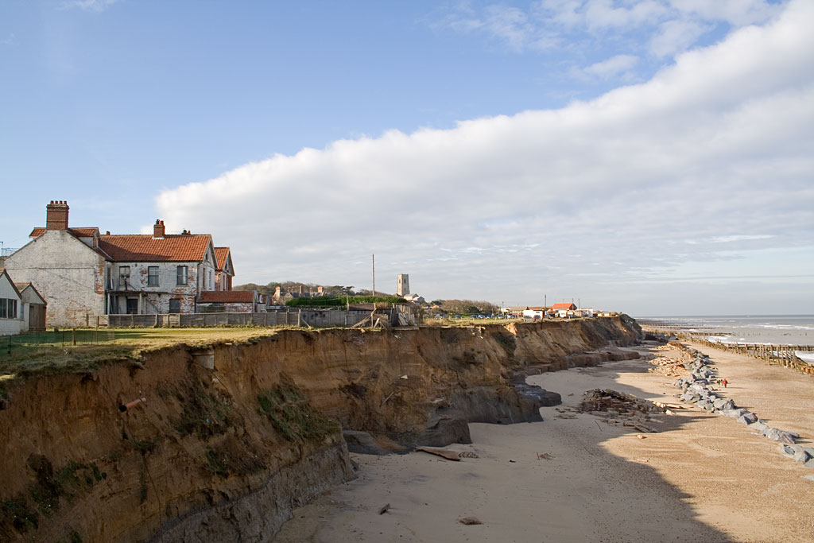
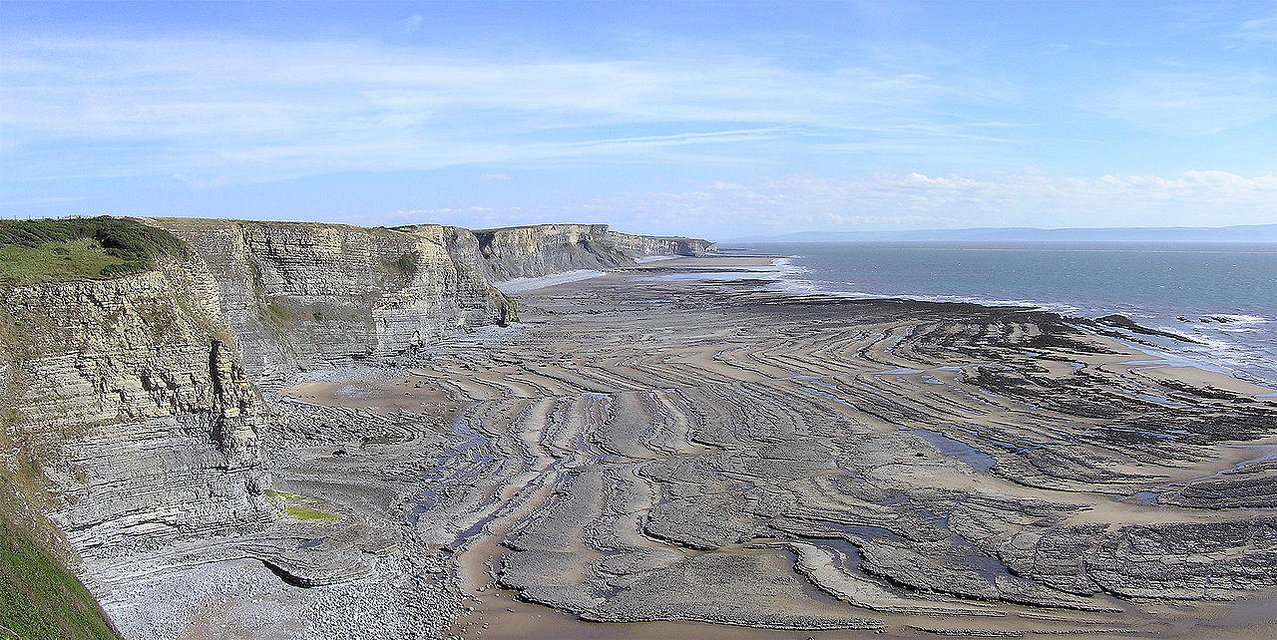
Compare the Photos
Photo courtesy of Andrew Dunn/Wikimedia Commons
Photo courtesy of Yummifruitbat/Wikimedia Commons

Slide 7
A New Landform Challenge!
Photo courtesy of Andrew Dunn/Wikimedia Commons

Slide 8
A New Landform Challenge!
With your partner, read the information on the handout. Then study the photo and read the questions.
Share your ideas about what might happen to the cliffs over time and why you think so.
Answer the questions on the handout:
What do you predict might happen to the cliffs over time? Why do you think so?
What do you think might happen to the houses near the cliffs? Why do you think so?
Decide who will share your ideas and evidence to with the class.

Slide 9
Let’s Share Our Ideas!
Questions | Your Ideas | Evidence
What do you predict might happen to the cliffs over time? Why do you think so?
What do you think might happen to the houses near the cliffs? Why do you think so?

Slide 10
Summarizing Our Ideas
We think that the ocean waves will keep wearing away the cliffs over time, and eventually, the houses will fall onto the beach.
Do we all agree with these predictions?
Does anyone disagree?

Slide 11
Key Science Ideas
Earths surface has many types of landforms.
The landforms in one place can be different from the landforms in another place.
Landforms change over time.
Some changes happen very slowly, like when canyons or deltas form, and other changes happen quickly, like during floods or landslides.
Flowing water can change landforms by moving rocks and soil from one place to another.

Slide 12
Let’s Summarize!
Our focus question: Can we predict and explain how landforms might be changing in our area?
Answer this question in your science notebook.
Support your ideas with evidence from our landform challenges.

Slide 13
Let’s Summarize!
Our unit central questions: What does the surface of Earth look like? Does it ever change?
Think about everything you’ve learned about Earth’s surface and landforms this week.
Write 3 or 4 sentences in your science notebook that you think answer these questions.
Make sure to include evidence from our investigations this week.

Slide 14
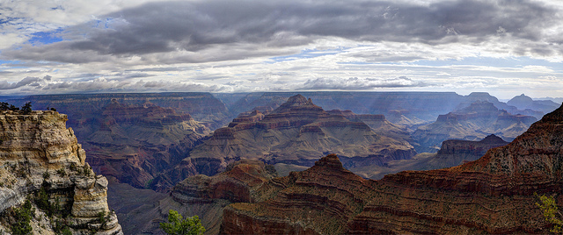
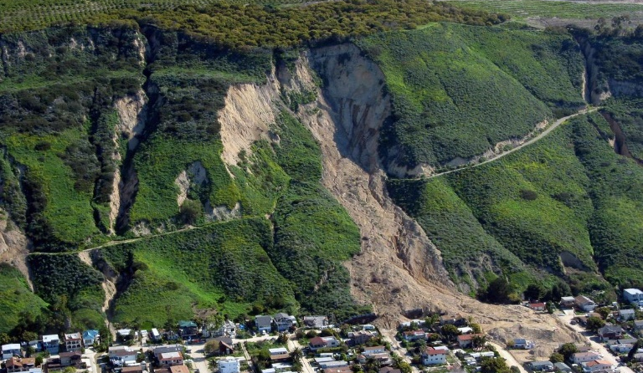
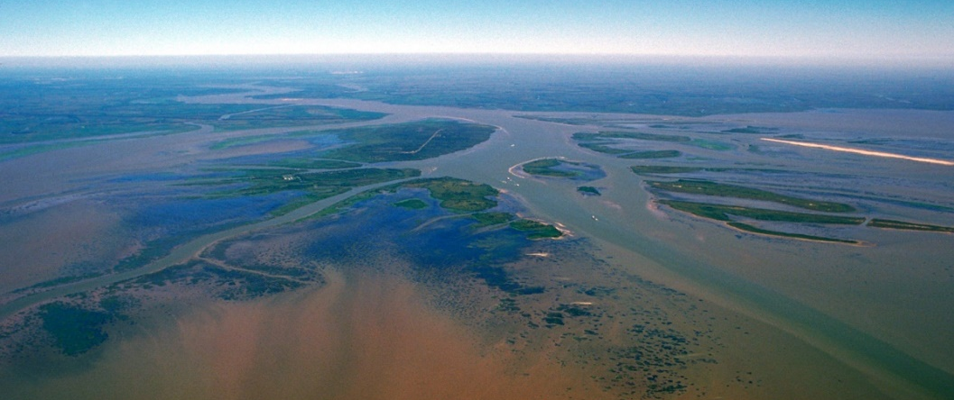
Earth’s Changing Surface
We’ll continue exploring Earth’s changing surface in future lessons, so don’t forget everything you’ve learned!
Photo courtesy of W. Tyson Joye/NPS
Photo courtesy of Mark Reid/USGS
Photo courtesy of Arthur Belala/Wikimedia Commons

