Slide 1
Properties of Matter Lesson 5a
What Is Matter Made Of? How Can Matter Change?

Slide 2
What Have You Learned about Matter?
What have you learned about matter in this unit?
What do you know now that you didn’t know before?
What science ideas were new to you?

Slide 3
Our Unit Central Questions
What is matter made of? How can matter change?
These questions are also our focus questions for today’s lesson!

Slide 4
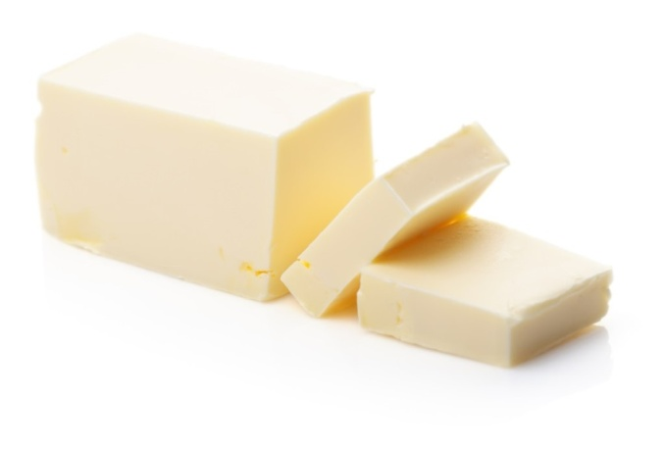
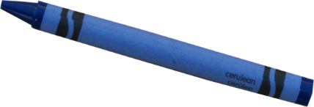
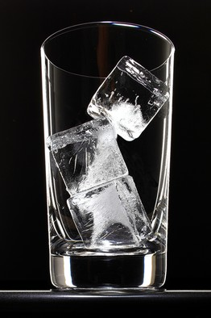
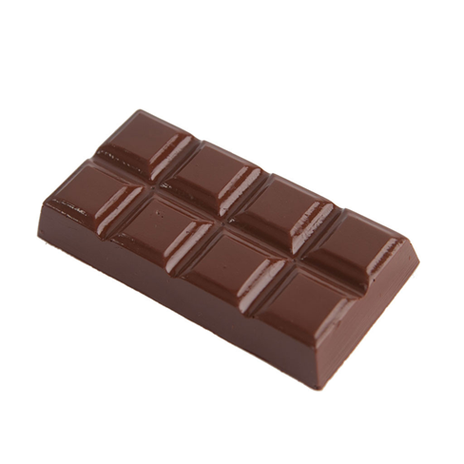
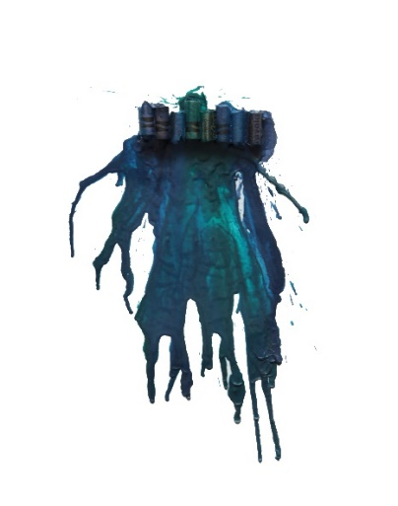
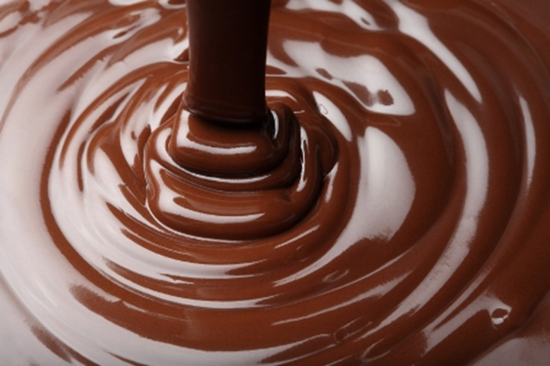
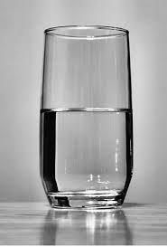
Examples of Changes in Matter
Photos courtesy of BSCS
Photo courtesy of BSCS
Photo courtesy of BSCS
Photo courtesy of BSCS
Photo courtesy of BSCS
Photo courtesy of Creatingkeepsakes.com
Photo courtesy of BSCS
Photo courtesy of BSCS

Slide 5
Other Examples of Matter Changing
Think about these questions and then share your ideas with an elbow partner:
Can you think of other examples of matter changing in the world around us?
What changes in matter have you noticed in your everyday life?
What examples can you think of that we haven’t observed in class?

Slide 6
Imagine You’re a Marshmallow!
Close your eyes and think about a marshmallow toasting over a fire.
Imagine you’re small enough to fit inside the marshmallow.
What happens to the molecules as the marshmallow melts?
What happens to the molecules before the change, during the change, and after the change?

Slide 7
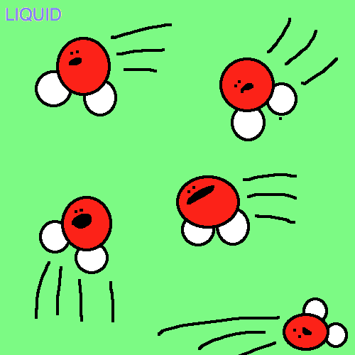
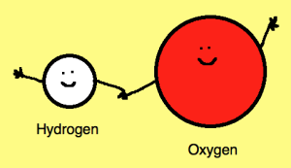
Show What You Know
Create a comic strip describing the molecules before, during, and after the matter changes.
You can draw pictures, add labels, write captions, and create talk bubbles.
Photo courtesy of BSCS
Courtesy of BSCS
Courtesy of BSCS

Slide 8
Let’s Share Our Comic Strips!
Presenting team: Try to help the other team understand the science ideas you’re illustrating in your comic strip.
Listening team: Think of suggestions to help make the comic strip better.
Are the science ideas clear?
Do the drawings help you understand the science ideas?
How can the comic strip be improved?

Slide 9
Revise Your Comic Strip
Based on the feedback and suggestions you received, how could you revise your comic strip? Think about these questions:
Does my comic strip show what matter is made of and how it can change?
Is there a better way to show what happens before, during, and after a change in matter?
Are my drawings and descriptions clear?
Have I used science words and ideas in my descriptions? Are they in the right places?
Do I need to add any labels, captions, or talk bubbles?

Slide 10
Next Time
You’ve done some really creative scientific thinking today!
Next time, you’ll share your revised comic strip with the class and show how it answers our unit central questions, What is matter made of? How can matter change?
Are you ready to show what you know about matter?

