Slide 1
Properties of Matter Lesson 6 (Extension)
What Happens When Matter Starts Off as One Thing and Changes into Something Different?

Slide 2
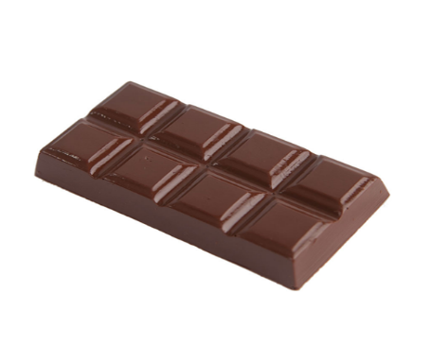
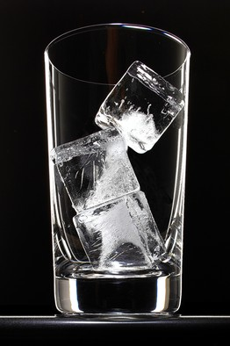
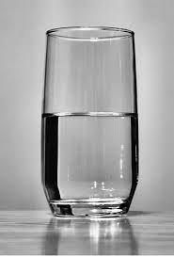
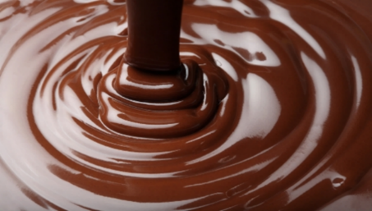
How Can Matter Change?
What happens to the molecules when a solid changes to a liquid?
What happens to the molecules when a liquid changes to a solid?
Photos courtesy of BSCS

Slide 3
A Human Model of Matter
Today you’ll become human models of matter!
As models of water molecules, you’ll act out what happens when a solid changes to a liquid and a liquid changes to a solid.
How would you move if you were a water molecule?

Slide 4
A Human Model of Matter
In your group, come up with a plan for acting out how water molecules behave in a solid and a liquid.
Make these decisions:
How close should we stand as molecules of solid water and liquid water?
How should we all move as molecules of solid water and liquid water?

Slide 5
A Drop of Water
Let’s read about water molecules!
Photo courtesy of BSCS

Slide 6
Key Science Ideas
Heating (melting) and removing heat (freezing) can cause changes in matter.
Matter changes from a solid to a liquid when heat is added and the molecules move around more freely.
Matter changes from a liquid to a solid when heat is taken away and the molecules slow down and vibrate in place.

Slide 7
Today’s Focus Question
What happens when matter starts off as one thing and changes into something different?

Slide 8
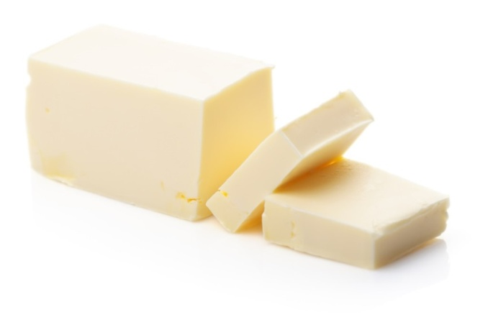
Examples of Changes in Matter
Photos courtesy of BSCS

Slide 9
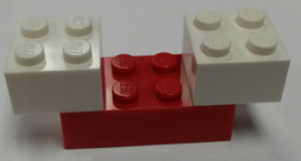
Our Lego Model
H₂O = Water
More than one Lego brick = One molecule
Photo courtesy of BSCS

Slide 10
Vinegar and Baking Soda
What happened in lesson 1 when we mixed vinegar with baking soda in a plastic freezer bag?

Slide 11
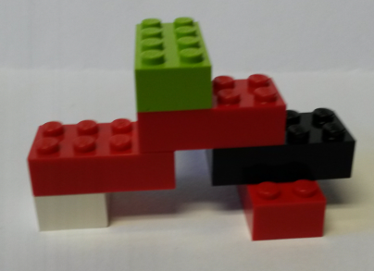
A Baking-Soda Molecule
This is a Lego model of a baking-soda molecule:
How is this molecule like a water molecule? How is it different?
Photo courtesy of BSCS

Slide 12
A Baking-Soda Molecule
A baking-soda molecule has six atoms. Two atoms are the same as the atoms in water (hydrogen and oxygen), and two are different.
Photo courtesy of BSCS

Slide 13
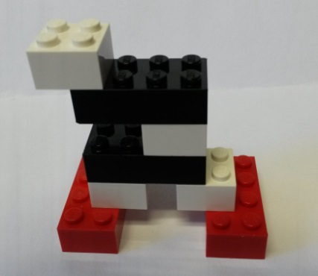
A Vinegar Molecule
This is a Lego model of a vinegar molecule:
How is this molecule different from a baking-soda molecule?
Photo courtesy of BSCS

Slide 14
A Vinegar Molecule
A vinegar molecule is bigger than a baking-soda molecule with a total of eight atoms. But it has only three different kinds of atoms.
Photo courtesy of BSCS

Slide 15
Your Predictions
What do you think will happen to these molecules when we mix the vinegar and the baking together?
Vinegar Molecule
Baking-Soda Molecule
Photos courtesy of BSCS

Slide 16
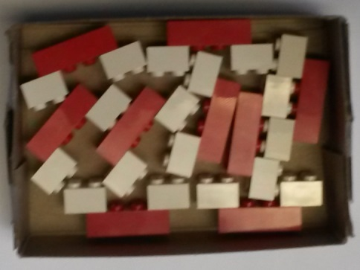
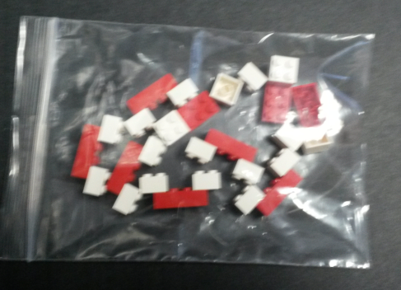
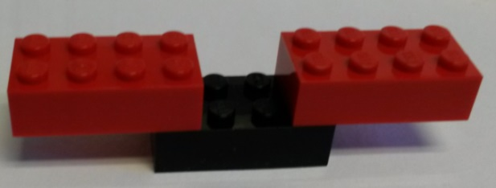
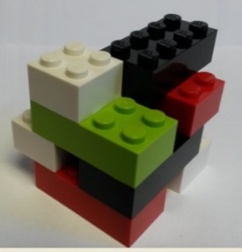
Physical and Chemical Changes
Physical Change
Add Heat
Remove Heat
Chemical Change
Photos courtesy of BSCS

Slide 17
Let’s Summarize!
Today’s focus question: What happens when matter starts off as one thing and changes into something different?
Turn and Talk: Share your ideas with an elbow partner. Then write your best answer to this question in your science notebook using 1 or 2 complete sentences.
Listen carefully and ask questions to help each other come up with clear answers that include science words and ideas about matter.

Slide 18
Atoms and Molecules
Today we started with 2 types of molecules (baking soda and vinegar) and ended up with 3 new molecules!
If we can end up with a different number of molecules in a chemical change, can the number of atoms change too?
Think about this question. Then share your ideas with an elbow partner using this sentence starter:
I think the number of atoms [can/can’t] change because ____________.

Slide 19
Next Time
In our next lesson, we’ll talk more about whether the number of atoms can change like the number of molecules in a chemical change.
Then we’ll see if our ideas match the ideas of scientists.

