Slide 1
Properties of Matter Lesson 7 (Extension)
Is Matter Created or Destroyed When It Changes? How Do You Know?

Slide 2
Unit Central Questions
What is matter made of? How can matter change?

Slide 3
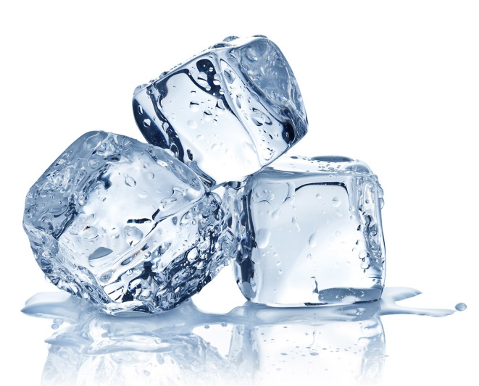
Review: How Does Matter Change?
What happens to the molecules when a solid changes to a liquid?
Photos courtesy of BSCS

Slide 4
Review: How Does Matter Change?
What happens to the molecules when a liquid changes to a solid?
Photos courtesy of BSCS

Slide 5
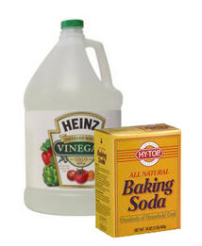
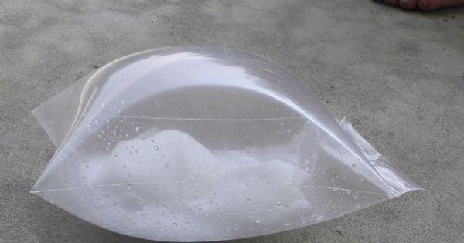
Review: How Does Matter Change?
What happens during a chemical change when matter fizzes or burns?
Photo courtesy of BSCS
Photo courtesy of BSCS
Photo courtesy of pixabay.com
Photo courtesy of BSCS

Slide 6
Today’s Focus Questions
Is matter created or destroyed when it changes? How do you know?

Slide 7
Is Matter Created or Destroyed?
How could we figure out whether matter is created or destroyed during a physical or chemical change?
What kind of data could we collect that might tell us whether there’s more or less matter or “stuff” after a change than before?

Slide 8
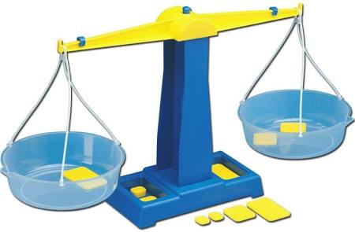
Weighing Matter
Weighing matter will help us figure out whether there’s more or less “stuff” after a change, or if the amount of matter is the same.
We’ll use a balance to weigh our matter.
Before the Change
After the Change
Courtesy of BSCS

Slide 9
Weighing Matter
How will we know whether the amount of matter is the same before and after a change? What will the balance look like?
How will we know there’s a different amount of matter after a change than before? What will the balance look like?
Courtesy of BSCS

Slide 10
Is Matter Created or Destroyed?
Have one member of your group gather the supplies you’ll need for part 1 of the investigation.
Discuss your predictions; then record them on your handouts (step 2).
Weigh the water bottles on the balance and record your data on the data table (see your handout).
Weigh the 2 bags of Legos on the balance and record your data on the data table.
Draw a conclusion and answer the focus questions (step 5) .

Slide 11
Is Matter Created or Destroyed?
Have one member of your group gather the supplies you’ll need for part 2 of the investigation.
Discuss your predictions; then record them on your handouts (step 6).
Carefully follow the directions for step 7 before weighing the bags of vinegar and baking soda on the balance. Then record your data on the data table.
Weigh the 2 bags of Legos on the balance and record your data on the data table.
Draw a conclusion and answer the focus questions (step 9) .

Slide 12
What Did You Observe?
What did you observe when you weighed the water bottles?
What did you observe when you weighed the 2 bags of Lego water molecules?
What did you observe when you weighed the bags of vinegar and baking soda before and after the chemical change?
What did you observe when you weighed the 2 bags of Lego molecules?

Slide 13
Let’s Summarize!
Our focus questions: Is matter created or destroyed when it changes? How do you know?
What did we discover about matter in physical and chemical changes that might help us answer these questions?

Slide 14
Let’s Summarize!
Our focus questions: Is matter created or destroyed when it changes? How do you know?
Write your best answer to these questions in your science notebook. Make sure to include evidence from your data tables and Lego models.

