Slide 1
Earth’s Changing Surface Lesson 2a
What Happens to Earth’s Surface That Causes Mountains to Form?

Slide 2
Landforms on Earth’s Surface
We agree that Earth’s surface has a variety of landform patterns and that different areas have different kinds of landforms.
Have the landforms on Earth’s surface always looked the way they do now?
Will these landforms change in the future?

Slide 3
Review: Does Earth’s Surface Change?
How do you think Earth’s surface might change over time?
Let’s review our list of ideas from last time.

Slide 4
Today’s Focus Question
What happens to Earth’s surface that causes mountains to form?

Slide 5
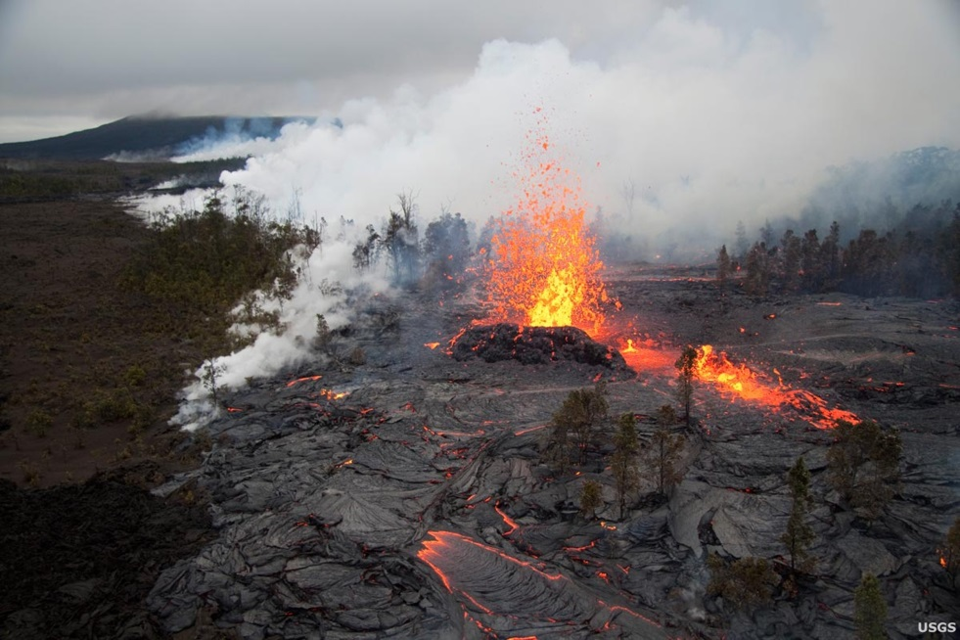
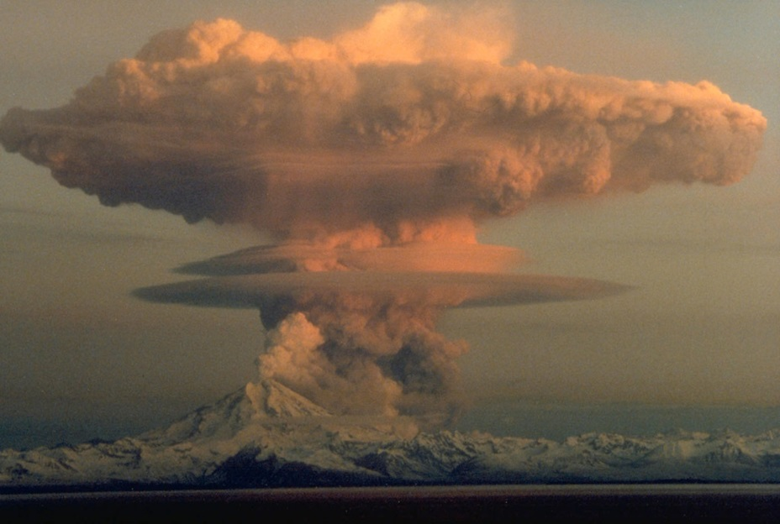
Investigation 1: Do Volcanoes Build Mountains?
Photo courtesy of USGS
Photo courtesy of USGS
Do volcanoes change Earth’s surface? Do you think they could be involved in building mountains? If so, how? Use evidence from these photographs to explain your answer.

Slide 6
Investigation 1: Do Volcanoes Build Mountains?
In your science notebooks, draw a picture showing how a volcano might change Earth’s surface over time. Make sure to add labels to your drawings using words from the word bank below.
Then write a brief description in your own words.
Word Bank
Volcano Rock Cool
Mountain Erupt/Eruption Harden
Lava Flow

Slide 7
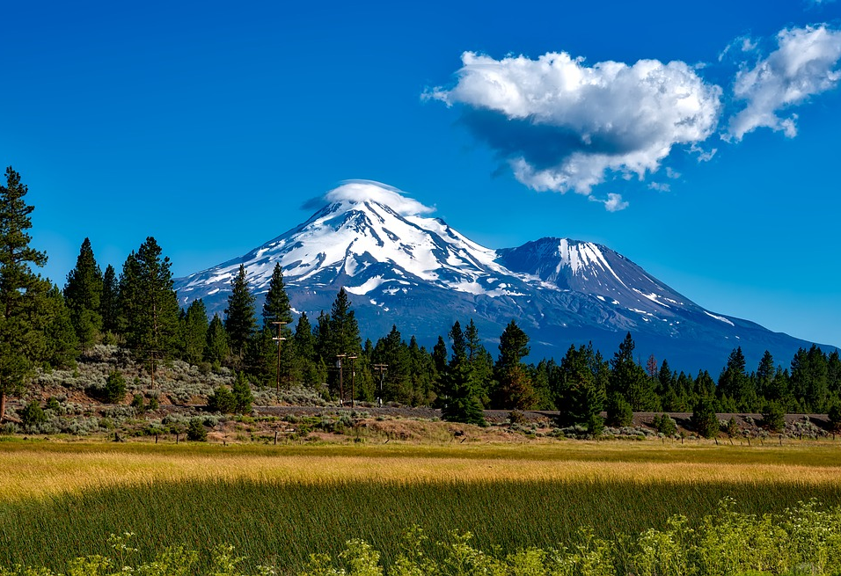
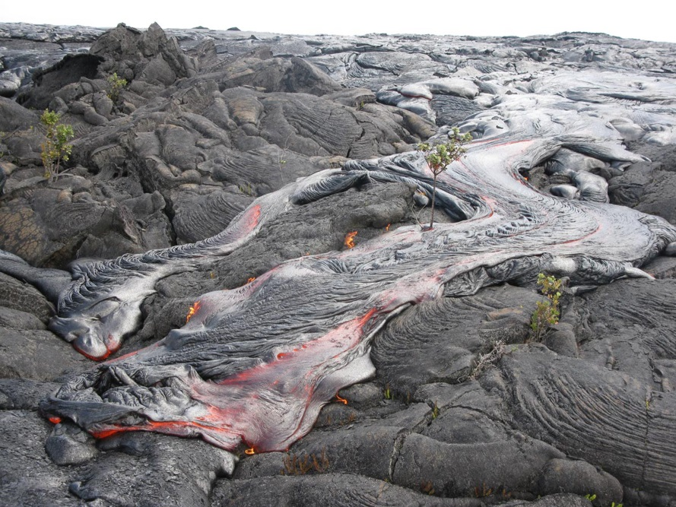
Investigation 1: Do Volcanoes Build Mountains?
Photo courtesy of Pixabay.com
Photo courtesy of USGS
The volcano on the left is no longer erupting. After many volcanic eruptions, the lava hardened and built up this mountain over a long period of time!

Slide 8
How Do Mountains Form?
We’ve seen that volcanoes build up mountains, but how exactly do mountains form?
What about mountains on Earth that aren’t volcanoes?
Where did they come from?
How did they form?
Let’s hear some of your ideas!

Slide 9
Our Focus Question
What happens to Earth’s surface that causes mountains to form?

Slide 10
Investigation 2: A Hard-boiled Egg
In what ways is this hard-boiled egg different from Earth?
In what ways is this hard-boiled egg similar to Earth?

Slide 11
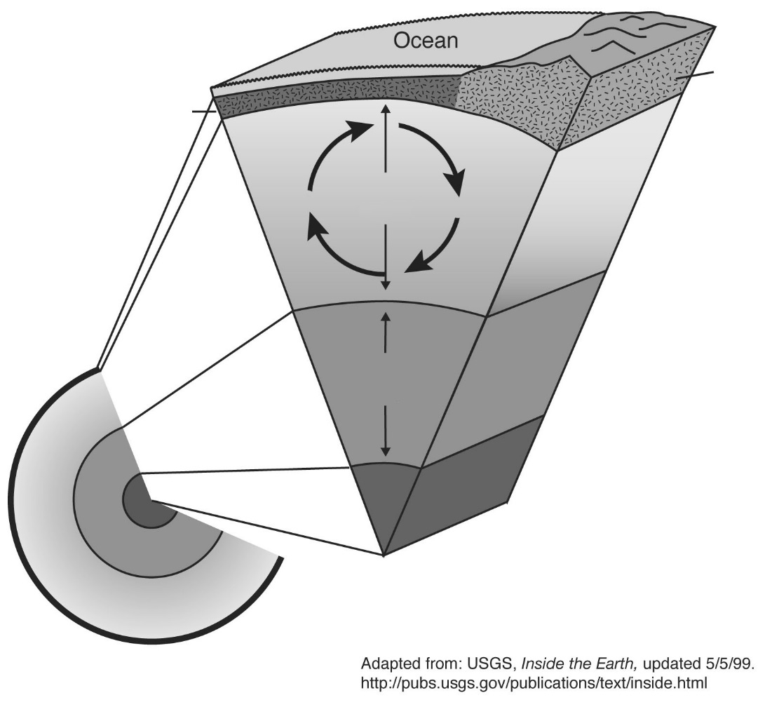
Investigation 2: A Hard-boiled Egg
Key science idea: Earth’s crust is very thin.
Where do you think Earth’s crust is in this diagram?
How is Earth’s crust like an eggshell?
Image courtesy of USGS

Slide 12
Investigation 2: A Hard-boiled Egg
Key science idea: Scientists have learned that Earth’s crust is made up of pieces or sections called tectonic plates that fit together like pieces of a puzzle.
These broken pieces are like a cracked eggshell!
Let’s look at our cracked eggshell again.
How would you describe the pieces?
Do they fit together like a puzzle?

Slide 13
Investigation 2: A Hard-boiled Egg
What important science ideas did we discover from our investigation? How is Earth’s crust like the shell of a hard-boiled egg?
Talk about these questions with a partner and summarize the key science ideas we discovered. (Hint: There are two key ideas, but see if you can come up with more.)
Be prepared to share these ideas with the class.

Slide 14
Key Science Ideas
Earth’s crust is thin.
Earth’s crust is made up of tectonic plates that fit together like puzzle pieces.

Slide 15
Today’s Focus Question
What happens to Earth’s surface that causes mountains to form?
How do volcanoes cause mountains to form? What is your evidence?
What did we learn about Earth’s surface from the hard-boiled egg and cracked eggshell?
Do you think tectonic plates have anything to do with building mountains on Earth’s surface? Why?

Slide 16
Next Time
We’re still wondering about whether Earth’s crustal (tectonic) plates might be involved in building mountains on Earth’s surface.
Next time we’ll gather more information to help us figure this out!

