Slide 1
Earth’s changing surface Lesson 3B
Are the Moving Plates of Earth’s Crust Involved in Building Up Earth’s Surface and Forming Mountains? If So, How?

Slide 2
Review: Our Foam-Mat Model
What did the foam mats represent?
What did the arrows represent?
What did we learn about how Earth’s tectonic plates might move?
What causes these plates to move?
Photo courtesy of BSCS

Slide 3
Key Science Idea
Earth’s tectonic plates float on a thick layer of hot, slow-moving rock underneath. This layer of rock causes the plates to move.

Slide 4
Today’s Focus Questions
Are the moving plates of Earth’s crust involved in building up Earth’s surface and forming mountains? If so, how?

Slide 5
How Earth’s Plates Move: Our Ideas
What ideas did our foam-mat investigation give us about how Earth’s plates might move?
How Earth’s Plates Move

Slide 6
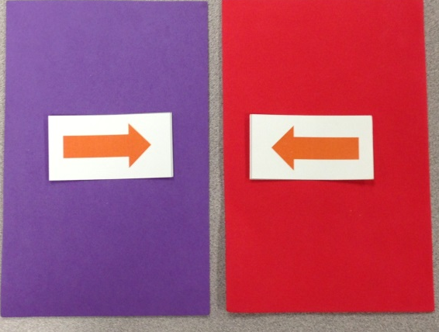
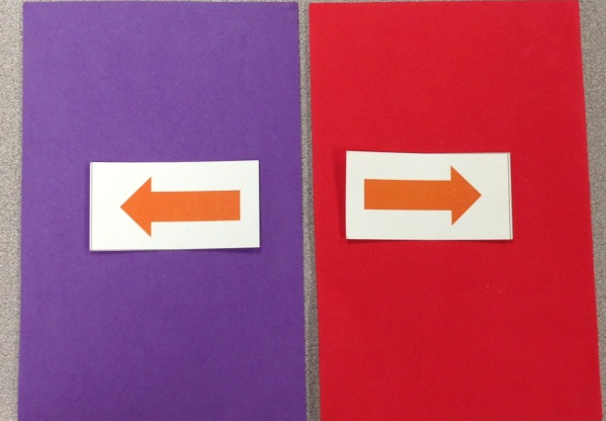
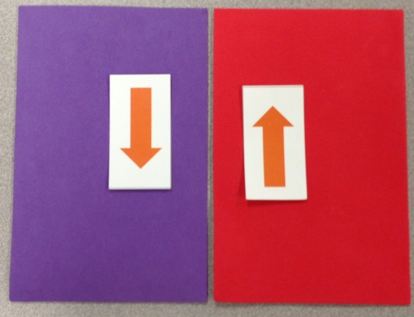
How Earth’s Plates Move: Scientists’ Ideas
Scientists have discovered that Earth’s tectonic plates move in 3 main ways.
How the Plates Move
 | Plates move toward each other and collide.
 | Plates move away from each other.
 | Plates move side to side (slide past each other).
Photo courtesy of BSCS
Photo courtesy of BSCS
Photo courtesy of BSCS

Slide 7
Investigation: Plate Movements and Mountain Building
Do you think any of these plate movements are involved in forming mountains?
Look at your answer to the focus question from last time. Then talk with a partner about whether you think Earth’s plates and their movements form mountains.
Be ready to share your ideas with the class. Use your foam mats and arrows to show how you think plates move to form mountains.

Slide 8
Investigation: Plate Movement and Mountain Building
Our conclusion: We think that when Earth’s plates collide, mountain ranges build up.

Slide 9
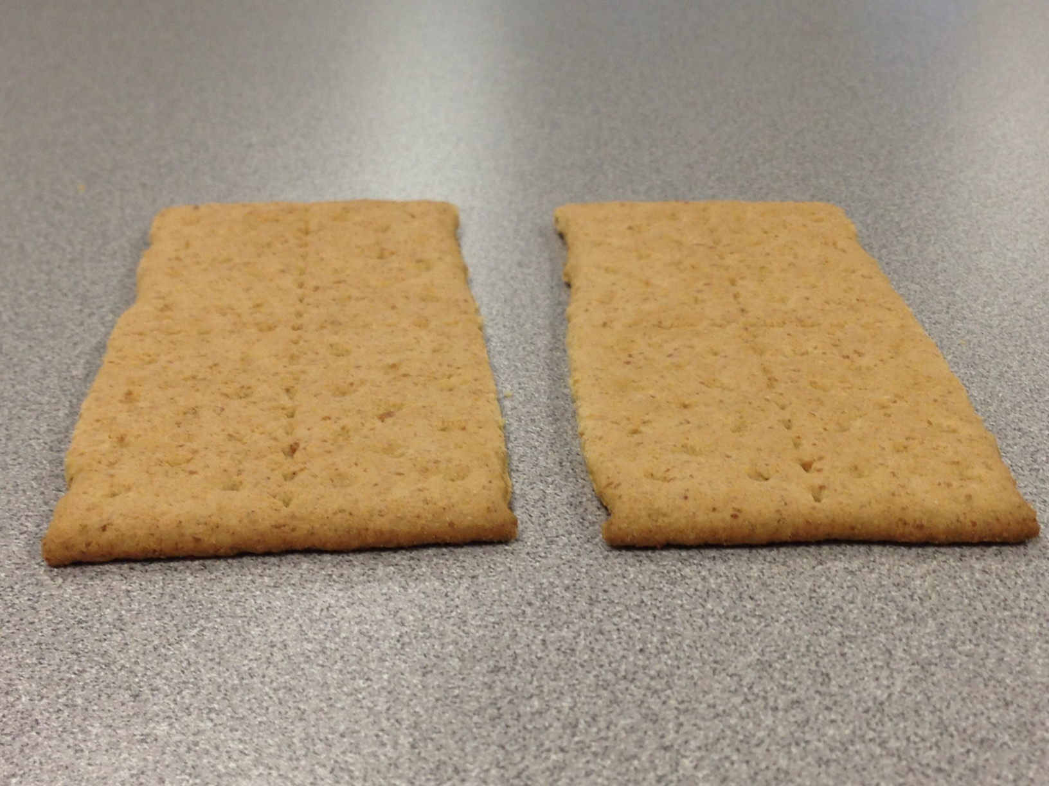
Investigation: Plate Movement and Mountain Building
Imagine that these graham crackers are two of Earth’s crustal (tectonic) plates. What do you predict will happen when they collide?
Photo courtesy of BSCS

Slide 10
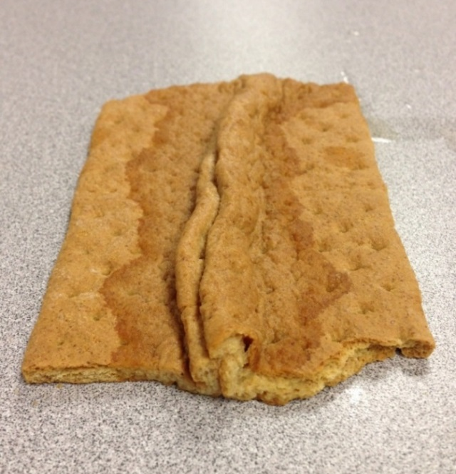
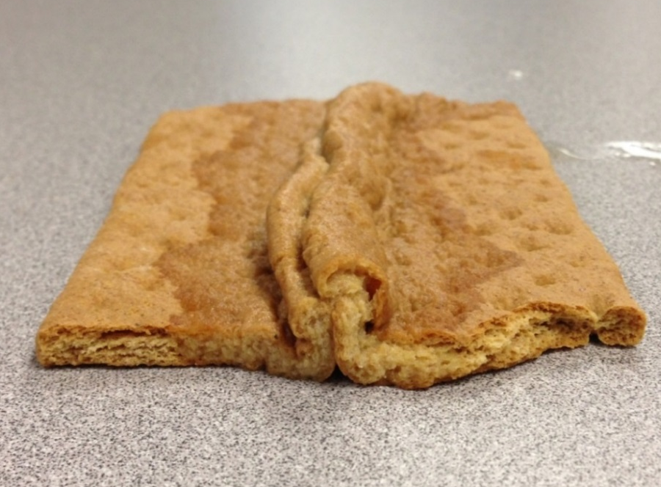
Investigation: Plate Movement and Mountain Building
Is this result what you predicted?
How is this result similar to or different from the foam-mat collision?
Photo courtesy of BSCS
Photo courtesy of BSCS

Slide 11
Our Foam-Mat Model and Earth’s Plates
Think about our foam-mat model and complete these sentences in your science notebooks:
I think the foam mats are LIKE Earth’s crustal plates because ______________.
I think the foam mats are NOT LIKE Earth’s crustal plates because ________.

Slide 12
Our Foam-Mat Model and Earth’s Plates
Think about time as we compare our foam-mat model with Earth’s crustal plates.
How long did it take to push our foam mats together to create a plate collision?
How long do you think it takes Earth’s plates to move and collide to form mountains?

Slide 13
Our Foam-Mat Model and Earth’s Plates
Earth’s plates move only 1 to 16 centimeters a year.
Imagine taking a whole year to move your foam mats just 1 centimeter!
Can you demonstrate how slowly the mats would move?
Notes:
On a Smart Board, have a student first draw a line 1 centimeter long on the slide and label it “1 cm.” Then have another student draw a line 16 centimeters long on the slide and label it “16 cm.”

Slide 14
Our Foam-Mat Model and Earth’s Plates
Earth’s plates move VERY, VERY slowly. That’s why we can’t see mountains being built. It happens a tiny bit at a time over many, many, many years.
When Earth’s plates DO move, what happen? What are some examples? (Hint: Think of events that happen in nature.)

Slide 15
Let’s Summarize!
What do you think now about how mountains form?
Complete this sentence in your science notebook:
I think mountains are formed by ________.

Slide 16
Our Focus Questions
Are the moving plates of Earth’s crust involved in building up Earth’s surface and forming mountains? If so, how?
Look at the answer to the focus questions that you wrote at the end of the last lesson.
How have your ideas changed after today’s investigation?
Think about this for a moment and then share with a partner.

Slide 17
The Bubble Challenge!
Draw this bubble map in your science notebook:
Collide
Move Side to Side
Move Apart

Slide 18
The Bubble Challenge!
What might you see or feel at each type of boundary between two of Earth’s tectonic plates?
Are the movements at these boundaries the same or different?
What might happen at all of the boundaries?
What might happen at only one type of boundary?

Slide 19
Key Science Ideas
Let’s review some key ideas about Earth’s crustal plates and mountain building:
Earth’s surface is made up of tectonic (or crustal) plates that float on top of hot, slow-moving rock inside Earth.
We think that mountain form where these plates collide.
We also think that plate collisions sometimes cause volcanic eruptions and earthquakes.

Slide 20
Next Time
In the next lesson, we’ll see if we can find evidence to support the idea that mountains form when Earth’s crustal plates collide.
Stay tuned!

