Slide 1
Earth’s changing surface Lesson 4b
What Evidence Can We Find to Support the Idea That Mountains Form When Earth’s Crustal Plates Collide?

Slide 2
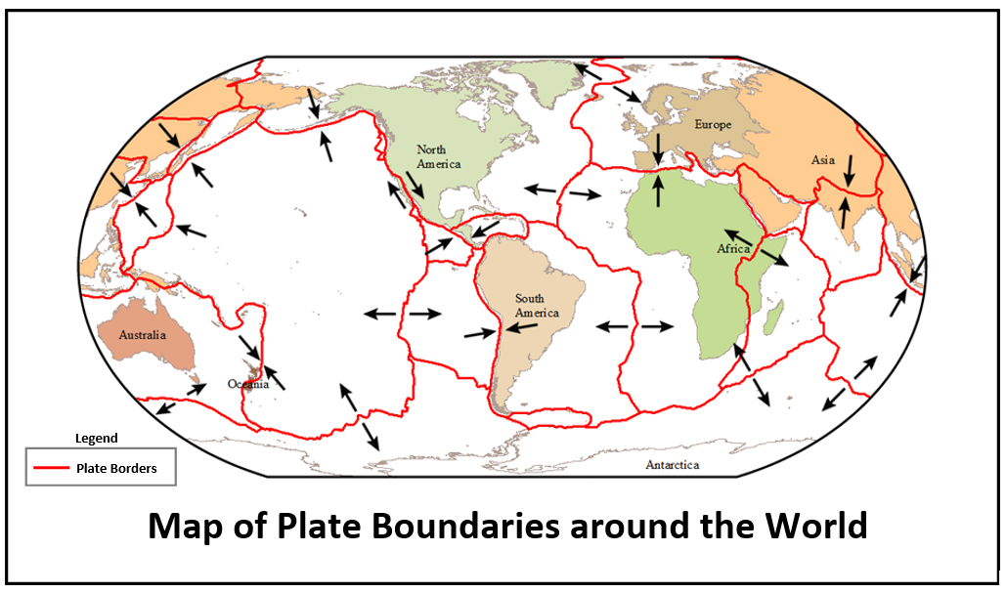
Map of Earth’s Plate Boundaries
What did we notice about how plates move?
Courtesy of BSCS

Slide 3
How Do Earth’s Plates Move?
Where on the boundary map did we notice Earth’s plates moving in these ways?
Toward each other (colliding)
Away from each other
Side to side (sliding past each other)
What did we decide might happen when two of Earth’s crustal plates collide?

Slide 4
Today’s Focus Question
In this lesson, we’ll continue investigating our focus question from last time:
What evidence can we find to support the idea that mountains form when Earth’s crustal plates collide?

Slide 5
Investigation: Comparing Maps
Courtesy of USGS

Slide 6
Investigation: Comparing Maps
Compare these two maps:
Physical Map of the World (handout 4.2)
Map of Plate Boundaries around the World (handout 4.1 from the last lesson)
What landforms do you see on the physical map that appear in the same areas where Earth’s plates collide on the map of plate boundaries?
Complete this sentence in your notebooks:
We notice _______________ on the physical map where Earth’s plates collided on the boundaries map.
Is this what you predicted you would see?

Slide 7
Investigation: Comparing Maps
Mountain ranges form where Earth’s plates collide.
Do you agree or disagree with this statement?
Sentence starters:
I AGREE with this statement. My evidence is _______________________.
I DON’T AGREE with this statement. My evidence is _______________________.

Slide 8
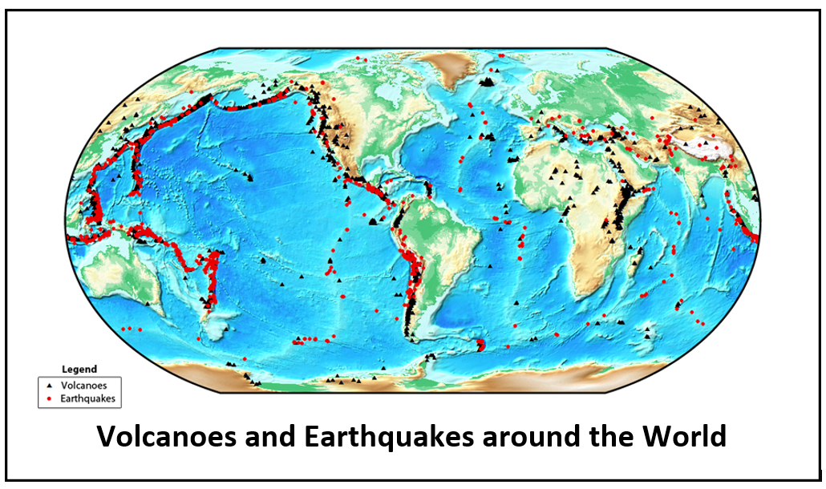
Investigation: Comparing Maps
Courtesy of BSCS

Slide 9
Investigation: Comparing Maps
Compare these two maps and discuss your observations:
Volcanoes and Earthquakes around the World (handout 4.2)
Map of Plate Boundaries around the World (handout 4.1 from the last lesson)
What patterns do you notice when you compare the maps?
What do you notice about the locations of volcanoes and earthquakes?
Record these patterns in your science notebooks.

Slide 10
Plate Collisions and Mountain Building
What do you think now?
Are plate collisions involved in building mountains?
What’s your evidence from these three maps?
Map of Plate Boundaries around the World
Physical Map of the World
Volcanoes and Earthquakes around the World

Slide 11
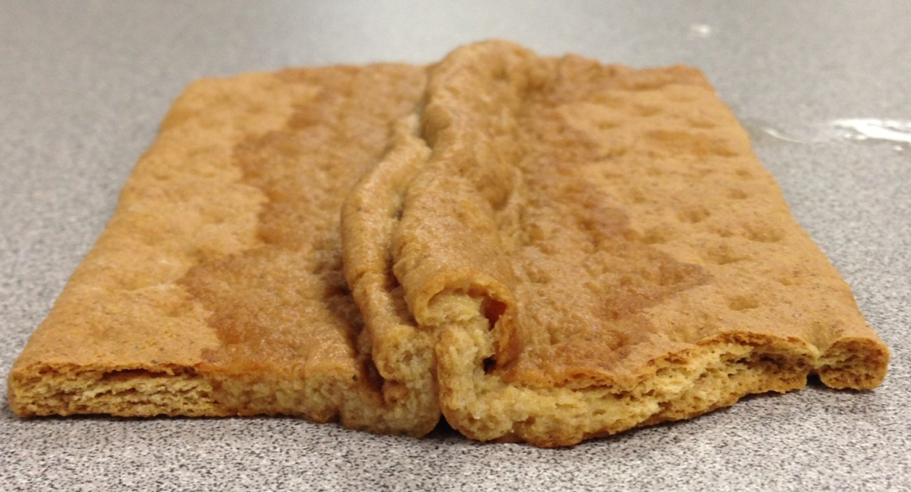
Earth’s Crustal Plates
Photo courtesy of BSCS
How are these graham-cracker “plates” LIKE and NOT LIKE the crustal plates on the map of plate boundaries?

Slide 12
Earth’s Crustal Plates
Photo courtesy of BSCS
When plate collisions build up Earth’s surface, this is called uplift. Forces from inside Earth are lifting up the crust!

Slide 13
Key Science Ideas
Earthquakes happen along fault lines when tectonic plates collide or slide past each other.
Most earthquakes and volcanoes occur at plate boundaries, but sometimes they happen in the middle or interior of a plate.
Volcanoes that happen at interior locations are called hotspots.
Fault lines are cracks in Earth’s crust that occur at plate margins and in the middle (interior) of plates.
All plate boundaries are faults, but not all faults are plate boundaries.

Slide 14
Let’s Summarize!
Today’s focus question: What evidence can we find to support the idea that mountains form when Earth’s crustal plates collide?
Based on everything you’ve learned from our investigations, how would you answer this question now?
What evidence from the three maps supports the idea that mountains form when Earth’s plates collide?

Slide 15
Revise Your Bubble Maps
Collide
Move Side to Side
Move Apart

Slide 16
Show What You Know!
Revise your bubble maps to show what you know now about how Earth’s plates move.
What happens when Earth’s plates move in these ways?
Toward each other (collide)
Away from each other (move apart)
Side to side (slide past each other)
Where would you find mountains, volcanoes, earthquakes? What is your evidence?

Slide 17
Next Time
Think about this question before our next lesson:
If plate collisions form mountains and cause them to grow taller, can mountains eventually grow so tall that they reach outer space?

