Slide 1
energy transfer Lesson 1a
How Do We Know Whether Something Has Energy?

Slide 2
Unit Central Question
How does the energy of an object move and change?

Slide 3
Today’s Focus Question
How do we know whether something has energy?

Slide 4
Looking for Evidence of Energy
How might we find evidence of energy in the world around us?
How might we tell that something has energy?

Slide 5
What Is Your Evidence?
What did you do to show that you had a lot of energy?
What evidence of energy did you observe among your classmates?

Slide 6
What Is Your Evidence?
What did you do to show that you had very little energy or no energy at all?
Did you observe any evidence of energy among your classmates? If so, what evidence did you see?

Slide 7
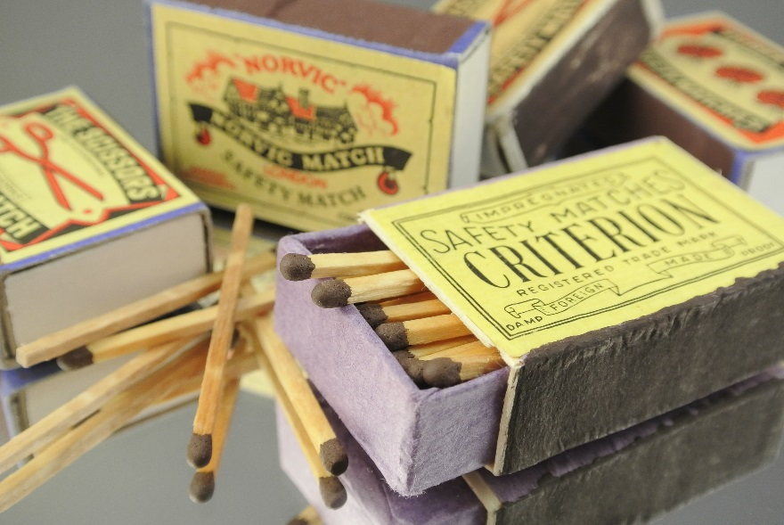
Investigation: Does a Match Have Energy?
Do you think a match has energy? Why or why not?
Photo courtesy of Pexels.com

Slide 8
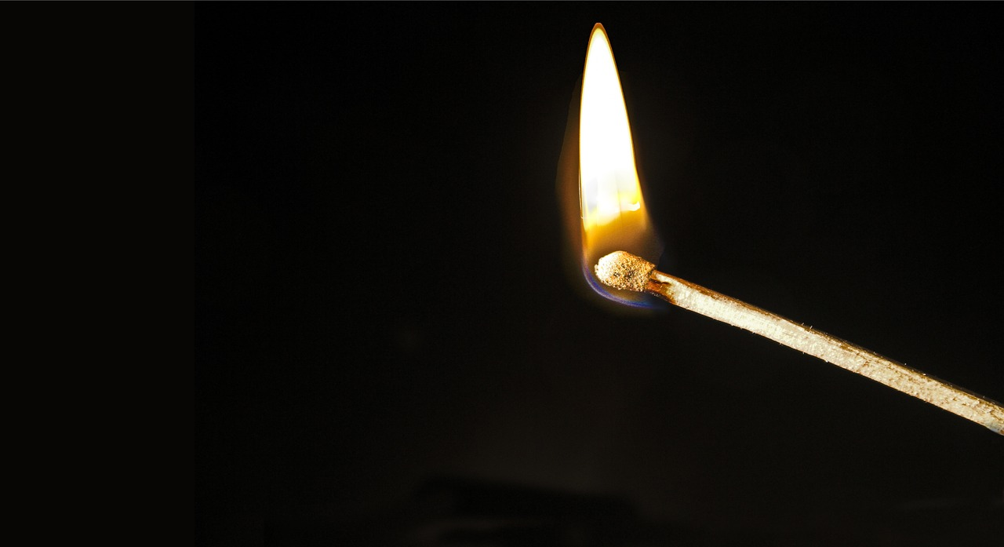
Investigation: Does a Match Have Energy?
Does a lighted match have energy? What’s your evidence?
Photo courtesy of Pixabay.com

Slide 9
Create a Data Table
Object | Evidence of Energy

Slide 10
Let’s Review Our Evidence
Object | Evidence of Energy
Our bodies | They move; they make sound
A match | Light; fire; heat; burning

Slide 11
Using Our Senses to Detect Energy
You used your SENSES to figure out whether something has energy.
You saw your classmates move and the match light up.
You heard classmates being noisy and the match strike the matchbox.
You may have felt yourself getting hot and smelled the match burning.
All of these senses helped you gather evidence of energy!

Slide 12
Let’s Summarize!
Focus question: Who do we know whether something has energy?
Think about your observations and the evidence of energy we gathered today. Then complete this sentence in your science notebook:
I know if something has energy because it _________________.
For extra credit: How did your senses help you find evidence of energy?

Slide 13
Next Time
In our next lesson, you’ll become energy detectives and use your senses to gather more evidence of energy in everyday objects.

