Slide 1
energy transfer Lesson 3a
What Happens to Energy When Objects Collide?

Slide 2
Review: Ideas about Motion Energy
Focus question from last time: What causes a moving object to have more or less motion energy?
Let’s share our ideas about motion energy.
What does the speed of an object have to do with energy?

Slide 3
Today’s Focus Question
What happens to energy when objects collide?

Slide 4
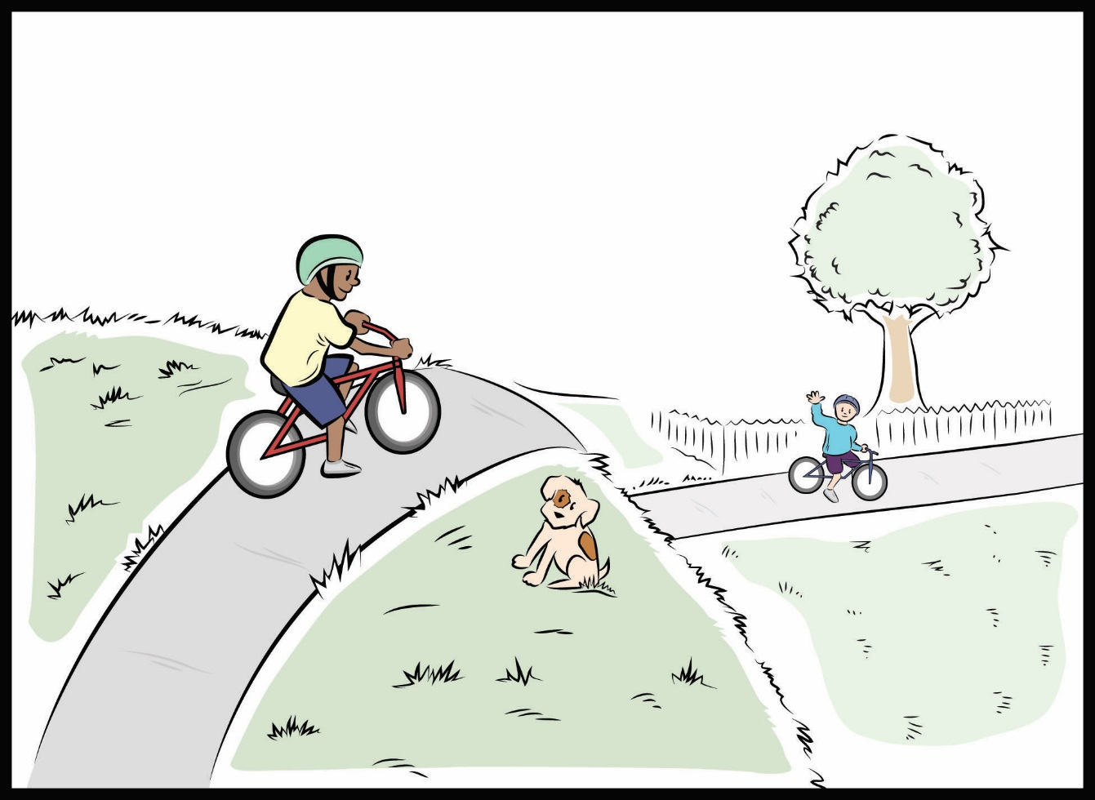
Mumford and Leroy’s Big Crash
Courtesy of BSCS

Slide 5
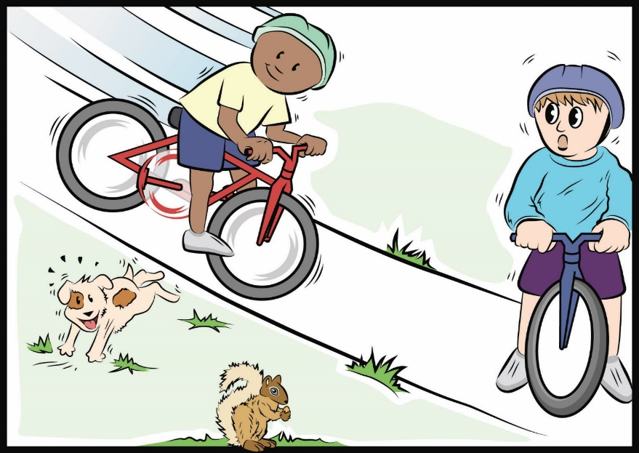
Your Predictions about Mumford and Leroy
What do you predict will happen when Mumford and Leroy collide on their bikes?
What will happen to Mumford’s speed?
What will happen to Leroy’s speed
What will happen to their motion energy?
Courtesy of BSCS

Slide 6
Your Predictions about Mumford and Leroy
Write your predictions in your science notebook.
When Mumford and Leroy collide on their bikes, I predict ______________________.
I think that Mumford’s speed and motion energy will _________.
I think that Leroy’s speed and motion energy will _________.
Use complete sentences and be prepared to share your ideas with the class.

Slide 7
Investigation: Colliding Marbles
Materials for each team:
A ruler with a groove in the middle
2 marbles
Blocks of wood (to increase ramp height)
Using these materials, how can we set up a model that represents the characters and events in our story?
Models help us imagine and think about real-life situations. A model is like something in real life, but not exactly like it.

Slide 8
Investigation: Colliding Marbles
Let’s think about our model.
What makes this a good model?
In what ways do you think this model is like Mumford and Leroy on their bikes?
What makes this not such a good model?
In what ways do you think this model is not like Mumford and Leroy on their bikes?

Slide 9
Investigation: Colliding Marbles
Instructions:
Design a way to test your predictions about what will happen when Mumford and Leroy collide.
How will you set up your model?
How will you describe the speed and energy motion of each marble before and after the collision?
Word list: fast/faster, slow/slower, speed, movement/motion energy
Write your plan in your science notebook and set up a data table to record your data and observations.

Slide 10
Investigation: Colliding Marbles
Sample data table:
 | Before Collision |  | After Collision
 | Marble 1 | Marble 2 | Marble 1 | Marble 2
Speed | Fast | None | Slower, then none | Slow Skid Slide
Motion Energy | A lot | None | Less, then none | Some

Slide 11
Investigation: Colliding Marbles
Share your team’s results and observations with the class:
What happened with the marbles?
How would you describe the speed of each marble before and after the collision?
What does marble speed have to do with motion energy?

Slide 12
Investigation: Colliding Marbles
How would you describe the motion energy of each marble before and after the collision?
What’s your evidence?
When you answer this question, make sure to use the words motion energy instead of speed!

Slide 13
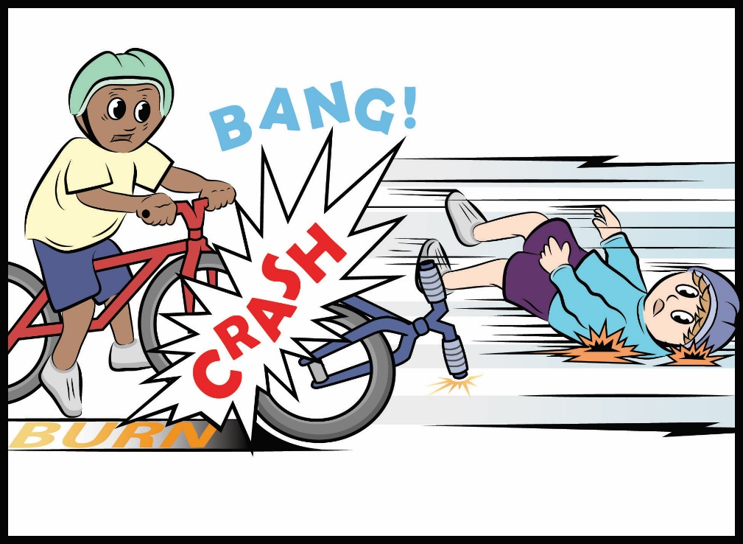
Mumford and Leroy’s Big Crash: Part 2
Courtesy of BSCS

Slide 14
Mumford and Leroy’s Big Crash: Part 2
Were your predictions about Mumford and Leroy correct?
How was your model like what happened to Mumford and Leroy?
Courtesy of BSCS

Slide 15
Let’s Summarize!
Key science ideas:
The faster an object moves, the more energy it has.
Energy can move or transfer somewhere else when objects collide.
When two objects collide, energy moves or transfers from one object to the other object.

Slide 16
Next Time
In our next lesson, we’ll use science ideas from our ramp-and-marble investigation to answer our lesson focus question, What happens to energy when objects collide?

