Slide 1
Energy transfer Lesson 3b
What Happens to Energy When Objects Collide?

Slide 2
Review: Key Science Ideas
The faster an object moves, the more energy it has.
Energy can move or transfer somewhere else when objects collide.
When two objects collide, energy moves or transfers from one object to the other object.

Slide 3
Today’s Focus Question
What happens to energy when objects collide?

Slide 4
Mumford and Leroy’s Big Crash
In our last lesson, we used a model to show what happened to motion energy when Mumford and Leroy collided on their bikes.
What did your team’s model look like?
Why did we use a model to represent Mumford and Leroy?

Slide 5
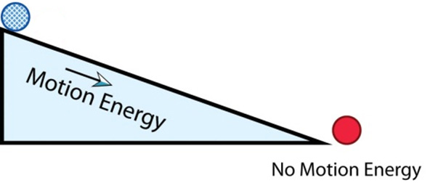
Investigation: Ramp-and-Marble Diagrams
Before the collision:

Slide 6
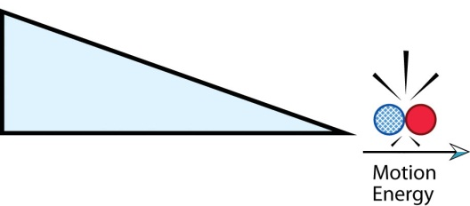
Investigation: Ramp-and-Marble Diagrams
During the collision:

Slide 7
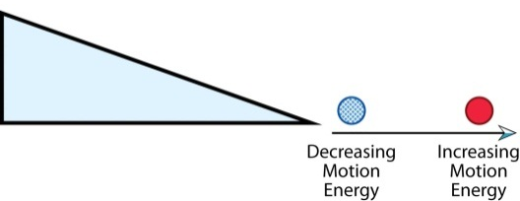
Investigation: Ramp-and-Marble Diagrams
After the collision:

Slide 8
Investigation: Ramp-and-Marble Diagrams
Think about the motion energy of the marbles.
Where did the motion energy of Marble 2 come from?
What happened to the motion energy of Marble 1?
This movement of energy from one object to another is called energy transfer. After the collision, energy moved or transferred from Marble 1 to Marble 2.

Slide 9
Energy Transfer
Definition:
Energy transfer occurs when energy moves from one object to another.
Describe the energy transfer that happened in Mumford and Leroy’s big crash.
How did energy move from one object to another after the collision?
Use evidence from the story and the ramp-and-marble model.

Slide 10
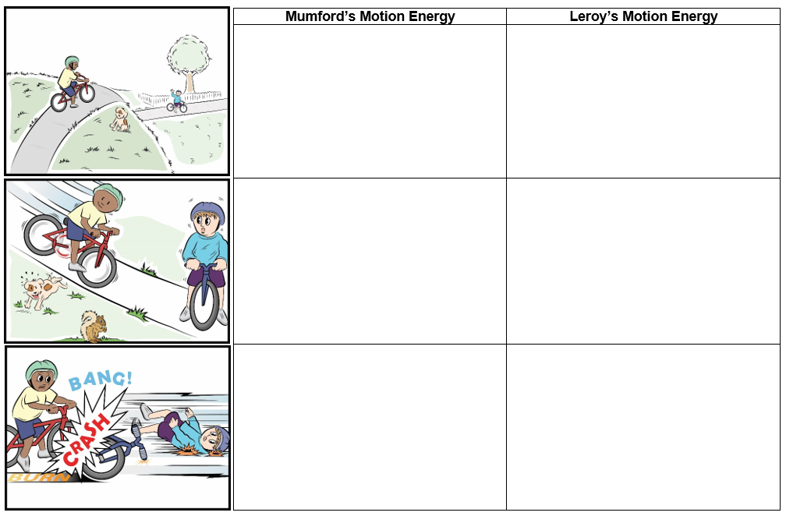
Mumford and Leroy’s Collision, Part 1

Slide 11
Let’s Summarize!
Focus question: What happens to energy when objects collide?
Answer this question in your science notebook using everything you’ve learned so far about motion energy and energy transfer.
Write in complete sentences and include evidence from these sources:
The story about Mumford and Leroy’s big crash
Our ramp-and-marble model
Our diagrams of the ramp-and-marble model

Slide 12
Key Science Idea
Kinetic energy is motion energy.
Draw a picture of kinetic energy in your science notebook to illustrate what this term means. (Hint: Show motion in some way.)

Slide 13
Next Time
Mumford had a LOT of kinetic energy when he raced down the hill on his bike.
Leroy got some of Mumford’s energy when they collided, but where did Mumford’s energy come from?
We’ll explore that question next time.

