Slide 1
energy transfer Lesson 4a
Where Does the Energy of a Moving Object Come From?

Slide 2
Unit Central Question
How does the energy of an object move and change?

Slide 3
Today’s Focus Question
Where does the energy of a moving object come from?

Slide 4
Mumford’s Energy
Mumford’s
Energy
Diagram courtesy of BSCS
How much kinetic energy did Mumford have at the top of the hill before he started moving?
When did he first have kinetic energy?
When did he have the most kinetic energy?
Where do you think his kinetic energy came from?

Slide 5
Review: Mumford and Leroy’s Big Crash
Key science idea: Energy can move or transfer from one object to another.
Where did you see examples of energy transfer in the story about Mumford and Leroy?
Where did you see examples of energy transfer in your ramp-and-marble model?

Slide 6
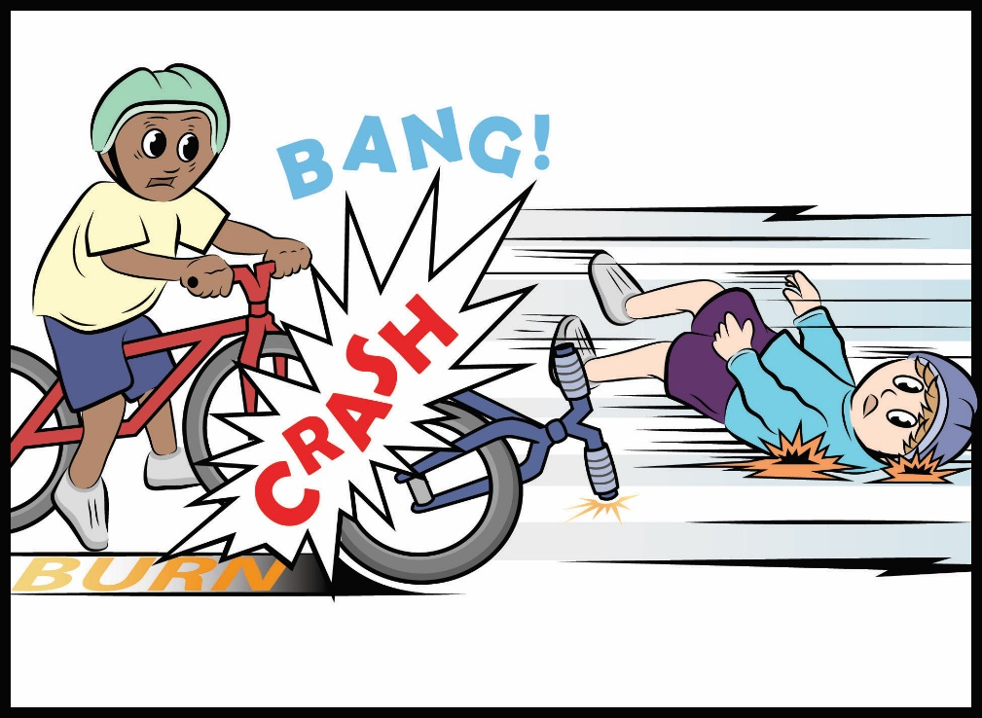
Mumford and Leroy’s Big Crash: Part 3
Courtesy of BSCS

Slide 7
Mumford and Leroy’s Big Crash
What new energy words did you see in today’s reading about Mumford and Leroy’s big crash?
What did you learn about potential energy?
What do you think it means for energy to “change costumes”? Use ideas from the essay we just read.

Slide 8
Potential Energy
Write the words potential energy in your science notebook.
Draw a table in your notebook and write the same words on top of the table to help you remember these ideas:
To have potential energy, an object has to be off the ground (above ground level).
The higher an object is off the ground (above ground level), the more potential energy it has.
Potential Energy

Slide 9
Investigation: Mumford and Leroy’s Big Crash
Locate handout 3.3 (Mumford and Leroy’s Collision, Part 1) in your notebook.
Read your descriptions of motion energy from last time.
On handout 4.1 (Mumford and Leroy’s Collision, Part 2), label where you think potential energy is located in each picture.
Then write a description of potential energy for each picture on the handout.

Slide 10
Investigation: Mumford and Leroy’s Big Crash
Let’s share our descriptions and ideas about potential energy.
Where did you label potential energy on each picture?
Why did you choose these locations?
Who has potential energy in each picture?

Slide 11
Ramp-and-Marble Investigation
In lesson 2, we rolled a marble down a ramp of different heights. On the steeper ramp, the marble was higher off the ground.
How fast did the marble move down each ramp?
How would you describe the marble’s kinetic energy on each ramp?
How would you describe the marble’s potential energy at the top of each ramp?

Slide 12
Mumford’s Energy
Now let’s think about the potential and kinetic energy of Mumford riding his bike down the hill.
Describe Mumford’s potential energy as he rode down the hill.
Describe Mumford’s kinetic energy as he rode down the hill.
Describe Mumford’s potential energy and the kinetic energy as he rode down the hill.

Slide 13
Today’s Focus Question
Where does the energy of a moving object come from?
Answer this question in your science notebook using this sentence starter:
I think the energy of a moving object comes from ____________________.
Include science ideas and evidence from our investigations with the marbles and ramps and our story about Mumford and Leroy’s crash.

Slide 14
Next Time
In our next lesson, we’ll continue exploring science ideas about potential energy and kinetic energy using this diagram.
Marble’s
Energy
Diagram courtesy of BSCS
Let’s see if we can figure out how energy changes costumes!

