Slide 1
energy transfer Lesson 4b
Where Does the Energy of a Moving Object Come From?

Slide 2
Review: Energy Changing Costumes
What do you think it means for energy to change costumes?

Slide 3
Today’s Focus Question
Where does the energy of a moving object come from?

Slide 4
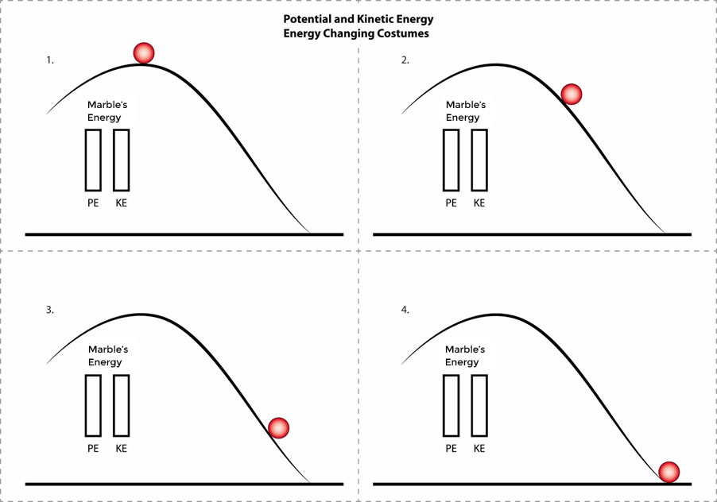
Investigation: Energy Changing Costumes
Write one sentence in your notebook that describes what you observe in each diagram.

Slide 5
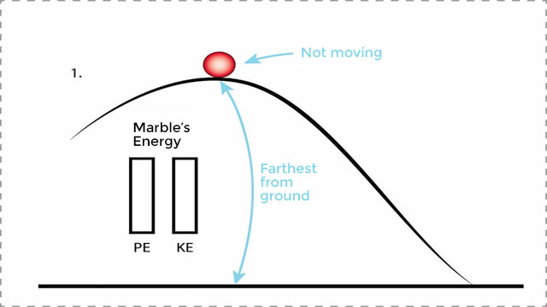
Investigation: Energy Changing Costumes
Let’s work on the first diagram together.

Slide 6
Investigation: Energy Changing Costumes
Questions for diagrams 2–4:
What did you observe about the marble’s position, speed, and motion?
How would you describe the marble’s potential energy?
How would you describe the marble’s kinetic energy?
Does the marble have more or less [kinetic energy/potential energy] than it did in diagram 1? How do you know?

Slide 7
Investigation: Energy Changing Costumes
Use different-colored pencils to shade in the PE (potential energy) and KE (kinetic energy) meters for each diagram.

Slide 8
Potential Energy and Kinetic Energy
If you’re sharing, answer these questions:
How much kinetic energy does your meter show for each diagram? Why?
How much potential energy does your meter show for each diagram? Why?
If you’re listening, think about these questions:
Do you agree or disagree?
Do you have any questions?
Do you have an idea to add?

Slide 9
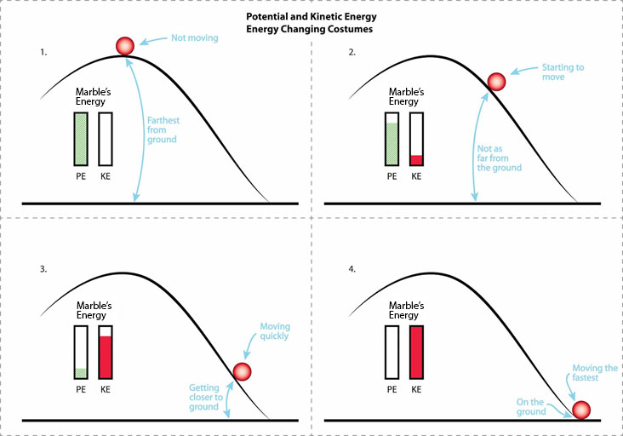
Comparing Our Results

Slide 10
Let’s Summarize!
Write 3 or 4 complete sentences describing how potential and kinetic energy worked together to help Mumford ride down the hill.
Think about all of the models we’ve used in our energy investigations:
Our ramp-and-marble models/diagrams
Pictures of Mumford and Leroy before, during, and after their collision
Our diagrams of potential and kinetic energy

Slide 11
Today’s Focus Question
Where does the energy of a moving object come from?
How do our ideas about Mumford’s energy help us answer this question?

Slide 12
Key Science Ideas
An object above ground level (off the ground) has potential energy.
Potential energy can transform into kinetic energy as an object moves from a higher place toward a lower place.
Potential energy transforms into kinetic energy.
Energy doesn’t disappear. It changes costumes!

Slide 13
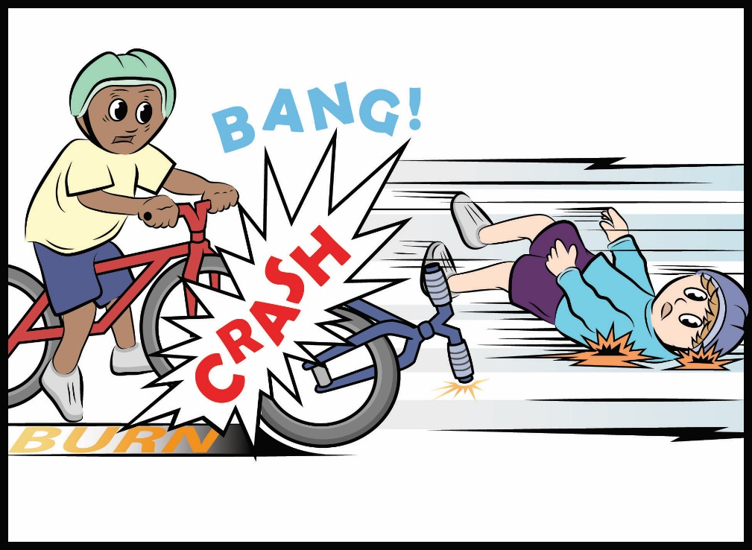
Next Time
What evidence do you see of energy changing costumes? Where did this energy come from?
Courtesy of BSCS

