Slide 1
energy transfer Lesson 5a
Where Does Energy Come From? Where Does It Go?

Slide 2
Review: Key Science Ideas about Energy
Where did Mumford get his energy to ride down the hill?
Where did Leroy get the energy to move after Mumford collided with him?
What happens with energy when two objects (like marbles or boys on bikes) collide? State this as a science idea using a complete sentence.
What happens when energy changes costumes? State this as a science idea using a complete sentence and science words.

Slide 3
Today’s Focus Questions
Where does energy come from? Where does it go?

Slide 4
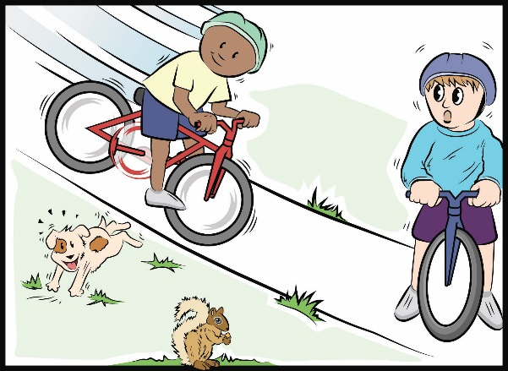
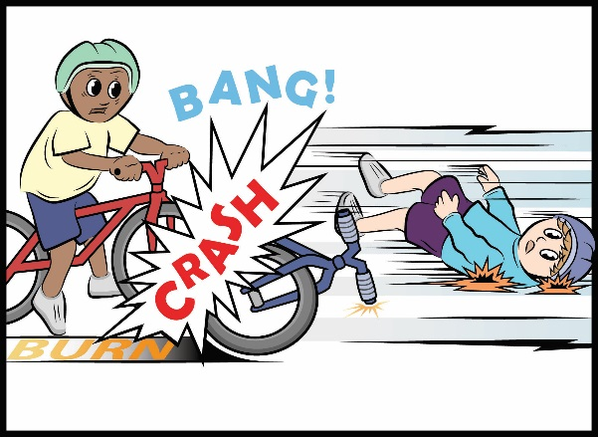
Mumford and Leroy’s Big Crash!
As you and a partner read the handout, highlight energy words and important ideas about energy.
Courtesy of BSCS
Courtesy of BSCS
Courtesy of BSCS

Slide 5
Key Science Idea
All of the energy in the crash came from somewhere and went somewhere.

Slide 6
Investigation: Tracking Energy Flow
Today you’ll use an energy-flow diagram to track where energy comes from and where it goes as it moves through an object.
Keep this science idea in mind:
All of the energy in an interaction between two objects comes from somewhere and goes somewhere.

Slide 7
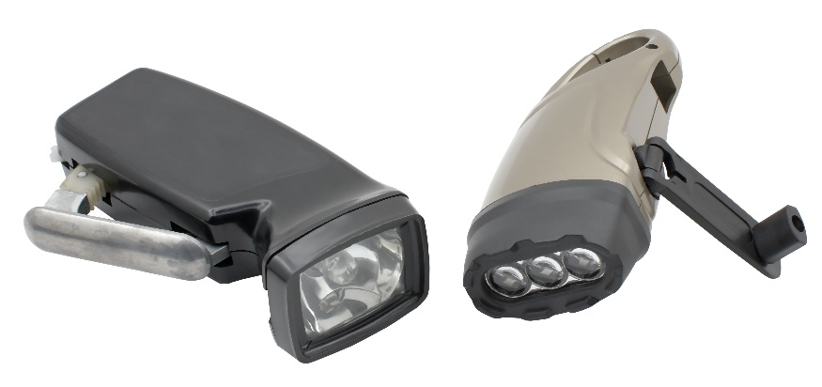
Investigation: Tracking Energy Flow
Energy-Flow Diagram for Hand-Crank Flashlight
Draw This
Not This
Hand-Crank Flashlight and Hand
Photo courtesy of Stock.Adobe.com
Notes:
Image is from EMAT Coal unit—OPB took it

Slide 8
Investigation: Tracking Energy Flow
Energy-Flow Diagram for Hand-Crank Flashlight
Hand-Crank Flashlight and Hand
Motion
Energy

Slide 9
Be an Energy Detective!
What did you detect when I cranked the flashlight?
What kind of energy did you detect? How did you detect it?
How did the energy change costumes?

Slide 10
Investigation: Tracking Energy Flow
Energy-Flow Diagram for Hand-Crank Flashlight
Hand-Crank Flashlight and Hand
Sound
Motion
Energy
Light

Slide 11
Key Science Ideas
All of the energy in the flashlight came from somewhere and went somewhere.
We can use an energy-flow diagram to describe the energy transfers and transformations that happened with the flashlight.
Motion energy transferred from my hand to the flashlight. Then the motion energy changed costumes or transformed into sound energy and light energy.

Slide 12
Create an Energy-Flow Diagram
Review the energy words and science ideas you highlighted in handout 5.1 (Mumford and Leroy’s Big Crash, Part 4).
Using these energy words and ideas, work with a partner to design an energy-flow diagram that describes what happened to the energy in Mumford and Leroy’s big crash!
Keep the focus questions in mind: Where did the energy come from? Where did it go?

Slide 13
Our Energy-Flow Diagrams
Questions:
Where does the diagram show evidence of energy transfer and transformation?
Does the diagram show that all of the energy came from somewhere and went somewhere?
Sentence starters:
I notice …
What do you mean when you say …?
I [agree/disagree] with _______ because …
That idea makes sense to me because …

Slide 14
Comparing Our Energy-Flow Diagrams
Mumford and Leroy’s Big Crash!
Kinetic Energy (Leroy)
Sound
Potential
Energy
(Mumford)
Kinetic
Energy
(Mumford)
Light
Heat
Does your energy-flow diagram look something like this? Do you want to make any changes to your diagram?

Slide 15
Let’s Summarize!
Today’s focus questions: Where does energy come from? Where does it go?
How do you think an energy-flow diagram can help us answer these questions?
Sentence starter: An energy-flow diagram can help us understand where energy comes from and where it goes by ____________________.
Does energy ever disappear?
Sentence starter: I think energy [does/doesn’t ever] disappear because ____________.

Slide 16
Next Time
In the next lesson, we’ll create more energy-flow diagrams showing where energy comes from and where it goes in other kinds of objects.

