Slide 1
energy transfer Lesson 5b
Where Does Energy Come From?
Where Does It Go?

Slide 2
Does Energy Ever Disappear?
How did you complete this sentence last time?
I think energy [does/doesn’t ever] disappear because ___________.

Slide 3
Today’s Focus Questions
Where does energy come from? Where does it go?

Slide 4
Review: Potential Energy
What is potential energy?
Can you give an example of something that has potential energy?

Slide 5
Key Science Ideas
Potential energy is another way of saying that energy is stored.
Objects that are above ground level, like at the top of a hill or ramp, have stored energy.
Other kinds of objects can have stored energy too.

Slide 6
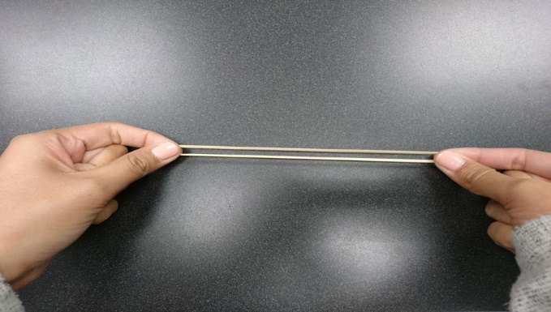
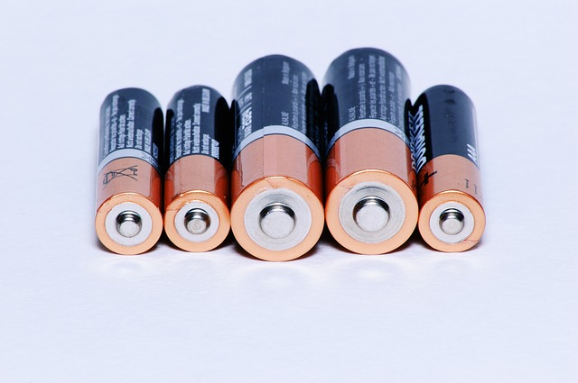
Ideas about Potential Energy
Do these objects have stored (potential) energy? Explain your ideas.
Photo courtesy of Cal Poly Pomona
Photo courtesy of Pexels.com
Photo courtesy of Pixabay.com

Slide 7
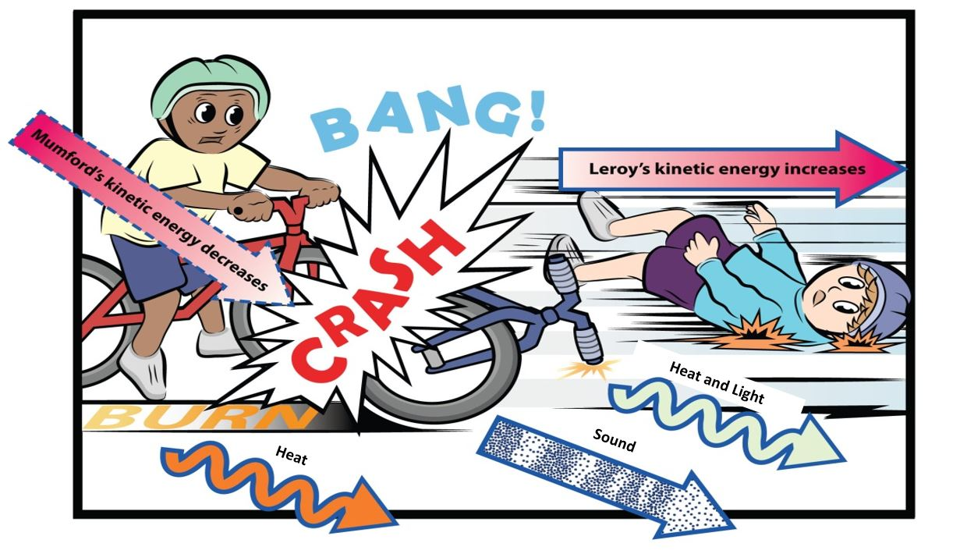
Mumford and Leroy’s Big Crash!
Courtesy of BSCS
The arrows in this picture track where energy came from and where it went.

Slide 8
Mumford and Leroy’s Big Crash!
Courtesy of BSCS
Notice that two of the arrows show energy moving away from the crash as HEAT.

Slide 9
Key Science Ideas
Energy is never used up or destroyed.
Energy doesn’t disappear, but it does change forms.
In any interaction, some energy changes into heat energy.
All useful forms of energy eventually change into heat energy.
Think about these ideas as you work on your energy-flow diagrams.

Slide 10
Investigation: Energy Flow in Objects
This is your assignment as an energy detective:
Choose one object from the bag and examine it.
Identify at least two different forms of energy (energy costumes).
Draw and label an energy-flow diagram showing where energy comes from and where it goes in your object. Also show where energy changes costumes into different forms.
Make sure to use arrows, and don’t forget about potential energy!

Slide 11
Investigation: Energy Flow in Objects
If you’re sharing:
Demonstrate your device and explain your energy-flow diagram.
Ask teammates how you could improve your diagram. Then make revisions based on their input.
If you’re listening:
Do you agree or disagree with your teammates’ ideas?
Do you questions or comments?
What improvements can you suggest?

Slide 12
Investigation: Energy Flow in Objects
Listen carefully as your classmates share their energy-flow diagrams and explanations.
Do you agree or disagree?
Do you have any questions or ideas to add?
Can you suggest any improvements?

Slide 13
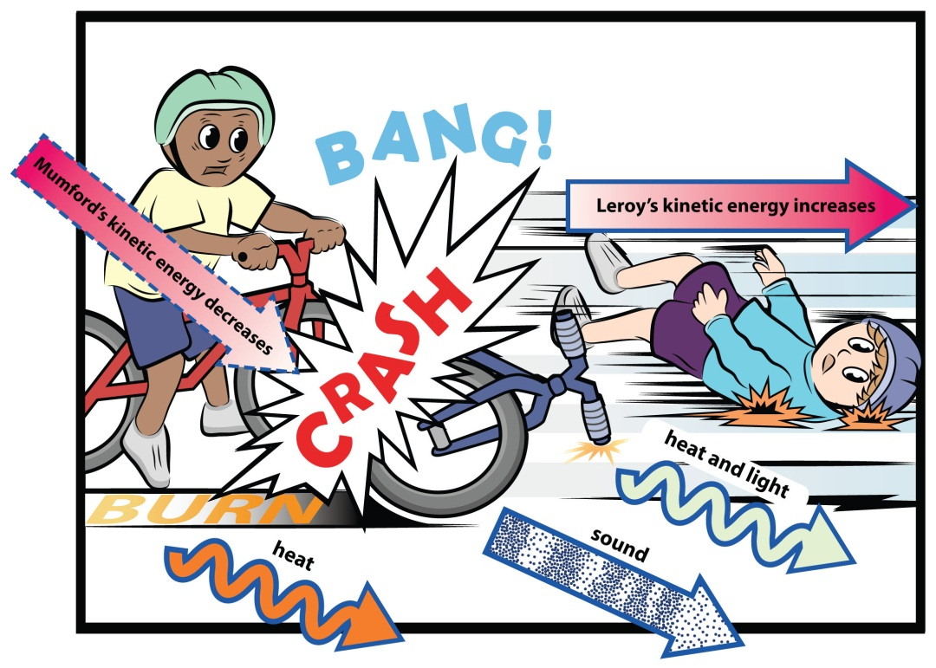
Mumford and Leroy’s Big Crash!
Courtesy of BSCS
What energy transfers happened in Mumford and Leroy’s crash?

Slide 14
Let’s Summarize!
Key science ideas:
Energy can move or transfer from object to object.
Energy can change costumes or transform into different forms of energy.
Energy isn’t created or destroyed, and it never disappears. It may look, sound, or feel different when it changes forms, but it’s still energy.
We can detect energy changes in objects and represent them in an energy-flow diagram.

Slide 15
Let’s Summarize!
Focus questions: Where does energy come from? Where does it go?
Write a caption (4 or 5 sentences) describing the energy transfers and changes (transformations) in your energy-flow diagram.
Make sure to include these science ideas:
Energy can move or transfer from object to object.
Energy can change costumes or transform into different forms of energy.
Energy isn’t created or destroyed. It may look, sound, or feel different when it changes forms, but it’s still energy.

Slide 16
Next Time
Mumford needs your help creating a device that lets the Thompsons know their paper has been delivered.
Do you think you can help Mumford solve his problem? Be prepared to share your ideas next time.

