Slide 1
energy transfer Lesson 6a
How Can Knowing about Energy Help to Solve Problems?

Slide 2
Review: Energy-Flow Diagrams
In previous lessons, we created energy-flow diagrams to show how energy moves and changes in different objects.
What did those diagrams show us about how energy moves and changes?

Slide 3
Today’s Focus Question
How can knowing about energy help us solve problems?

Slide 4
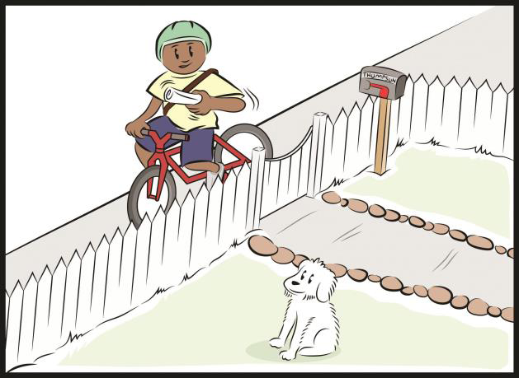
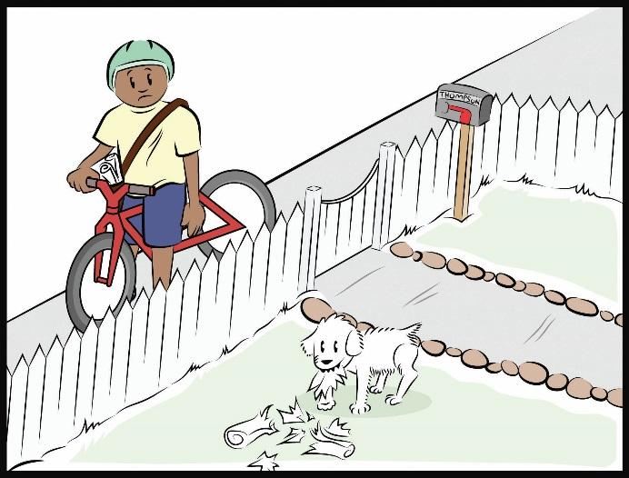
Investigation: Solving Mumford’s Problem
Let’s review Mumford’s problem.
What ideas can you think of for solving his problem? (Don’t forget about energy!)
Courtesy of BSCS
Courtesy of BSCS

Slide 5
Investigation: Solving Mumford’s Problem
Reminders:
Carefully follow the guidelines on your handout.
Make sure to check off each requirement on the list as you complete it.
To solve this problem, your device needs to include at least one energy transfer or energy transformation (change).
The key to success is showing how energy can be used to solve Mumford’s problem.
Your device doesn’t need to be complicated. A simple design is best!

Slide 6
Did You Solve Mumford’s Problem?
Make a sketch of your device in your notebook.
Talk about these questions with your teammates:
Does your device include an energy transfer and/or an energy transformation?
Does your device ring the bell? If not, what changes can you make so your device will ring the bell? (Think about how energy moves and changes in your device!)
Is each member of your team prepared to answer questions about your device?

Slide 7
Let’s Summarize!
Our focus question: How can knowing about energy help us solve problems?
Answers these questions in your science notebook:
Where does energy move from place to place or from object to object in your device?
Where does energy change costumes or transform into another kind of energy in your device?
Does your device have potential energy? If so, where?

Slide 8
Next Time
You came up with some creative ways to solve Mumford’s paper-delivery problem!
Next time, you’ll create diagrams showing how energy moves and changes in your device.
Isn’t it fun using what we’ve learned about energy to solve everyday problems?

