Slide 1
Food Webs Lesson 1a
What Is Food?

Slide 2
Unit Central Question
How do living things depend on one another to get the food (matter and energy) they need to live and grow?

Slide 3
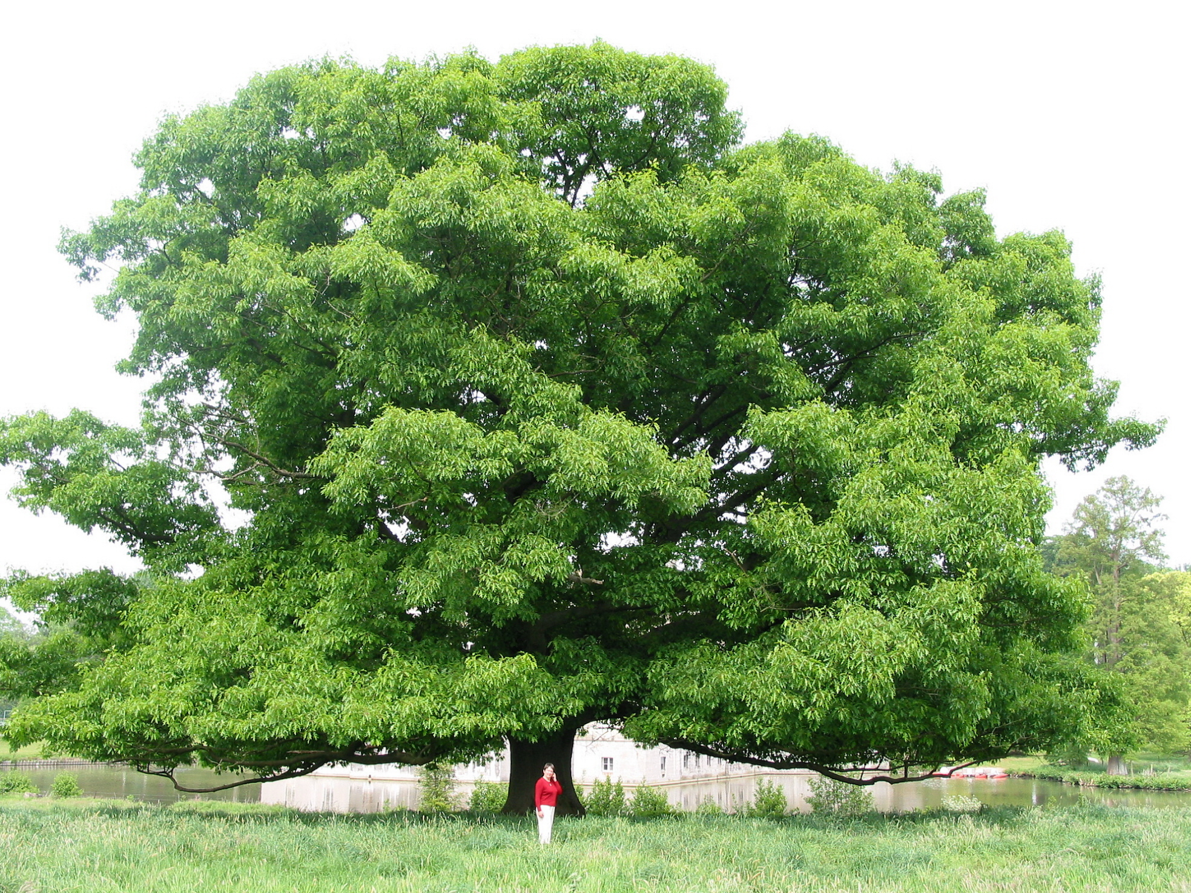
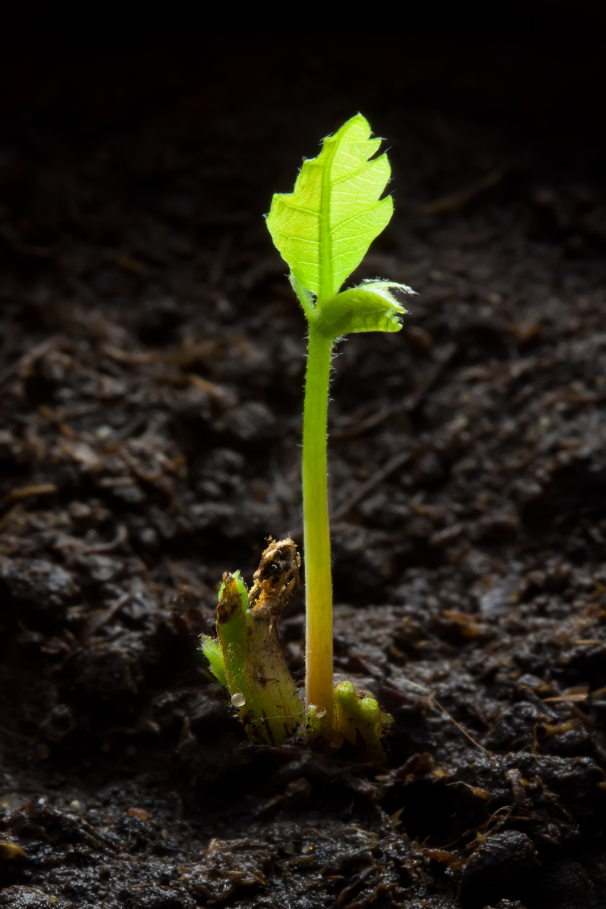
Photograph by Jean-Pol Grandmont
Photograph by Fotofermer
Notes:
2-day newborn oak sapling
Large Quercus rubra, Red Oak Tree

Slide 4
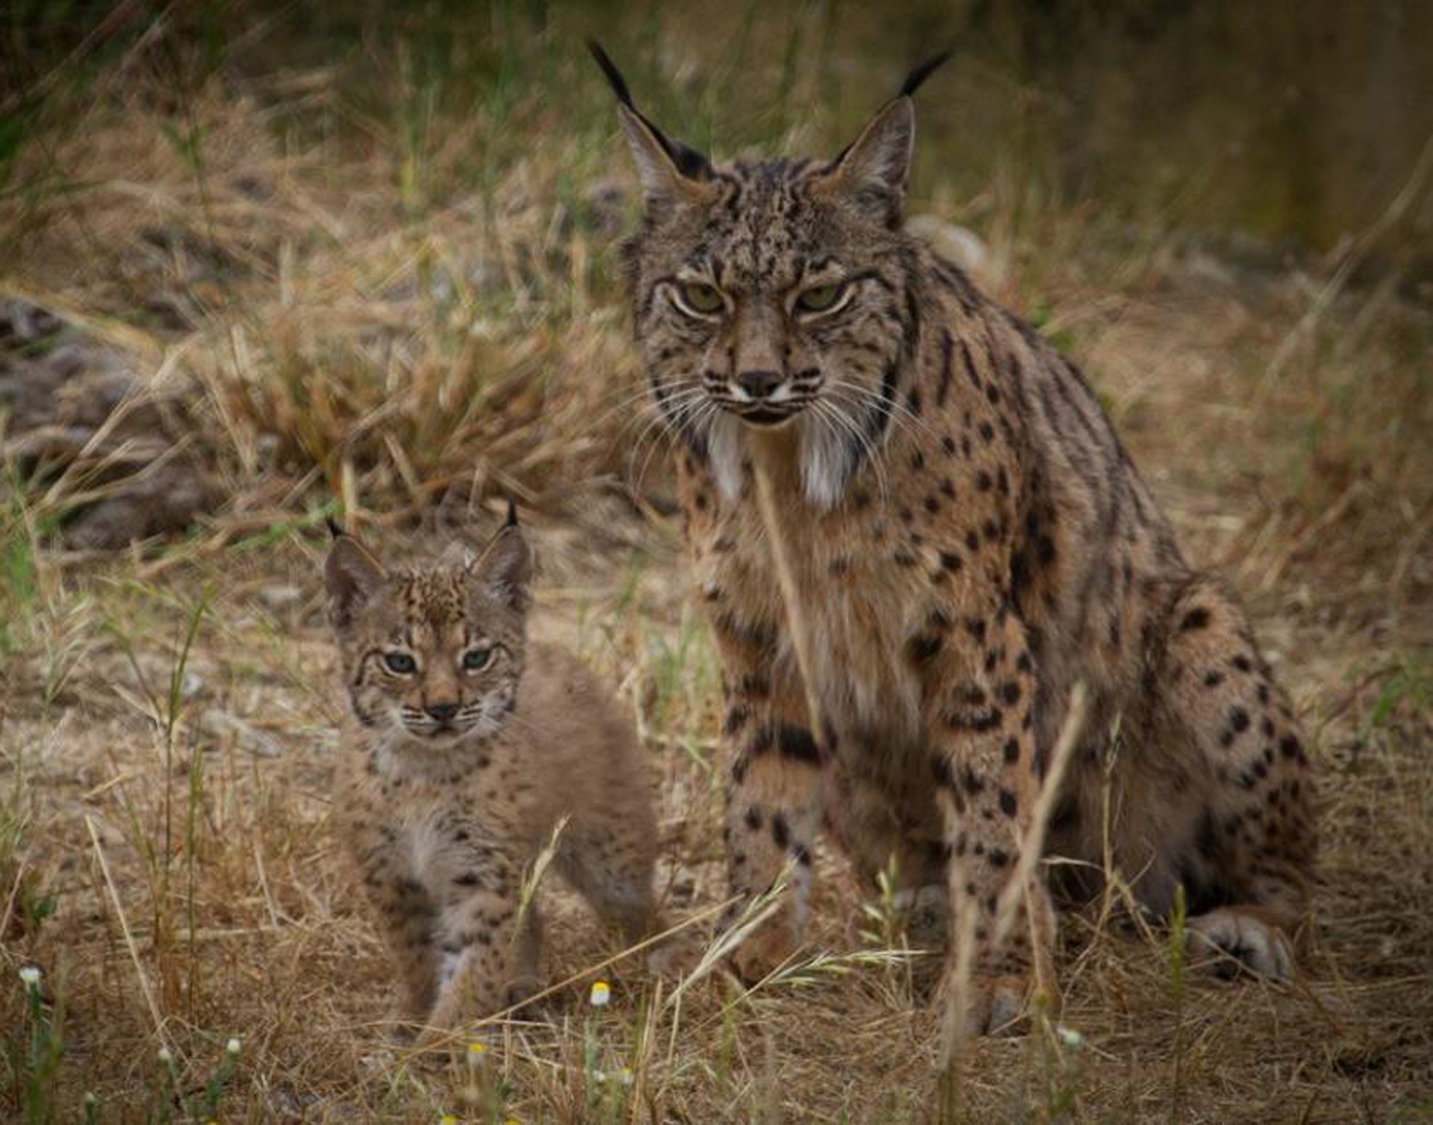
Photo courtesy of Lynxexsitu.es
Notes:
Lynx

Slide 5
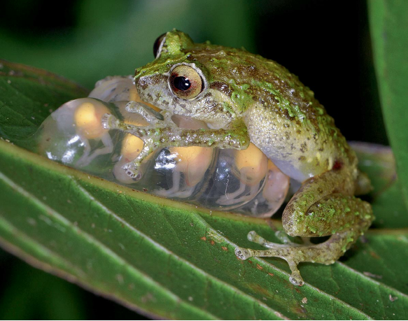
Photograph by Gregory Johnston
Notes:
Frog guarding froglets

Slide 6
Photo courtesy of Pixabay.com
Notes:
Brown bear and cub

Slide 7
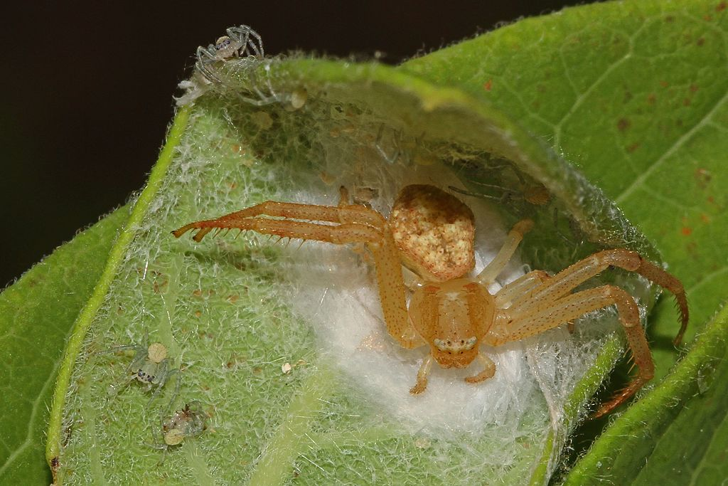
Photo courtesy of Wikimedia.org
Notes:
Spider and babies

Slide 8
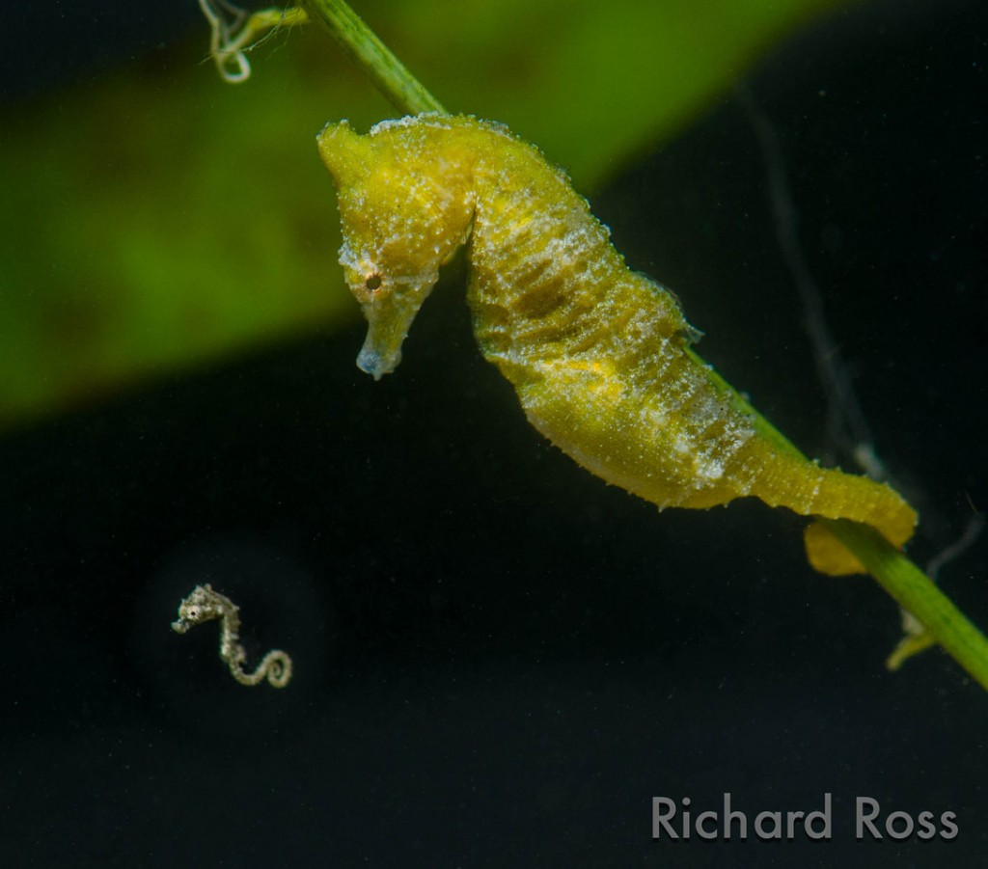
Photograph by Richard Ross
Notes:
Seahorse and baby

Slide 9
Photo courtesy of Pixabay.com
Notes:
Polar bear and cubs

Slide 10
Today’s Focus Question
What is food?

Slide 11
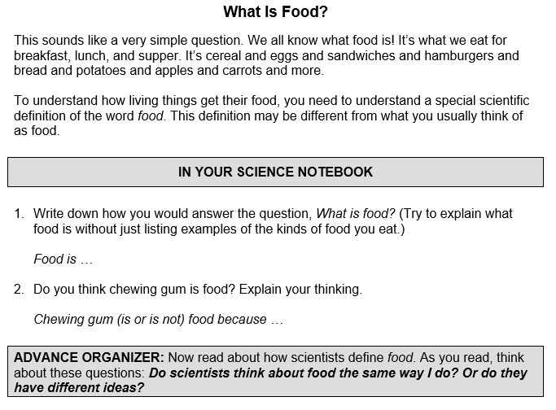
What Is Food? Your Ideas

Slide 12
Scientific Definition of Food
Food is matter (building materials) that contains energy living things can use to live and grow, to heal wounds, and to keep all their parts working.

Slide 13
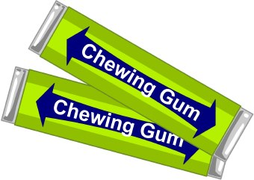
Is Chewing Gum Food?
Turn and Talk: How do we know whether chewing gum is matter that contains energy living things can use to live and grow?

Slide 14
Is Chewing Gum Food?
Material | Does It Have Mass (g)? (An Indicator That It’s Matter) | Does It Have Calories? (A Measure of Energy) | Is It Food by the Scientific Definition?
Chewing Gum #1
Chewing Gum #2

Slide 15
Is Chewing Gum #1 Food?

Slide 16
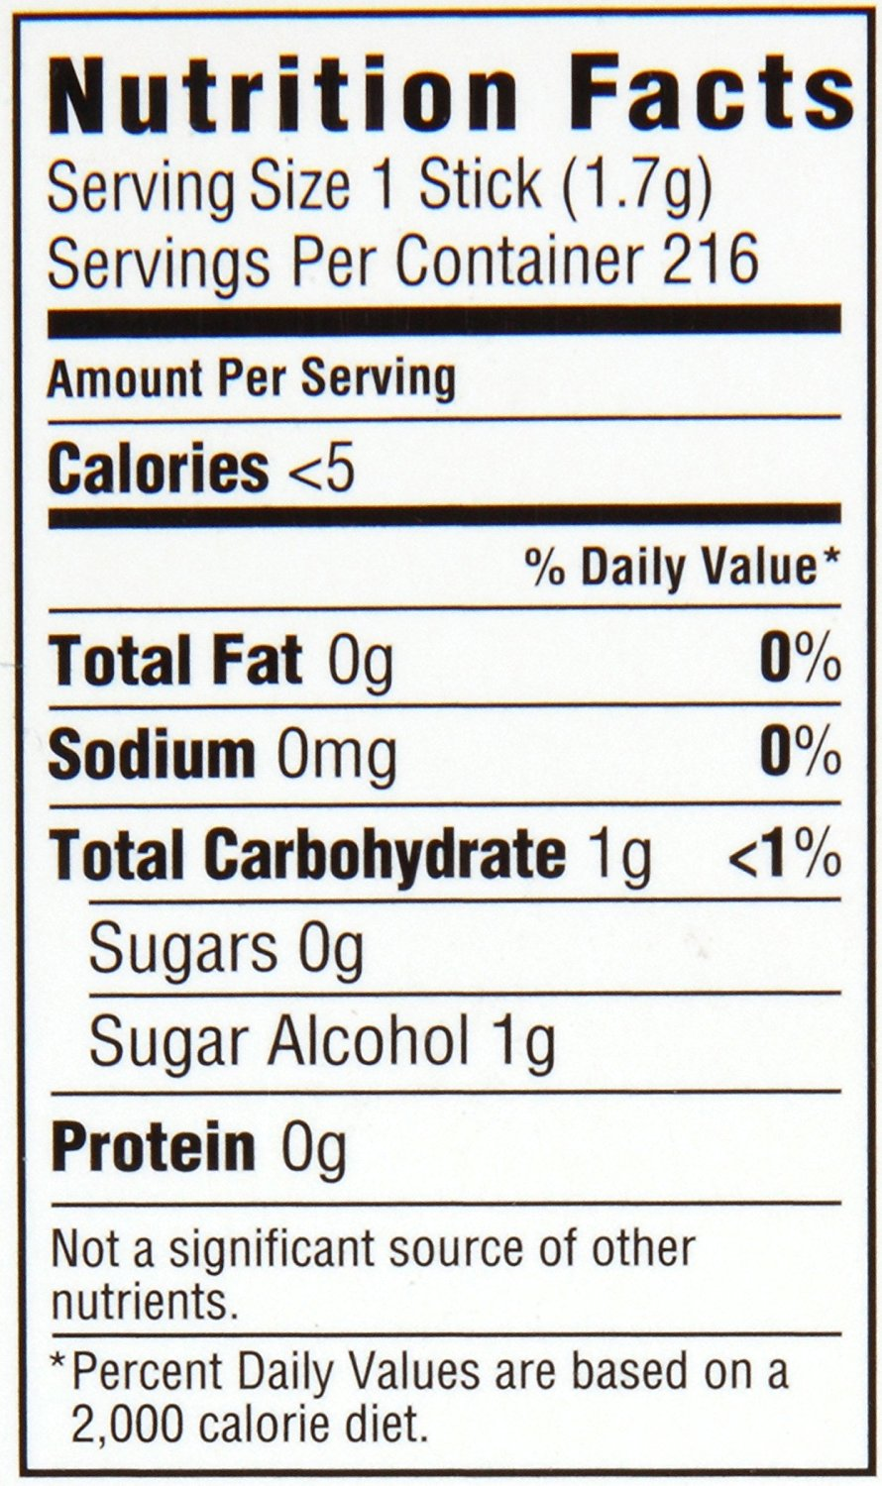
Is Chewing Gum #2 Food?

Slide 17
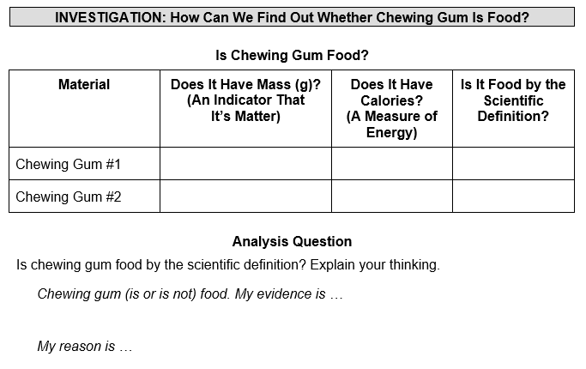
Is Chewing Gum Food by the Scientific Definition?

Slide 18
Focus Question
What is food?
Food is matter (building materials) that contains energy living things can use to live and grow, to heal wounds, and to keep all their parts working.

Slide 19
Let’s Summarize!
What new ideas do you have about the focus question, What is food?
Be ready to share your ideas with the class using one of these sentence starters:
I learned …
My new ideas are …

Slide 20
Next Time
Tomorrow we’ll explore this question: Do living things take in (“eat”) materials that are not food?

