Slide 1
Food Webs Lesson 3a
How Do Plants Grow Bigger?

Slide 2
Yesterday’s Focus Question
What is food for plants?

Slide 3
What Is Food for Plants?
Share your sentences for answering this question with a partner and help each other improve them.
1. Make sure all of these words were used:
2. Then ask your partner one clarification question:
What do you mean when you say …?
Can you say more about …?
Are you saying that …?
Carbon dioxide
Matter
Sunlight
Energy
Food
Water
Producers

Slide 4
Is It Food for Plants?
Water
Carbon dioxide
Sunlight
Soil
Minerals in the soil (“plant food”)
Food/sugar made in the leaves of plants

Slide 5
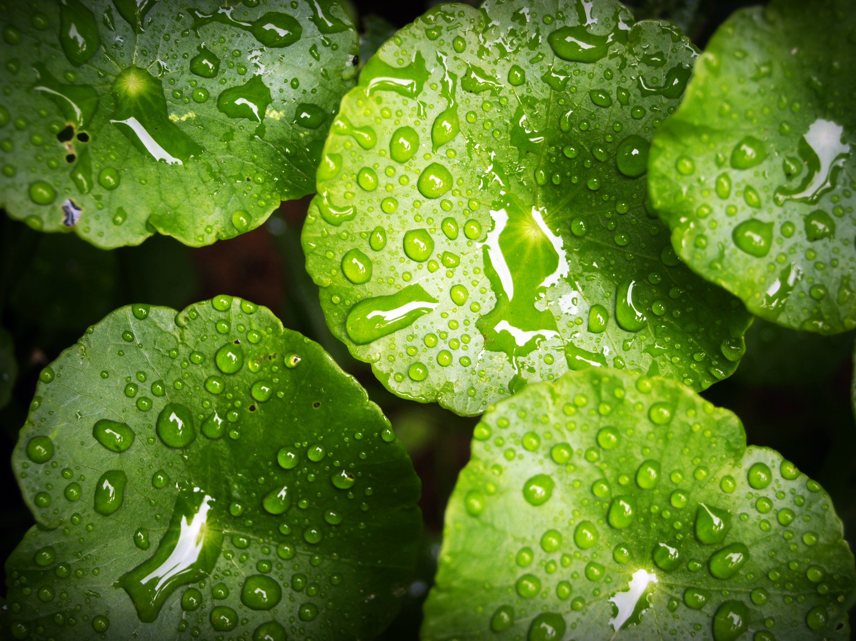
Plants Are Producers That Make Food
Light Energy
Water
Plant makes food molecules (sugar)
Carbon Dioxide
Photo courtesy of Pexels.com
Matter that doesn’t provide energy for living things
Matter that contains stored energy for living things to use

Slide 6
Today’s Focus Question
How do plants grow bigger?

Slide 7
Time-Lapse Video
First, let’s watch tomato seedlings grow.
Link to video clip: http://www.youtube.com/watch?v=LICDb8nM5rs

Slide 8
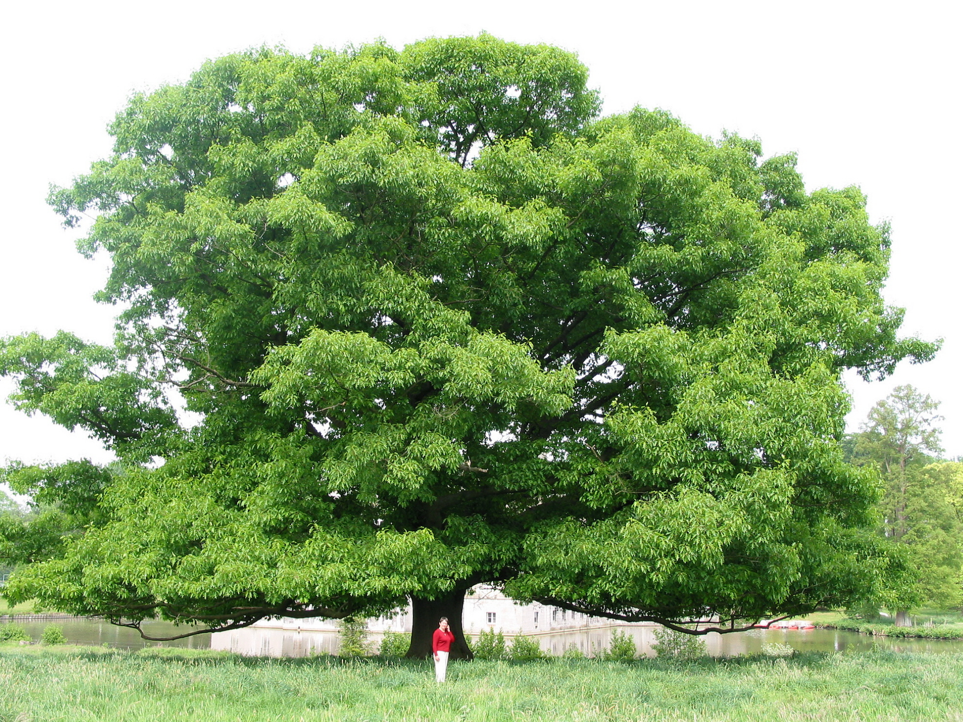
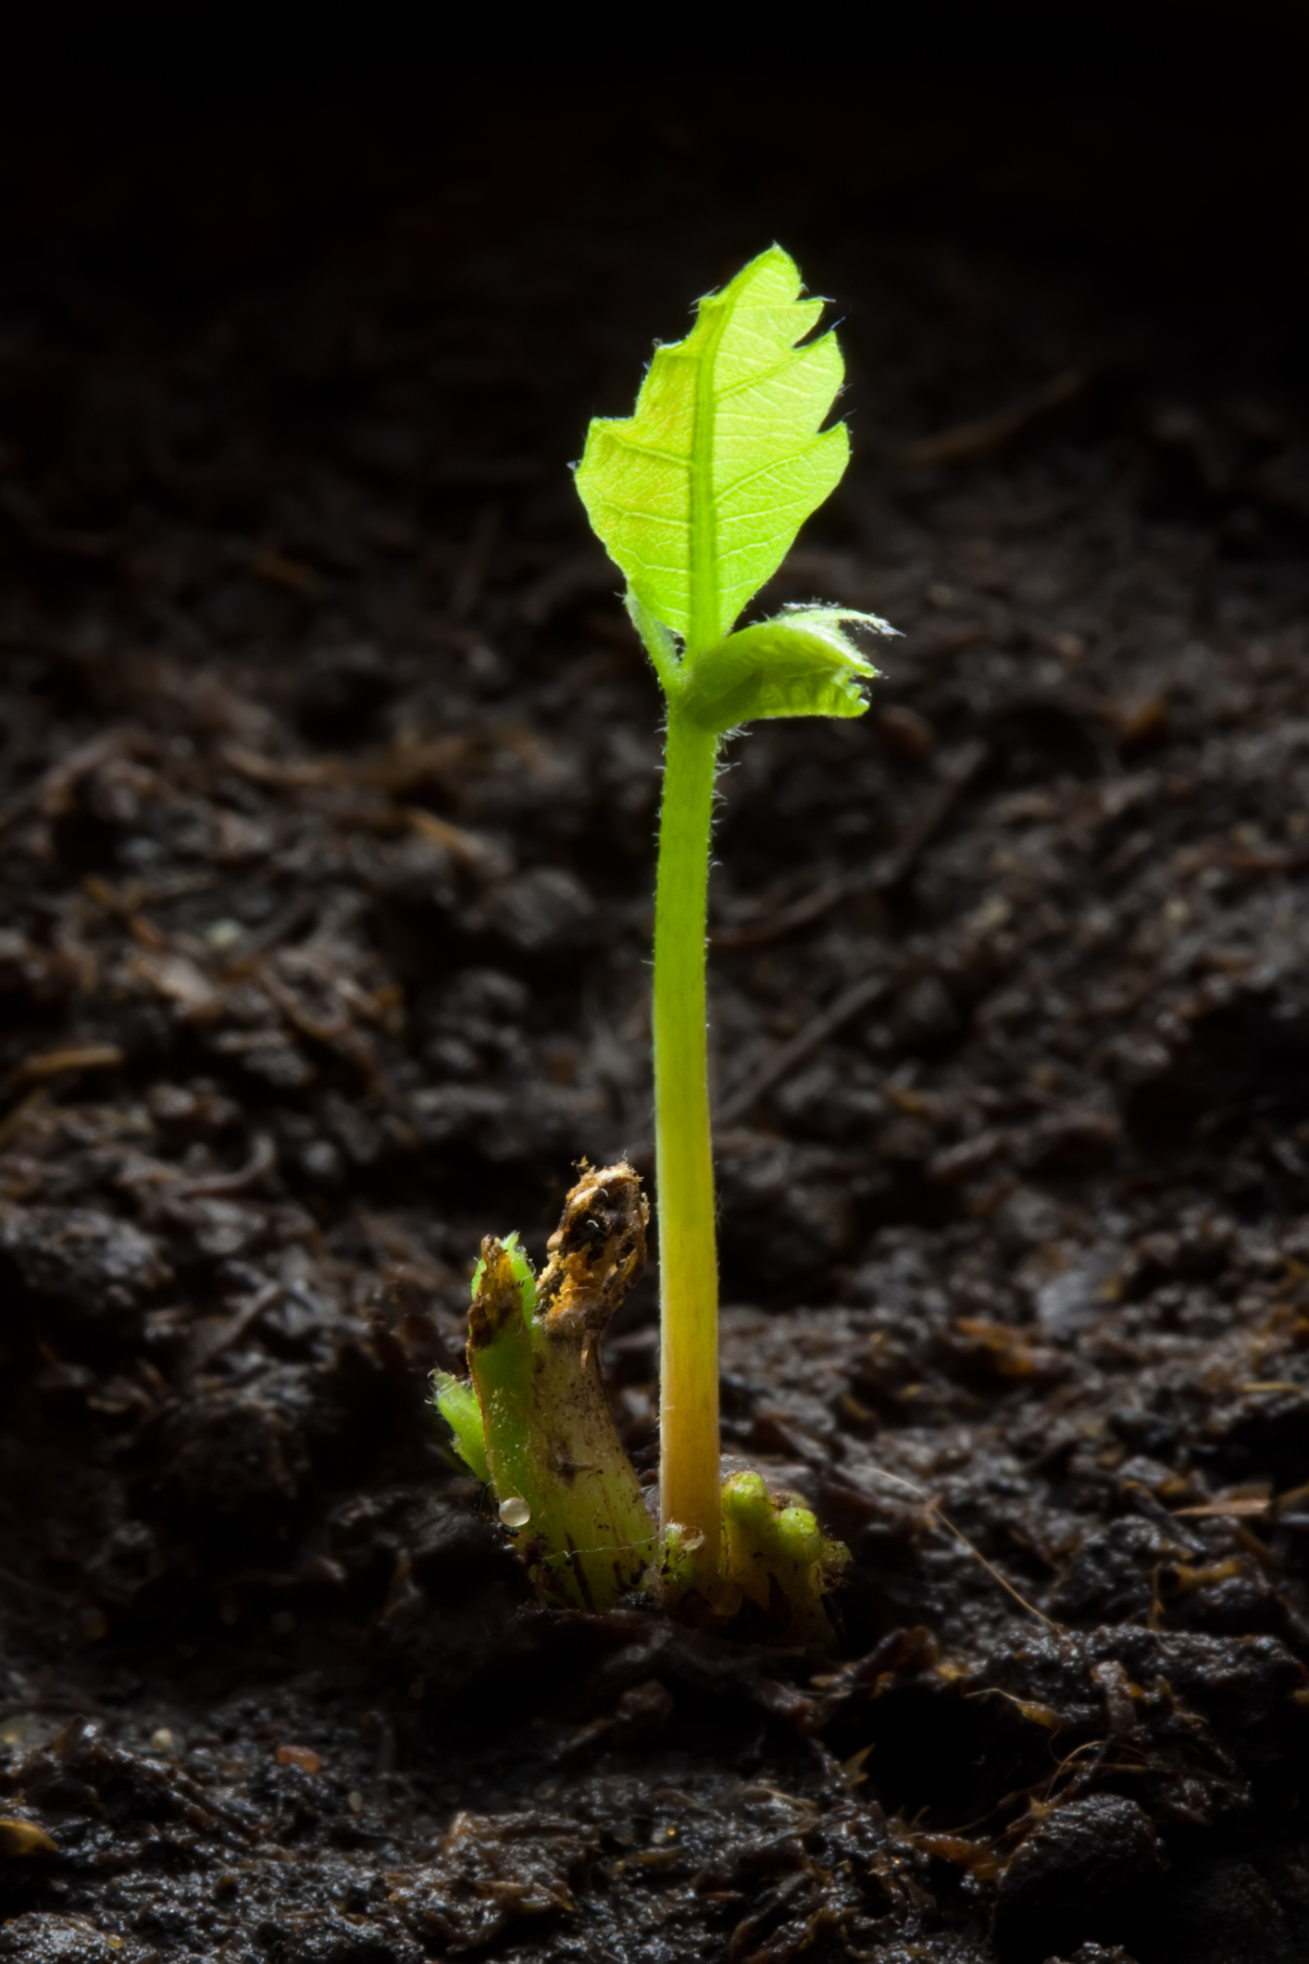
From an Acorn to a Full-Grown Tree!
Photograph by Fotofermer
Photograph by Jean-Pol Grandmont
Notes:
Oak seedling and tree

Slide 9
Building Organisms: Three Kinds of Matter
Water Molecule (H₂O)
Food Molecule (Sugar)
Carbon-Dioxide Molecule (CO₂)

Slide 10
How Does a Tree Grow Bigger?

Slide 11
A Diagram of How Plants Grow Bigger
Let’s add words, arrows, and drawings to show how plants grow bigger.

Slide 12
Let’s Summarize!
How do plants grow bigger?
They take carbon dioxide and water from their environment and light energy from the Sun and make tiny food particles called molecules.
Plants use these molecules to grow BIGGER and BIGGER!

Slide 13
Next Time
Tomorrow we’ll explore the question, How do animals grow bigger?

