Slide 1
Food Webs Lesson 3b
How Do Animals Grow Bigger?

Slide 2
Last Time
What did we find out in our last lesson about how plants grow bigger?

Slide 3
Today’s Focus Question
How do animals grow bigger?

Slide 4
Time-Lapse Video and Pictures of Animals
As you watch this video and look at the following pictures, think about this question:
Do animals grow bigger in the same way plants do, or in a different way?
Link to video clip: http://www.youtube.com/watch?v=ISYBpayqL-0

Slide 5
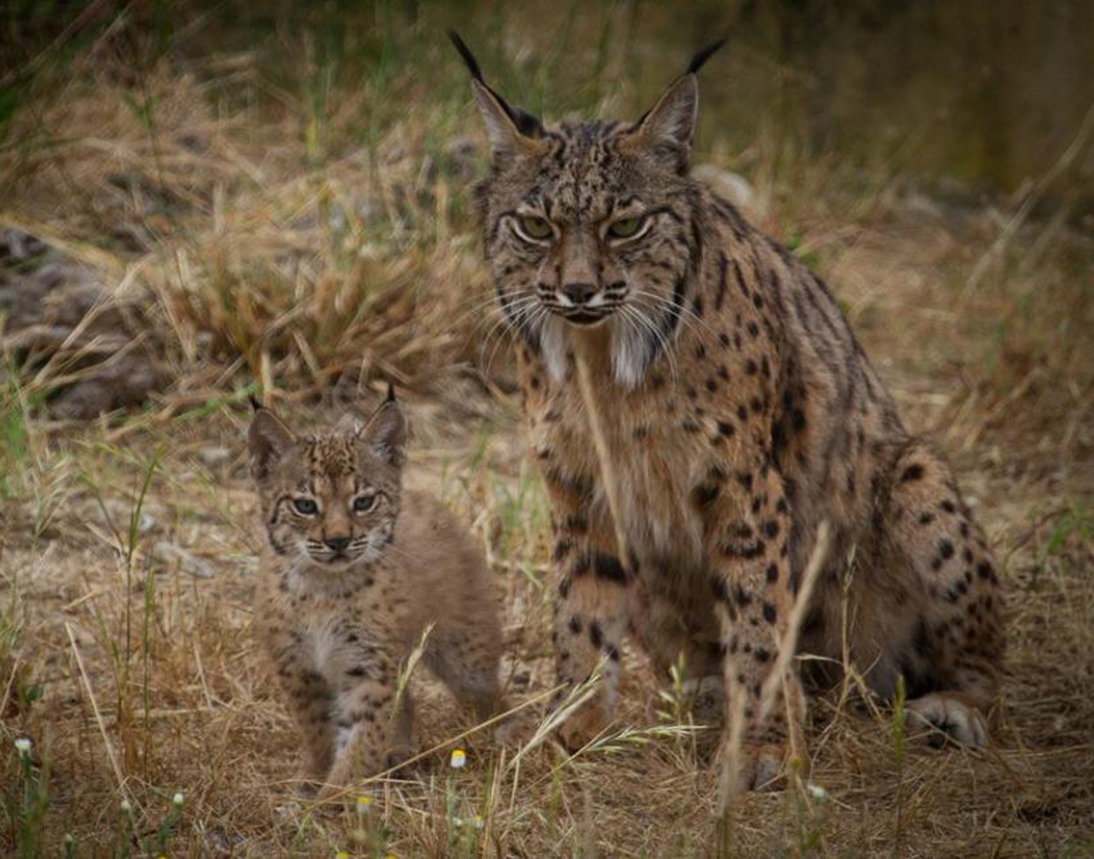
Photo courtesy of Lynxexsitu.es
Notes:
Lynx

Slide 6
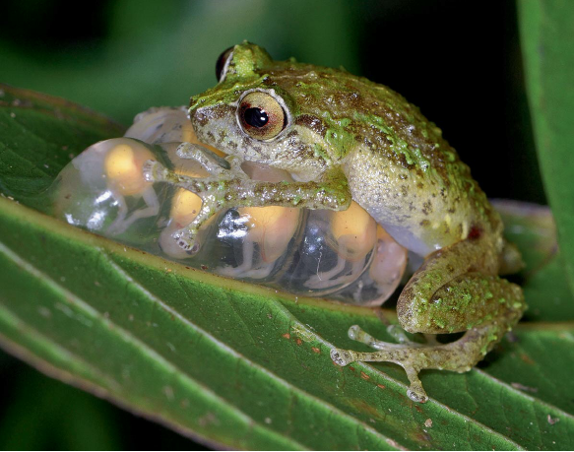
Photograph by Gregory Johnston
Notes:
Frog guarding froglets

Slide 7
Photo courtesy of Pixabay.com
Notes:
Brown bear and cub

Slide 8
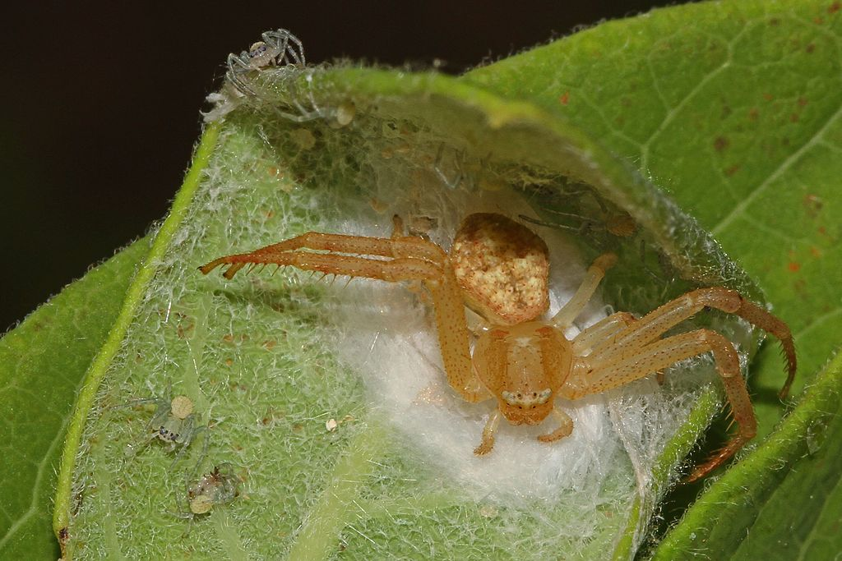
Photo courtesy of Wikimedia.org
Notes:
Spider and babies

Slide 9
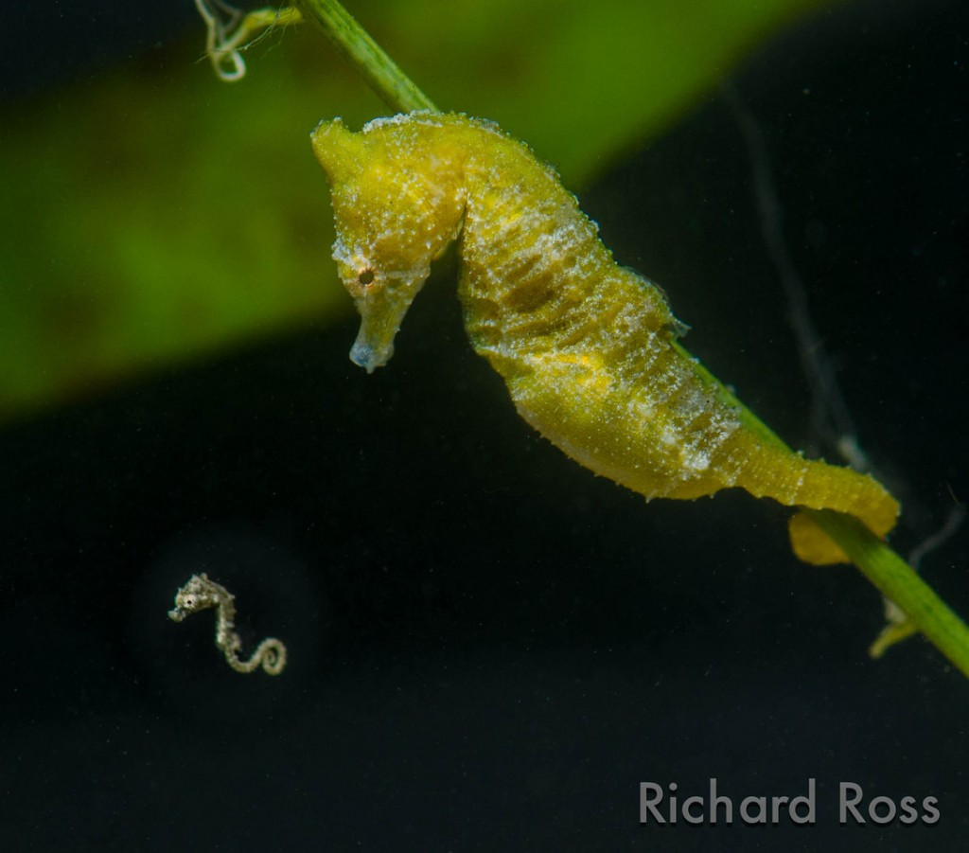
Photograph by Richard Ross
Notes:
Seahorse and baby

Slide 10
Photo courtesy of Pixabay.com
Notes:
Polar bear and cubs

Slide 11
Building Organisms: Three Kinds of Matter
Water Molecule (H₂O)
Food Molecule (Sugar)
Carbon-Dioxide Molecule (CO₂)

Slide 12
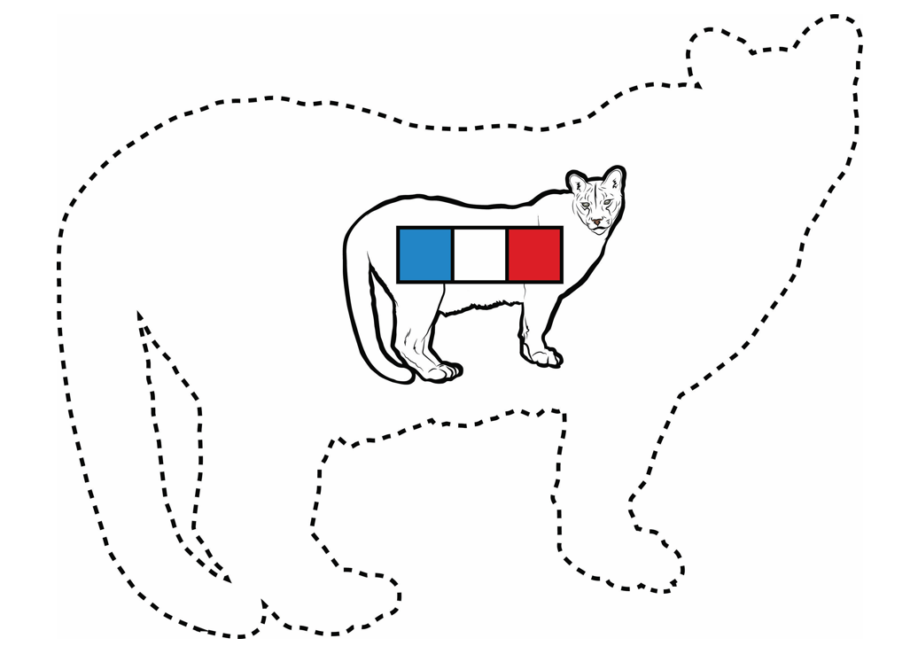
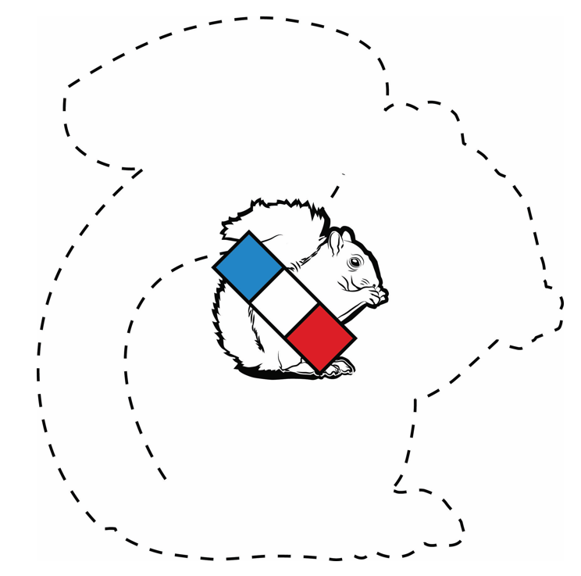
How Do Animals Grow Bigger?

Slide 13
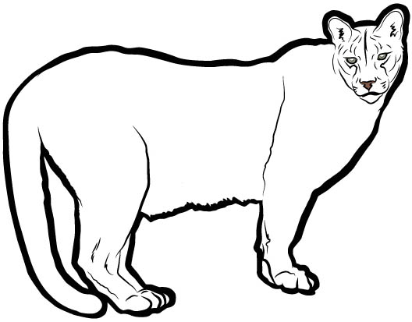
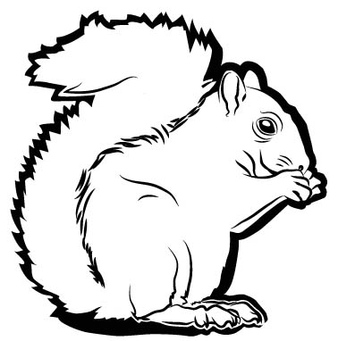
How Do Animals Grow Bigger?
What words, arrows, and drawings can we add to this diagram to show how these living things grow bigger?

Slide 14
Discussion Question
Where did the matter in the mountain lion’s food come from at the very beginning?
Carbon-Dioxide Molecule in the Air
Water Molecule in the Soil

Slide 15
Scientific Names for Relationships among Organisms
FOOD CHAIN
Producer
Consumer
Consumer

Slide 16
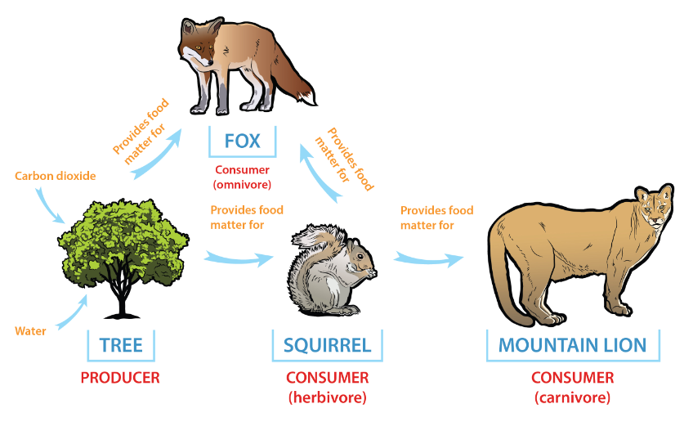
Tracing Matter in a Food Chain
Carbon Dioxide
PRODUCER
CONSUMER
(Herbivore)
CONSUMER
(Carnivore)

Slide 17
Understanding New Words
VORE means “to devour” or “to eat” in Latin.
Three kinds of animals “devour” (VORE) other organisms:
HERBIVORES “devour” herbs, which are plants or vegetation.
CARNIVORES “devour” meat. (Carne means “meat” in Spanish.)
OMNIVORES “devour” both plants and animals. (Omni means “all” in Latin.)

Slide 18
Make a Food-Chain Diagram: Part 1
Write this title at the top of your diagram: How Matter Moves in a Food Chain
Pick 3 or 4 organisms from this list:
Bush with berries Small bird Squirrel Raccoon Deer Oak tree with acorns Hawk Grass
Grasshopper Wolf
Draw a diagram with arrows and label your arrows “provides food matter for.”
Label the organisms in your food chain as either producers or consumers.

Slide 19
Make a Food-Chain Diagram: Part 2
Write two sentences underneath your diagram:
Producers grow by __________.
Consumers grow by __________.
Word Bank
Energy Matter
Molecules Carbon dioxide
Water Sun
Food
Use as many words from the word bank as you can.

Slide 20
Let’s Summarize!
How do animals grow bigger?
New scientific words we learned today:
Food chain
Producers
Consumers
Herbivores
Carnivores
Omnivores

Slide 21
Assessing Your Food-Chain Diagram
Does your food chain start with a plant?
Did you label the plant a producer?
Did you draw an arrow from the plant to an animal? Did you label this animal a consumer and either an herbivore or an omnivore?
Did you draw an arrow from this animal to another animal that eats it? Did you label this new animal a consumer and a carnivore?
Are your arrows labeled “provides matter for”?
Bonus: Does your food chain include more than three organisms?

Slide 22
Assessing Your Food-Chain Sentences
Does your sentence about producers (plants) say they use sunlight, carbon dioxide, and water to make their own food?
Does your sentence about consumers say they get food molecules by eating plants or other animals that eat plants?
Do both of your sentences say that plants and animals use food molecules to grow bigger?
Bonus: Do your sentences mention that only producers (plants) can make their own food?

Slide 23
Next Time
Tomorrow we’ll discuss your food-chain diagrams and explore this question: What happens to matter as it moves from organism to organism in a food chain?

