Slide 1
Food Webs Lesson 4a
What Happens to Matter as It Moves from Organism to Organism in a Food Chain?

Slide 2
Last Time
Our focus question last time was How do animals grow bigger?
During our lesson, we talked how organisms use food matter (molecules) to grow and how that matter is passed from one organism to another.
Let’s look at some examples of the food-chain diagrams we drew.

Slide 3
Today’s Focus Question
What happens to matter as it moves from organism to organism in a food chain?

Slide 4
What Do We Already Know about Matter?
What is matter?
What are some examples of matter that living things use?
Are plants and animals matter?
What do we call the smallest pieces of matter?
What do living things like a tree, a squirrel, and a mountain lion do with matter?

Slide 5
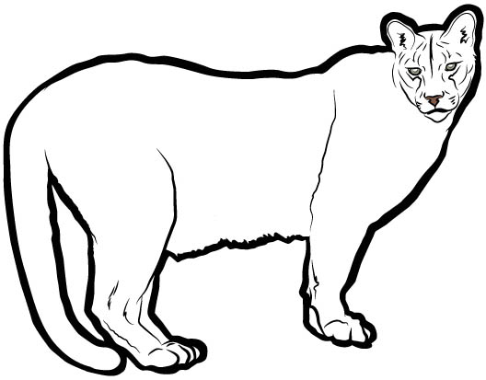
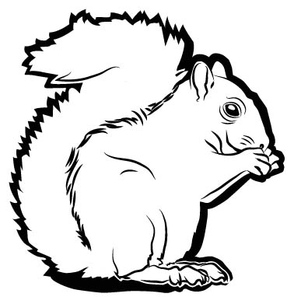
What Happens to the Molecules?
Use your linking cubes to show what happens to the water and carbon-dioxide molecules.
Carbon-Dioxide Molecule (CO₂)
Water Molecule (H₂O)

Slide 6
What Happens to Matter in the Tree?
1. | 2.
3. | 4.
5.
Draw this chart in your notebooks. Then write and draw in boxes 1 and 2 to show two things that happen to matter in the tree.

Slide 7
Today’s Focus Question
What happens to matter as it moves from organism to organism in a food chain?

Slide 8
Tree Chart
Let’s start a class chart to summarize key ideas about the tree.
What are two things the tree does with matter?

Slide 9
A Complicated Story
What happens to matter as it moves from organism to organism in a food chain?

Slide 10
What a Tree Does with Matter
Use linking cubes to show the tree making food and growing.
Use up all of your carbon-dioxide and water molecules to make food molecules in the tree.
Put leftover oxygen “atoms” in the oxygen bowl (or in the air around the tree).
Show how the tree grows bigger with all these food molecules.

Slide 11
Other Uses for the Food Molecules
What else can the tree do with the food molecules besides using them to grow? What else do food molecules contain besides matter?
The tree needs energy to live, so it breaks down the food molecules to release the stored energy.
Break apart four food molecules (linking cubes). The clicking sound you hear represents energy being released.
The tree uses this energy to live. But what happens to the leftover pieces of matter?

Slide 12
What Happens to the Leftovers?
In nature, the leftover pieces of matter immediately start matching up to make CO₂ and H₂O molecules.
So use your leftover pieces to make as many CO₂ and H₂O molecules as you can. If you need more oxygen molecules, take them from the oxygen bowl (or from the air around the tree).
Put your new CO₂ and H₂O molecules in their labeled bowls.

Slide 13
Other Uses for the Food Molecules
What else can the tree do with the food molecules it made?
Some of the matter can fall to the ground as wastes—like when leaves, branches, berries, or nuts fall to the ground.
So drop one food molecule into the bowl labeled Wastes.

Slide 14
How the Tree Uses Food Molecules
To grow bigger
To get energy (and give off CO₂ and H₂O)
As wastes that fall to the ground
And one more thing …

Slide 15
What Else Happens to the Food Matter?
It gets passed on to another organism!
So move nine food molecules from the tree to the squirrel.
What does this matter help the squirrel do?
Grow bigger!

Slide 16
Let’s Add to Our Tree Chart
What are five things that can happen to the matter in the tree?
We already have two things on our chart. Let’s add three more!

Slide 17
What Happens to Matter in the Tree?
Write and draw in boxes 3, 4, and 5 to show three more things that can happen to matter in the tree.
1. | 2.
3. | 4.
5.

Slide 18
What Happens to Matter in the Squirrel?
Draw a new chart in your notebooks. Then in box 1, draw and write about one thing that can happen to the food matter the squirrel takes from the tree.
1. | 2.
3. | 4.

Slide 19
Squirrel Chart
Let’s start a new class chart for the squirrel.
What is one thing that can happen to the food matter the squirrel gets from the tree?

Slide 20
Other Uses for the Food Molecules
What else can the squirrel do with the food matter?
Just like the tree, the squirrel uses food matter for … energy!
So take apart two of the squirrel’s food molecules to release energy.
What do you think you should do with the leftover pieces of matter?
Yes! Make CO₂ and H₂O molecules and put them in the appropriate bowls.

Slide 21
Other Uses for the Food Molecules
What else can the squirrel do with the food molecules?
It leaves wastes on the ground!
So take one food molecule and put it in the bowl labeled Wastes.

Slide 22
What Else Happens to the Food Matter?
One day a mountain lion eats part of the squirrel.
So move five food molecules from the squirrel to the mountain lion.

Slide 23
Let’s Add to Our Squirrel Chart
What are four things that can happen to the food matter in the squirrel?
We already have one thing on our chart. Let’s add three more.

Slide 24
What Happens to Matter in the Squirrel?
1. | 2.
3. | 4.
Draw and write about three more things that can happen to the food matter the squirrel takes from the tree.

Slide 25
What Happens to Matter in the Mountain Lion?
1. | 2.
3. | 4.
Draw a new chart in your notebooks. Then in box 1, draw and write about one thing that can happen to the food matter the mountain lion gets from eating the squirrel.

Slide 26
Mountain Lion Chart
Let’s start a class chart for the mountain lion.
What is one thing the mountain lion can do with the food molecules it gets from eating the squirrel?

Slide 27
Other Uses for the Food Molecules
What else can the mountain lion do with the food matter?
Just like the tree and the squirrel, the mountain lion uses the food matter for … energy!
So take apart two of the mountain lion’s food molecules to release energy.
What do you think you should do with the leftover pieces of matter?
Yes! Make CO₂ and H₂O molecules and put them in the appropriate bowls.

Slide 28
Other Uses for the Food Molecules
What else can the mountain lion do with the food molecules?
It leaves wastes on the ground.
So take one food molecule and put it in the bowl labeled Wastes.
Could the mountain lion pass on food molecules to other organisms?

Slide 29
Talk about the Focus Question
What happens to matter as it moves from organism to organism in a food chain?
Food molecules in an organism can
Look at the class summary charts and your drawings.
Talk about the focus question in your group.
Copy and fill in this diagram in your science notebooks.

Slide 30
Let’s Summarize!
Today’s focus question was What happens to matter as it moves from organism to organism in a food chain?
We saw that matter moves around a lot!
See if you can use what you’ve learned to answer the next question …

Slide 31
A Bird Eats a Worm
What different things might happen to the food matter in this worm when a bird eats it?
Word Bank
Matter
Food molecules
Carbon dioxide
Water
Food chains
Wastes
Energy
Photo courtesy of Pixabay.com
Notes:
https://pixabay.com/en/animal-bird-robin-feathers-worm-374217/

Slide 32
Next Time
Looks like we have some “matter” puzzles to solve!
Tomorrow we’ll explore the question, As matter moves from organism to organism in a food chain, does any of the matter disappear?

