Slide 1
Food Webs Lesson 5b
What Happens to the Matter That Makes Up Wastes and Dead Organisms? (Part 2)

Slide 2
Today’s Focus Question
What happens to the matter that makes up wastes and dead organisms?

Slide 3
What We Know So Far about the Strawberries
The strawberries are decomposing. They are breaking down into tiny pieces and shrinking.
There is something on the strawberries that we think is mold.
The mass of the strawberry jar is staying the same even though the strawberries are getting smaller.

Slide 4
Our Questions about the Strawberries
Two more questions:
What does the mold on the strawberries have to do with decomposition?
Why isn’t the mass of the jar going down as the strawberries get smaller?

Slide 5
What Happens to Wastes and Dead Stuff?
Next, we’re going to read an essay about decomposition.
As you read, look for any new ideas that can help us answer these analysis questions:
How do the strawberries decompose?
Why did the mass of the strawberry jar stay the same?

Slide 6
What New Ideas Did You Find?
Round-robin: Share one new idea you found in the essay.
Tell us what your new idea is in a complete sentence. Then tell us how you think it will help us answer one of our analysis questions:
How do the strawberries decompose?
Why did the mass of the strawberry jar stay the same?

Slide 7
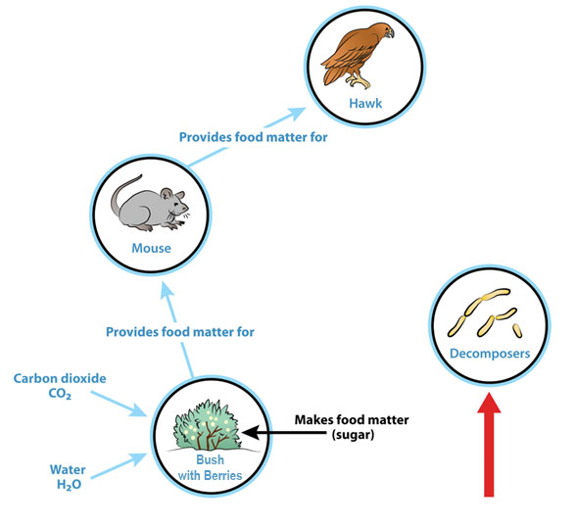
Your Food-Chain Diagrams
Add to your diagram to show what happens when the bush, the mouse, and the hawk die.

Slide 8
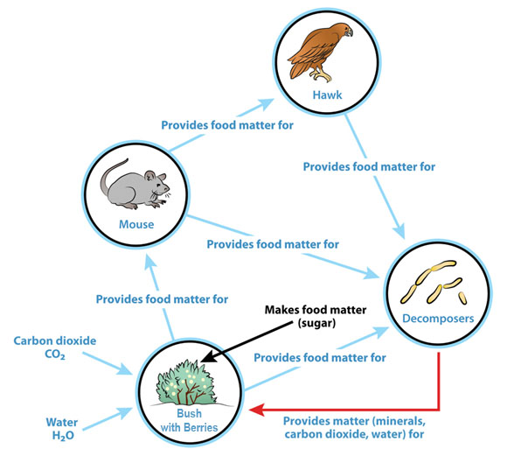
Matter Is Recycled!

Slide 9
Next Time
In the next lesson, we’ll explore these questions:
What happens to energy in food chains?
Can it be recycled like matter?

