Slide 1
Food Webs Lesson 7b
How Do Living Things in a Mini-environment Get the Food Matter and Energy They Need to Live and Grow?

Slide 2
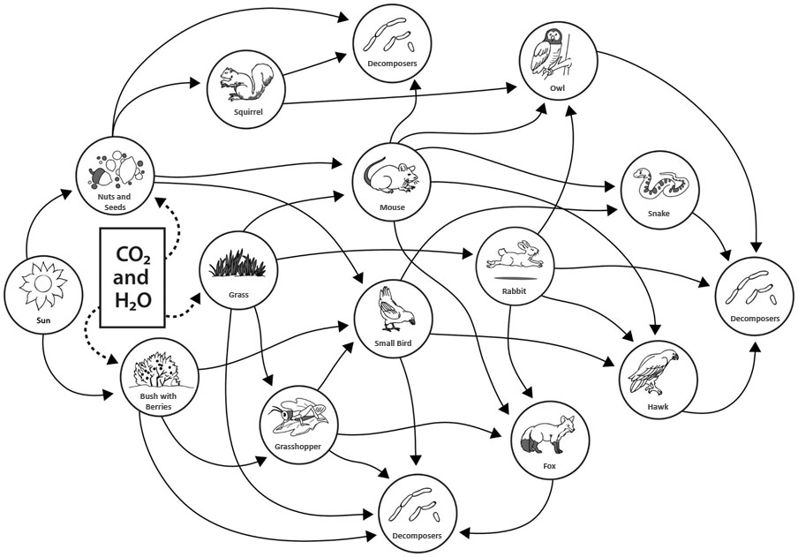
Meadow Food Web

Slide 3
Meadow Food Web
How does your organism in this food web depend on other organisms and the environment to get the matter and energy it needs to live and grow?
Use these words in your answer:
Depend
Matter
Energy
Environment (optional)
Notes:
NOTE TO TEACHER: Have students copy the question and word list from slide 3 into their notebooks. Then display slide 2 again while students are working on their answers.

Slide 4
Today’s Focus Question
How do living things in a mini-environment get the food matter and energy they need to live and grow?

Slide 5
Observing a Mini-environment
Before we begin our challenge, let’s watch a video of a mini-environment.
Link to Bottle Biology mini-environment video

Slide 6
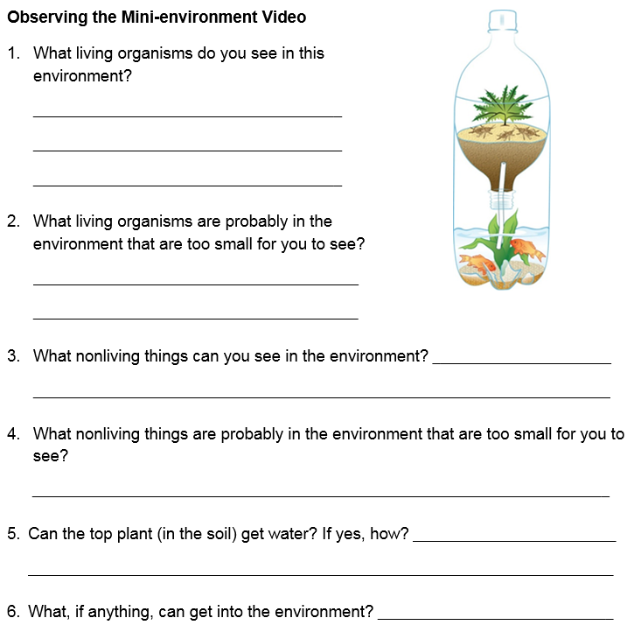
Observing a Mini-environment
Let’s watch the video again. This time, think about the questions on the handout.

Slide 7
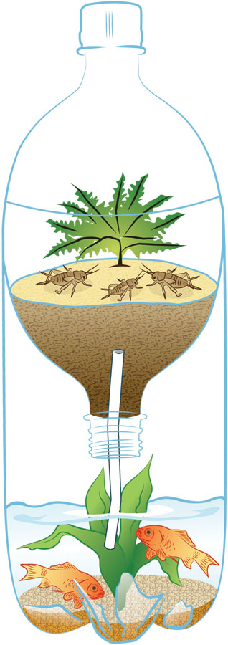
The Mini-environment Challenge
How can each organism in this mini-environment get the food matter and energy it needs to live and grow?

Slide 8
Instructions for the Challenge
Observe the mini-environment and talk about your ideas with a partner.
Draw and label your diagram to show what’s happening in this food web. Be sure to label your arrows!
Write a description of how each organism gets the matter and energy it needs to live and grow.
Use the following:
The key-ideas handout to guide your thinking
The words energy and matter
Optional: Red and blue pencils to represent energy and matter

Slide 9
Your Mini-environment Diagrams
Listen carefully while others are presenting their drawings and descriptions. Make sure to share any comments and suggestions in scientific ways.

Slide 10
Our Unit Central Question
How do living things depend on one another to get the food (matter and energy) they need to live and grow?

Slide 11
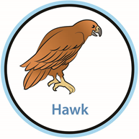
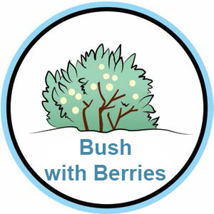
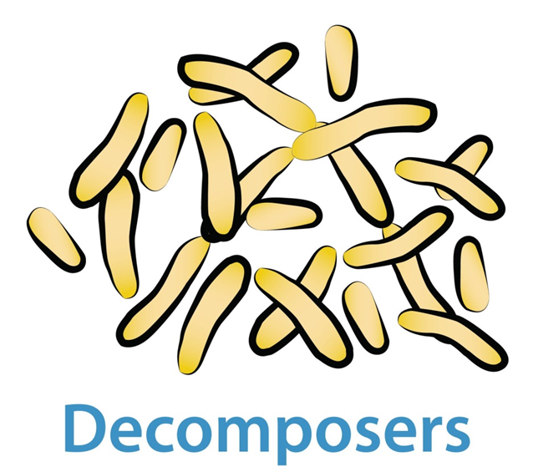
All Living Things Depend on Other Living Things

Slide 12
Without Decomposers …
X

Slide 13
Without the Sun …

Slide 14
Without Plants …
X

Slide 15
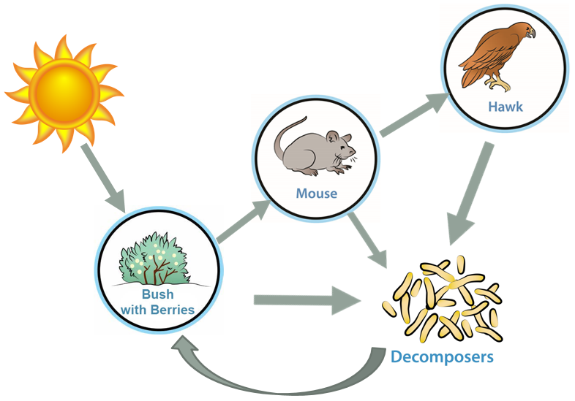
Food Webs Unit Summary
All living things depend on other living things to get the food matter and energy they need to live and grow.
And all living things depend on plants to capture energy from the Sun and use it to make food.
Without the Sun providing energy, there would be no food webs!

