Slide 1
WATER CYCLE Lesson 2A
Can You Make Water Vapor in the Air “Reappear” as Liquid Water?

Slide 2
Unit Central Questions
How does water change in the world around us? Does Earth ever run out of water?

Slide 3
Review: Water Changes
What kind of water change did we investigate yesterday?
What did we find out?

Slide 4
Key Idea
Because of evaporation, liquid water changes to a gas called water vapor. Water vapor rises into the air, but we can’t see it!

Slide 5
Use Science Ideas to Explain Water Changes
After it rains, the leaves on plants are wet. But after the Sun comes out, the leaves dry off.
What happened to the water that was on the leaves?
What are some other situations where liquid water evaporates?

Slide 6
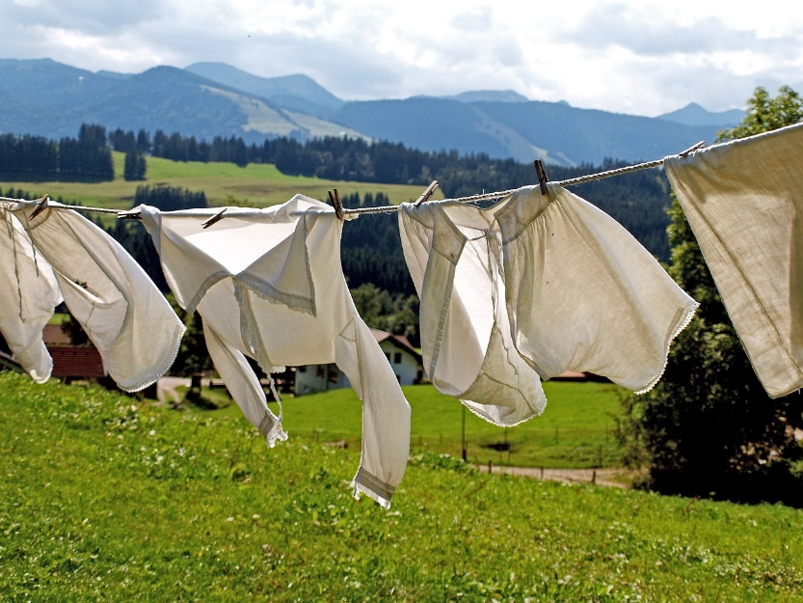
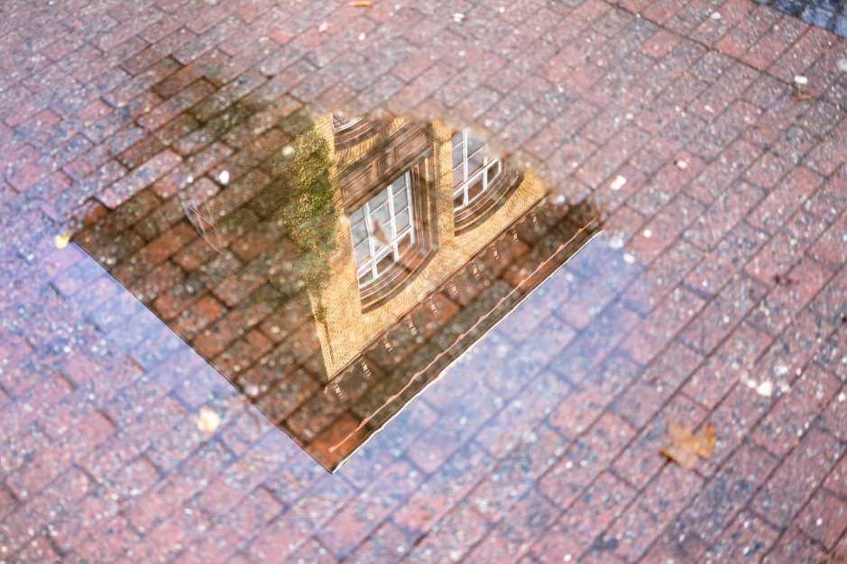
Everyday Examples of Evaporation
Photo courtesy of Pixabay.com
Photo courtesy of Pixabay.com
Photo courtesy of Pixabay.com

Slide 7
Today’s Focus Question
Can you make water vapor in the air “reappear” as liquid water? Explain your thinking.

Slide 8
Investigating Our Focus Question: Predictions
First, draw and label “Cup A” and “Cup B.”
Predict what you think will happen if the cups sit for a while. Then tell why you think this will happen.
I predict _______. My reason is _______.

Slide 9
What Is Happening with the Cups?
Observe what is happening with the 2 cups.
Make another drawing of the 2 cups in your science notebooks to show what you observed. Be sure to label the cups.
Talk in your group about how you would explain what is happening.
What is your claim?
What is your evidence?

Slide 10
Our Ideas about What Happened
What did you observe?
How did the water get onto the outside of cup B (the cup of ice water)?
What is your claim (your answer to the question)?
What evidence do you have to support your claim?
Does anyone have evidence to challenge the claim?

Slide 11
Today’s Focus Question
Can you make water vapor in the air “reappear” as liquid water? Explain your thinking.
Another question: How did the water droplets get on the outside of the cup of ice water?
My claim is __________________________.
My evidence is _______________________.

Slide 12
Let’s Summarize!
We know that when liquid water is heated, it can change to a gas (water vapor) and rise into the air. This is called evaporation.
Today we considered the opposite: Can water vapor in the air turn back into liquid water?
We observed water droplets form on the outside of a cup of ice water, but not on a cup of water at room temperature. Why did this happen?
We started to explain this by making our best claims and supporting them with evidence.

Slide 13
Next Time
We have our best claims and evidence about how and why the water droplets formed on the cup of ice water.
To finish our scientific explanation, we need to add some logical reasoning using science ideas.
Next time we’ll learn some new science ideas that will help us explain what we observed in the 2-cups experiment.

