Slide 1
WATER CYCLE LESSON 2B
Can You Make Water Vapor in the Air “Reappear” as Liquid Water?

Slide 2
Unit Central Questions
How does water change in the world around us? Does Earth ever run out of water?
Notes:
Quick link to unit central questions.

Slide 3
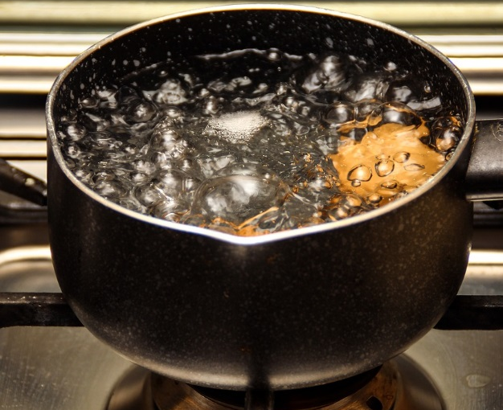
Review: Water Changes
Photo courtesy of Pixabay.com

Slide 4
Today’s Focus Question
Can you make water vapor in the air “reappear” as liquid water? Explain your thinking.
Photo courtesy of Pixabay.com

Slide 5
Our Claims and Evidence So Far …
Question: Why are water droplets forming on the outside of the cup of ice water?
Listen to the claims and evidence others share:
Do you agree/disagree? Why?
Do you have evidence to support or challenge the claim you heard?
Our goal: To agree on which claim has the strongest evidence

Slide 6
How Scientists Explain Water Changes
In the boiling-water experiment, water changed states from a liquid to a gas in a process called evaporation. Water vapor rose into the air, and we couldn’t see it.
In the two-cups experiment, liquid-water droplets formed only on the ice-water cup. The air near that cup had less heat energy (was colder), so when water vapor in the air came close to the ice-water cup, it lost heat energy (cooled) and formed droplets of liquid water in a process called condensation.

Slide 7
A Diagram Showing Condensation
Turn and Talk: Let’s add condensation to our diagram of evaporation from lesson 1. Talk with a partner about how to do this.

Slide 8
Key Science Ideas
Gas (or water vapor) in the air changes to liquid water when the water vapor loses heat energy (cools).
This process is called condensation.

Slide 9
Write a Scientific Explanation
Why are water droplets forming on the outside of the cup of ice water?
A Scientific Explanation | What It Means | Sentence Starters
Claim | Your answer to the question | Our claim is …
Evidence | What you observed that supports your claim | Our evidence is …
Reasoning | How science ideas support your claim and evidence | Our claim and evidence make sense because … (Use science ideas like heat energy and condensation.)

Slide 10
Today’s Focus Question
Can you make water vapor in the air “reappear” as liquid water? Explain your thinking.
Think time: Using the science ideas you’ve learned, answer this question in a complete sentence.
Sentence starter: Water vapor in the air can reappear as liquid water if …
Word bank:
Evaporates/evaporation
Condenses/condensation
Gains heat energy/loses heat energy (cools)

Slide 11
Let’s Summarize!
Water can change from one form (state) to another in two ways:
It can change from a liquid to a gas (water vapor) through evaporation.
It can change from water vapor (gas) back into a liquid through condensation.

Slide 12
Next Time
In this unit, we’ve seen that water can change states by gaining or losing heat energy. But …
How does gaining or losing heat energy make water change states?
Why is water sometimes a liquid, sometimes a solid, and sometimes a gas?
That’s what we’ll explore next!

