Slide 1
WATER CYCLE lesson 3b
Water Molecules in Three States of Matter

Slide 2
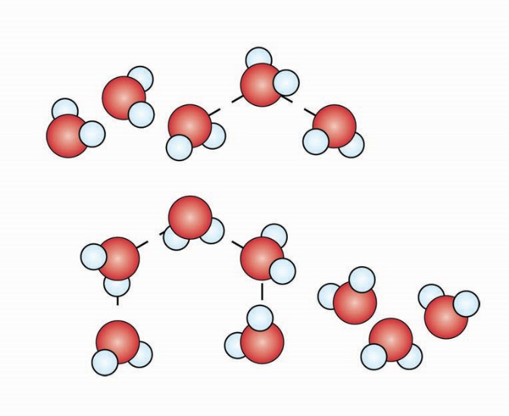
Liquid (Water)

Slide 3
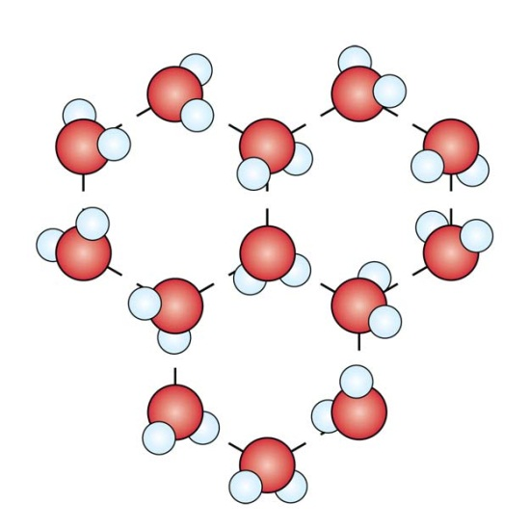
Solid (Ice)

Slide 4
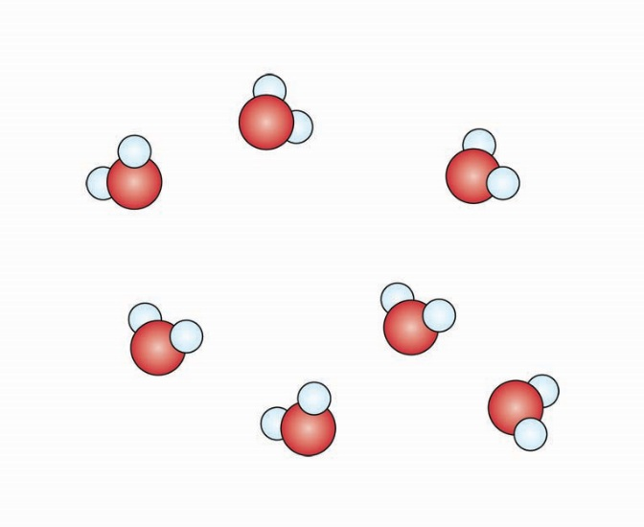
Gas (Water Vapor)

