Slide 1
WATER CYCLE LESSON 3B
How Do Water Molecules Move?

Slide 2
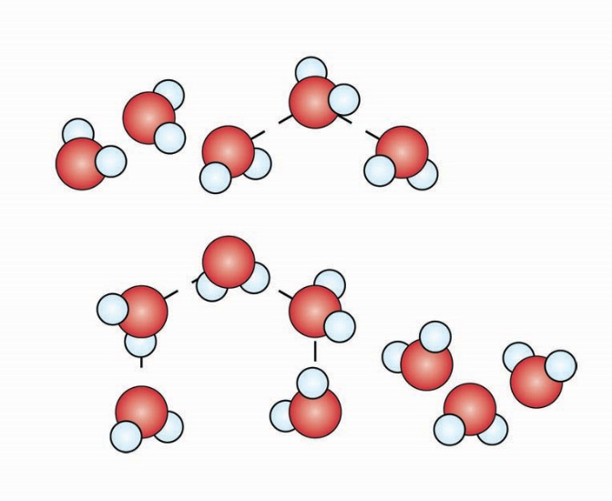
Liquid (Water)
H₂O molecules are joined together.
They are not in a rigid structure.
They can slip past one another.

Slide 3
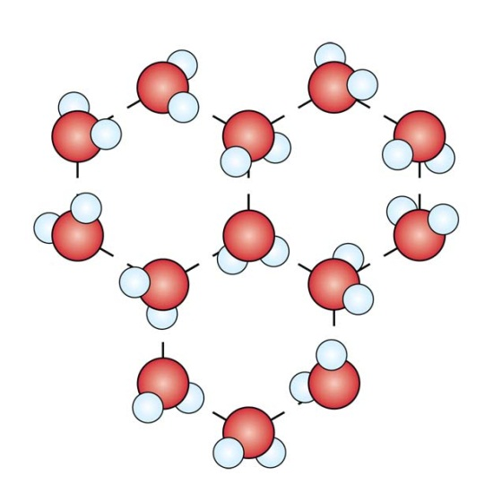
Solid (Ice)
H₂O molecules are joined together.
They are in a rigid structure.
They vibrate in place.

Slide 4
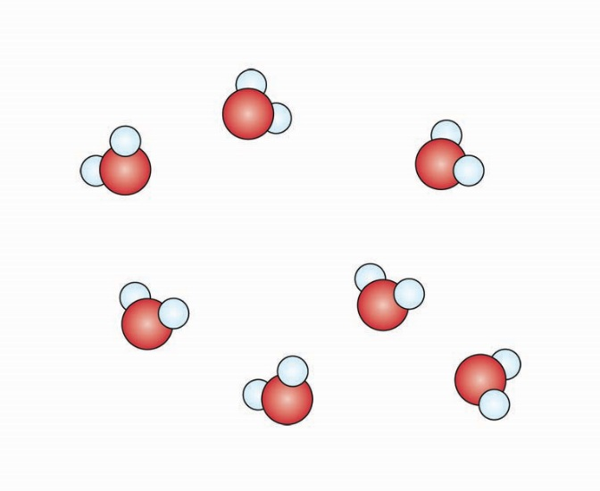
Gas (Water Vapor)
H₂O molecules are separate from each other.
They are not in a rigid structure.
They move very fast all over the place.

