Slide 1
WATER CYCLE LESSON 3B
Why Is Water Sometimes a Liquid, Sometimes a Solid, and Sometimes a Gas?

Slide 2
Unit Central Questions
How does water change in the world around us? Does Earth ever run out of water?

Slide 3
Review: Changes in States of Matter
What do we know so far about the states of matter and how water molecules change states?
Turn and Talk: Discuss this question with a partner, listing as many ideas as you can in 3 minutes.
Then we’ll chart what you came up with.

Slide 4
Today’s Focus Question
Why is water sometimes a liquid, sometimes a solid, and sometimes a gas?

Slide 5
Water Molecules on the Move!
Next we’re going to watch a simulation (model) that shows what scientists have learned about how water molecules move in liquid, solid, and gaseous states.
Link to simulation: https://phet.colorado.edu/en/simulation/states-of-matter

Slide 6
Your Observations
As you watched each simulation, what did you notice about water molecules in the liquid, solid, and gaseous states?
What similarities did you observe across the three states of matter?
What differences did you observe across the three states of matter?

Slide 7
How Do Water Molecules Move?
As we watch each simulation again, draw and write your observations on the handout.

Slide 8
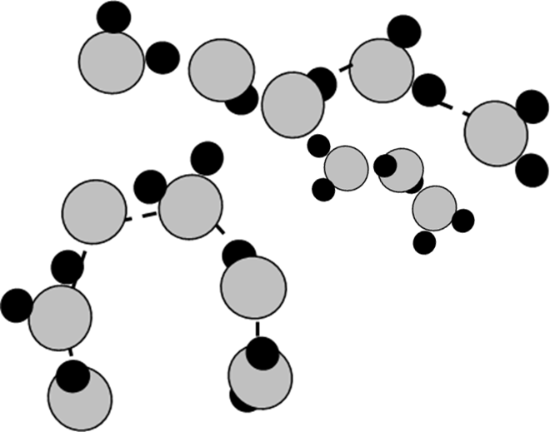
Check Your Understanding
What state of matter do you think these water molecules are in?
What key words or (Use a complete sentence!) phrases could you use to describe water molecules in this state of matter?

Slide 9
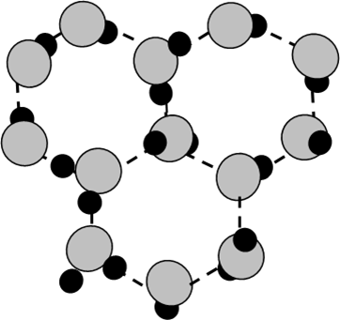
Check Your Understanding
What state of matter do you think these water molecules are in? (Use a complete sentence!)
What key words or phrases could you use to describe water molecules in this state of matter?

Slide 10
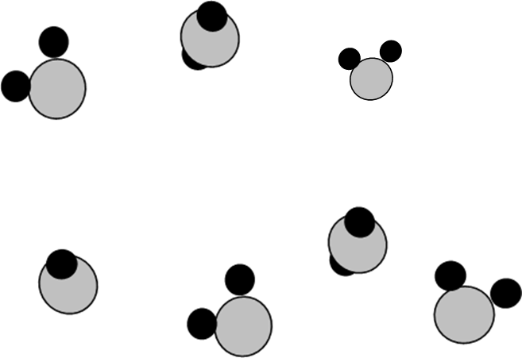
Check Your Understanding
What state of matter do you think these water molecules are in? (Use a complete sentence!)
What key words or phrases could you use to describe water molecules in this state of matter?

Slide 11
Let’s Summarize!
Today’s focus question: Why is water sometimes a liquid, sometimes a solid, and sometimes a gas?
Write an answer to the focus question using ideas about how water molecules are arranged and move in liquid, solid, and gaseous states.

Slide 12
Next Time
Today we learned about how water molecules move in different states of matter.
Next time we’ll use this knowledge to better explain how evaporation and condensation happen.

