Slide 1
WATER CYCLE Lesson 4A
How Can Ideas about Water Molecules Help Us Explain Evaporation and Condensation?

Slide 2
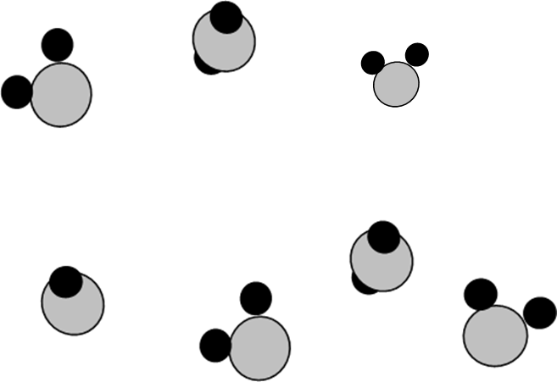
Review: States of Matter
What does this diagram show?
What state of matter do you think these water molecules are in? How do you know?

Slide 3
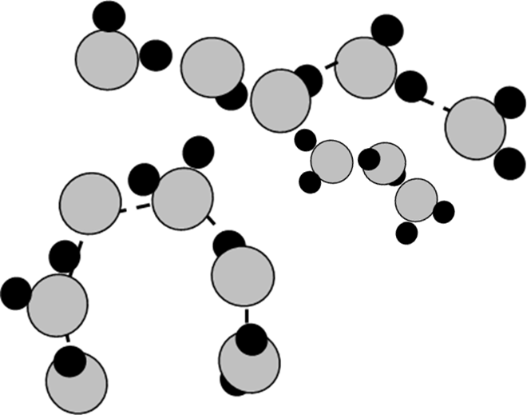
Review: States of Matter
What does this diagram show?
What state of matter do you think these water molecules are in? How do you know?

Slide 4
Today’s Focus Question
How can ideas about water molecules help us explain evaporation and condensation?

Slide 5
What Happens to Water Molecules?
What do you think happens to water molecules during evaporation and condensation? How do you think they move?

Slide 6
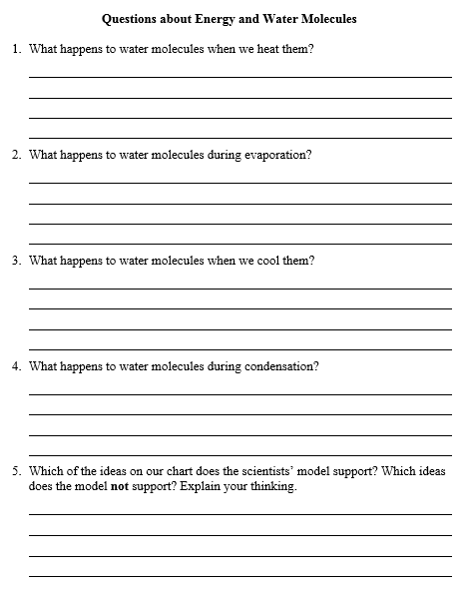
Watch the simulation and then answer the questions on your handout about energy and water molecules.
Let’s Find Out What Happens!
Link to simulation: https://phet.colorado.edu/en/simulation/states-of-matter

Slide 7
Comparing Our Ideas with the Simulation
Which ideas on our chart does the scientists’ model support? Which ideas does the model NOT support? Explain your thinking.

Slide 8
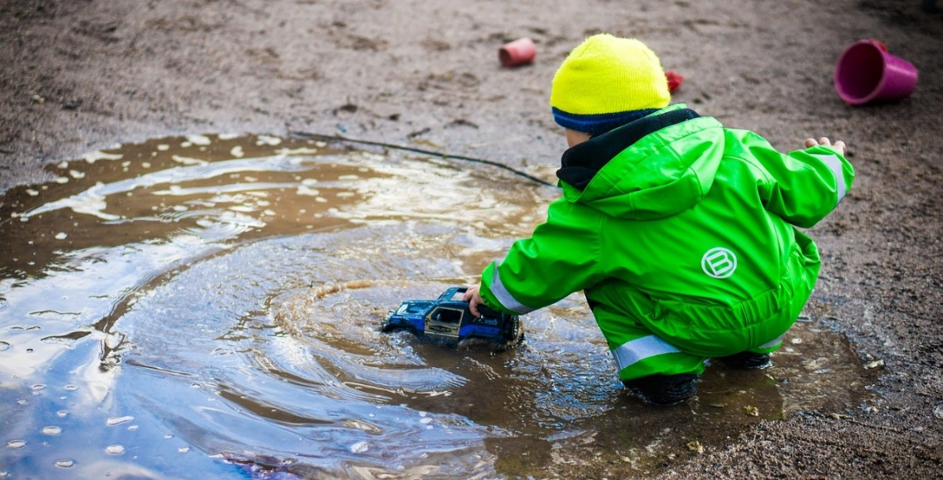
Situation 1: A Puddle of Rainwater
After a rainstorm, there is a puddle of water
on the sidewalk, and the Sun is out.
What change of state is going to occur?
Why will this change of state happen? Use the words energy and water molecules in your answer.
Photo courtesy of Pixabay.com

Slide 9
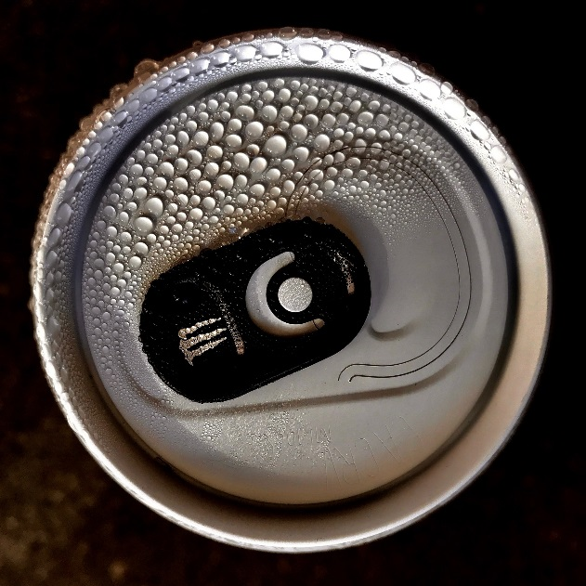
Situation 2: A Cold Soda Can
On a hot day, you put a very cold can of soda on the table.
What change of state is going to occur?
Why will this change of state happen? Use the words energy and water molecules in your answer.
Photo courtesy of Pixabay.com

Slide 10
Summary Statements
Today’s focus question: How can ideas about water molecules help us explain evaporation and condensation?
Write a summary statement for the question assigned to you:
What happens to water molecules during evaporation?
What happens to water molecules during condensation?

Slide 11
Let’s Summarize!
How can ideas about water molecules help us explain evaporation and condensation?
Key ideas:
During evaporation, molecules in the liquid state gain heat energy, which makes them move faster and escape into the air as water vapor (a gas).
During condensation, water-vapor molecules lose energy (cool), which makes them slow down and join together to form liquid-water droplets.

Slide 12
Next Time
Tomorrow we’ll think more about evaporation and condensation as we observe a demonstration of water changes in a system.

