Slide 1
WATER CYCLE Lesson 5A
How Can Ideas about Water Molecules, Evaporation, and Condensation Help Us Explain Everyday Situations?

Slide 2
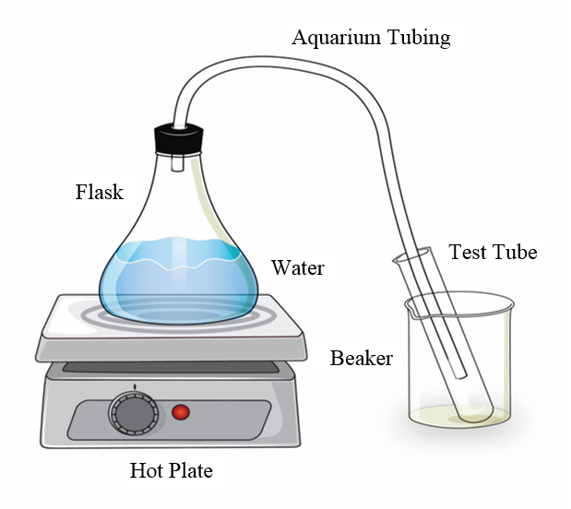
Review: The Water-Changes System
What’s happening to the water molecules in this water-changes system?

Slide 3
Where Are Molecules Arranged Like This?

Slide 4
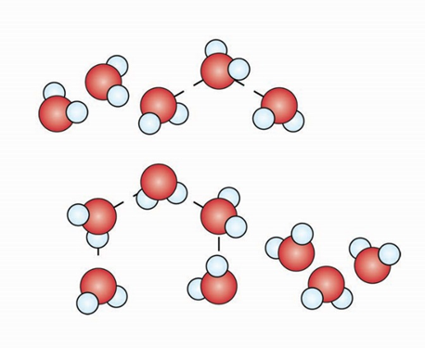
Where Are Molecules Arranged Like This?

Slide 5
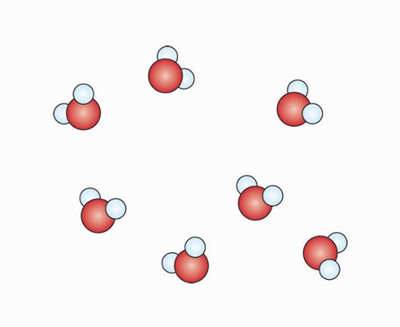
Where Are Molecules Arranged Like This?

Slide 6
Today’s Focus Question
How can ideas about water molecules, evaporation, and condensation help us explain everyday situations?

Slide 7
What We Know about Water Molecules
Group 1: Come up with one idea about water molecules and evaporation.
Sentence starter: Evaporation occurs when …
Group 2: Come up with one idea about water molecules and condensation.
Sentence starter: Condensation occurs when …

Slide 8
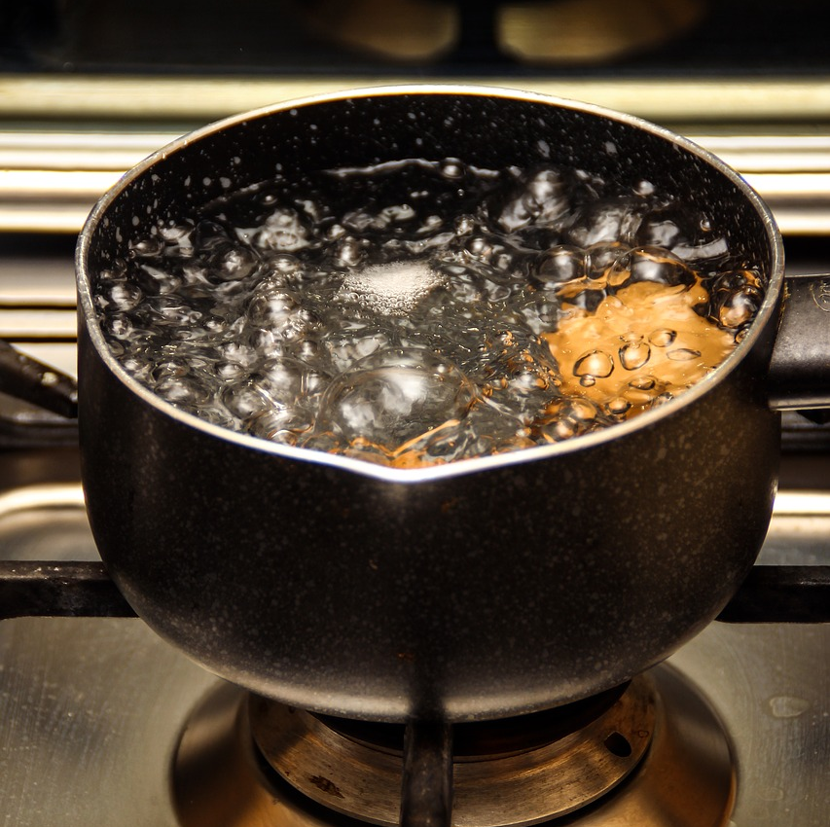
Situations We’ve Already Observed
What’s happening to the water molecules?
Photo courtesy of Pixabay.com
Photo courtesy of Pixabay.com

Slide 9
A New Situation to Explain: Clouds
Photo courtesy of Pixabay.com

Slide 10
Ideas about How Clouds Form
In your science notebooks, write down your ideas about how clouds form.
How Clouds Form
My ideas:

Slide 11
Ideas about How Clouds Form
In your science notebooks, add new ideas from the handout about how clouds form.
How Clouds Form
My ideas:
From the handout:

Slide 12
Ideas about How Clouds Form
Now let’s watch a video about cloud formation and see if we discover some more ideas!
Link to the Happy Scientist video: https://www.thehappyscientist.com/content/cloud-formation-part-1

Slide 13
Ideas about How Clouds Form
In your science notebooks, add any new ideas from the video about how clouds form.
How Clouds Form
My ideas:
The handout:
The video:
Notes:
Happy Scientist link: https://www.thehappyscientist.com/content/cloud-formation-part-1

Slide 14
Key Ideas about Clouds
Clouds are NOT …
Made of water vapor!
Formed only by evaporation.
Clouds are …
Made of tiny liquid-water drops.
Formed by condensation!
Clouds form when liquid-water molecules from Earth’s surface gain heat energy, move faster, break away from other molecules, and rise into the air as water vapor (evaporation).
When the water-vapor molecules lose heat energy (cool), they slow down and join together to form liquid-water drops on dust particles in the air (condensation). This is a CLOUD!

Slide 15
Use what you know about clouds to explain what’s happening in this picture.
Teakettle Situation
Photo courtesy of Pixabay.com

Slide 16
TeaKettle Summary
Evaporation: Invisible water vapor (gas) escapes from the spout.
Steam
Condensation: Drops of liquid water (steam) form when the water vapor hits the cooler air outside the kettle.
Water Vapor
Photo courtesy of Pixabay.com

Slide 17
Another Everyday Situation
Arturo went into the bathroom to take a hot shower. Before his shower, the mirror over the sink was dry. After his shower, the mirror was fogged up.
Photo courtesy of Stock.Adobe.com

Slide 18
Foggy-Mirror Summary
Photo courtesy of Stock.Adobe.com
Photo courtesy of Stock.Adobe.com
Liquid-water molecules from the shower gain heat energy, break away from other molecules, and spread out into the air as water-vapor molecules (evaporation).
Water-vapor molecules in the air lose heat energy near the cooler mirror. They slow down and join together to form liquid-water drops on the mirror (condensation).

Slide 19
Let’s Summarize!
Today’s focus question: How can ideas about water molecules, evaporation, and condensation help us explain everyday situations?
What everyday situations did we explain today using ideas about water molecules and changes from one state to another?

Slide 20
Processes in Everyday Situations
Today we studied three everyday situations:
Cloud formation
Steam formation above a teakettle spout
Water-drop formation on a bathroom mirror
Which process was involved in each situation?
Evaporation
Condensation
Both evaporation and condensation
Neither evaporation nor condensation

Slide 21
The Steam Cloud
How did the steam cloud form above the test tube?

Slide 22
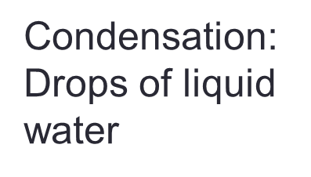
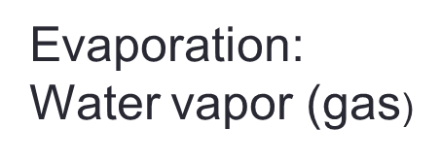
Explaining the Steam Cloud
How did the steam cloud form above the test tube?

Slide 23
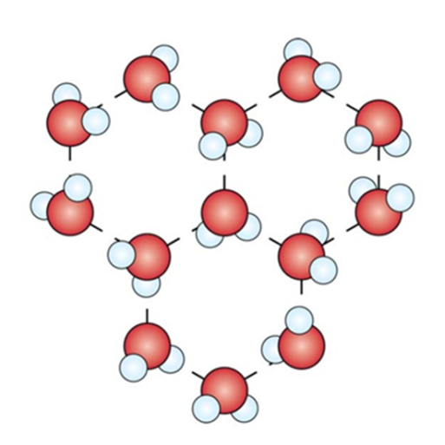
How Are Molecules Arranged in the Steam Cloud?

Slide 24
Molecular Arrangement in the Steam Cloud
The water molecules in the steam cloud are arranged in the liquid state.

Slide 25
Next Time
These ideas about molecules, evaporation, and condensation can also help us explain Earth’s water cycle.
That’s what we’ll explore next time.

