Slide 1
water cycle LESSON 5B
How Can Ideas about Molecules, Evaporation, and Condensation Help Us Explain the Water Cycle in the World around Us?

Slide 2
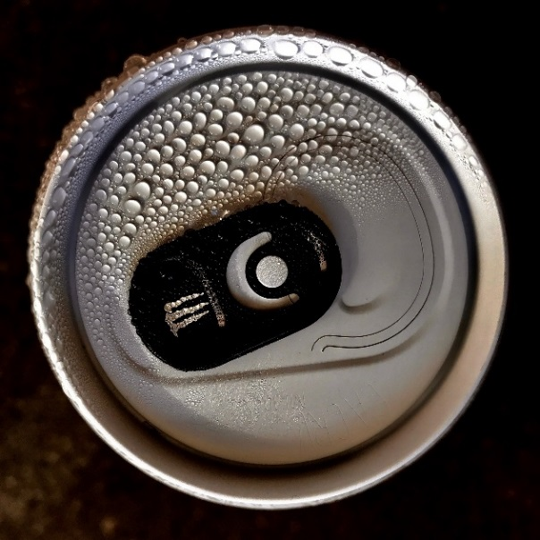
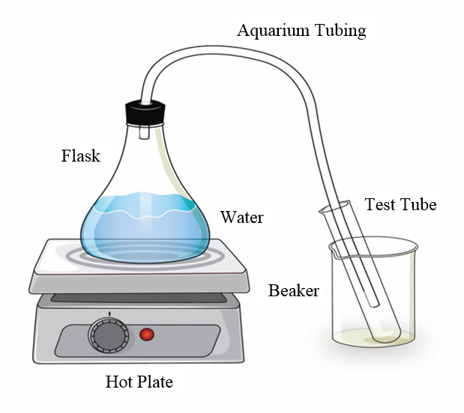
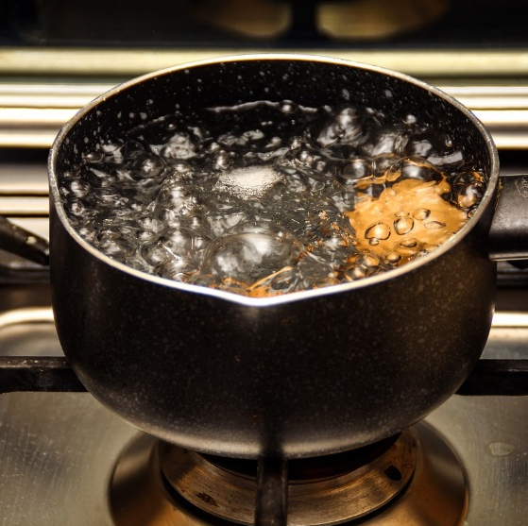
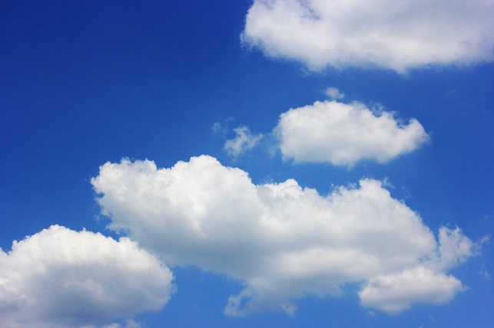
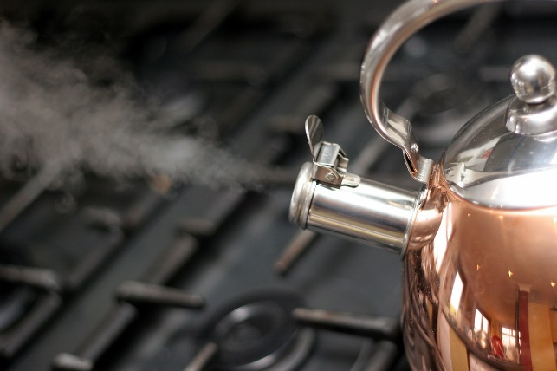
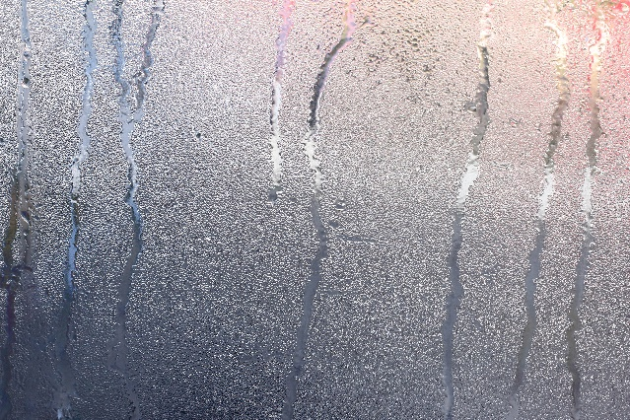
Review: Ideas about Water Molecules
Photo courtesy of Pixabay.com
Photo courtesy of Pixabay.com
Photo courtesy of Pixabay.com
Photo courtesy of Pixabay.com
Photo courtesy of Stock.Adobe.com

Slide 3
Today’s Focus Question
How can ideas about molecules, evaporation, and condensation help us explain the water cycle in the world around us?

Slide 4
The Water Cycle
What do you already know about the water cycle?

Slide 5
New Ideas about the Water Cycle
Let’s see what we can discover about the water cycle from the handout.
As you read, mark any ideas that are new to you or weren’t mentioned in our discussion.
What new ideas can we add to our initial ideas about the water cycle?

Slide 6
Water in the World around Us

Slide 7
The Water Cycle on Earth
Where on the diagram would you expect to find water molecules in the liquid, gas, and solid states?
Write liquid everywhere you would expect to find water molecules in the liquid state. Draw 6 liquid-water molecules.
Write water vapor everywhere you would expect to find water molecules in the gaseous state. Draw 6 water-vapor molecules.
Write solid everywhere you would expect to find water molecules in the solid state (snow, ice). Draw 6 solid-water molecules.

Slide 8
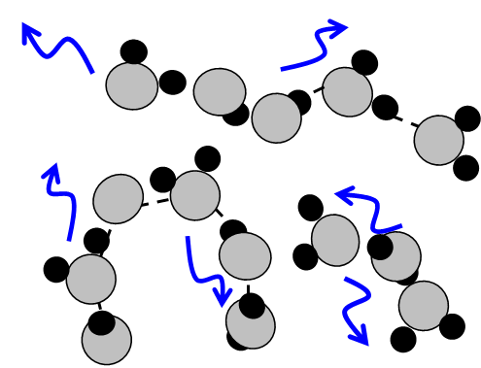
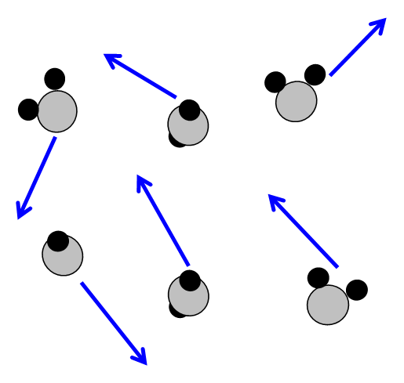
Water Molecules
LIQUID STATE
SOLID STATE
GAS STATE (WATER VAPOR)

Slide 9
Where Did You Draw Water Molecules in the Liquid, Gas, and Solid States?

Slide 10
Where Do These Processes Happen?
Add arrows and labels to your diagram to show where these processes occur on Earth:
Evaporation
Condensation
Precipitation
Gaining heat energy
Losing heat energy

Slide 11
Where on Earth Do We Find Evaporation, Condensation, and Precipitation?

Slide 12
The Water Cycle on Earth
Work with a partner to come up with a sentence that describes what happens to water molecules in the water cycle. Include the idea of energy in your sentence.

Slide 13
Let’s Summarize!
Listen carefully as I summarize what we’ve learned so far about the water cycle.
When I finish, it will be your turn to summarize what happens!

Slide 14
Summarize These Key Ideas
1. Through evaporation, _________, and __________, water molecules are constantly changing from a liquid to a gas and back to a liquid (or a solid) as they cycle from Earth to the atmosphere and back to Earth.
2. Changes of state happen when water molecules ____ heat energy (evaporation) or ____ heat energy (condensation or freezing).
3. The _______ provides the energy that keeps water molecules changing and moving.
2

Slide 15
Next Time
Today we explored how water molecules in the world around us continuously change from one state to another and move from place to place on Earth and in the atmosphere.
These ideas helped us answer our first unit central question: How does water change in the world around us?
Next time we’ll consider our second unit central question: Does Earth ever run out of water?

