Slide 1
GENETICS Lesson 2a
Can Certain Traits Disappear in a Family? Why or Why Not?

Slide 2
Our Ideas and Questions about Inheritance
Our Current Ideas about Inheritance
Our Questions about Inheritance
Do you have any new ideas or questions to add to our class charts?

Slide 3
Unit Central Question
Why are individuals of a species different from one another?

Slide 4
Lesson Focus Questions
Can certain traits disappear in a family? Why or why not?

Slide 5
Traits in the Dachshund Family
Do you think the long-hair trait in the dachshund family is gone forever?
Discuss your ideas with a partner. Then write your predictions in your science notebooks.

Slide 6
Your Predictions
What did you predict about the long-hair trait in the dachshund family? Let’s see a show of hands.
How many of you think the long-hair trait is gone forever?
How many of you think the trait is NOT gone forever?

Slide 7
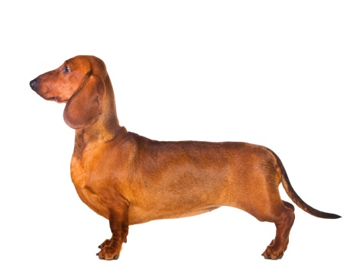
Basic Rules for Creating a Pedigree Chart
Female Male
Photo courtesy of © Oxilixo | Dreamstime.com
Photo courtesy of © Isselee | Dreamstime.com
Circles = females; squares = males
Parents have a horizontal line between them.
Different circle and square colors = different versions of a trait (yellow = short hair; gray = long hair)
In this example, the female parent has short hair, and the male parent has long hair.

Slide 8
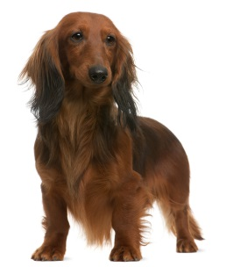
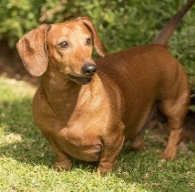
Basic Rules for Creating a Pedigree Chart
Photo courtesy of © Oxilixo | Dreamstime.com
Photo courtesy of © Isselee | Dreamstime.com
Female Male
Generation 1
Generation 1
All photographs courtesy of pixabay.com
Circles = females; squares = males
Yellow shading = short hair; gray shading = long hair
Brothers and sisters are connected by a line above them.
In this example, there are 2 girls and 1 boy, all with short hair.

Slide 9
The Next Generation: What Will Happen?
Female Male
Photo courtesy of © Oxilixo | Dreamstime.com
Photo courtesy of © Isselee | Dreamstime.com
Generation 1
Generation 1
All photographs courtesy of pixabay.com
Each of the first-generation dachshunds mates with another short-haired dachshund that also had one parent with short hair and one parent with long hair. What do you think their offspring will look like?

Slide 10
The Next Generation: The Results
Generation 1
Photo courtesy of © Oxilixo | Dreamstime.com
Photo courtesy of © Isselee | Dreamstime.com
Generation 1
Generation 2
Generation 2
What do you notice about the second generation of dachshund puppies?
How do the results compare with your predictions?
Photos courtesy of pixabay.com

Slide 11
The Dachshund Pedigree
Key science ideas:
In all sets of parents, one parent had long hair, and one parent had short hair.
In the first generation of offspring, all of the puppies had short hair.
In the second generation of puppies, some had short hair, and some had long hair.
So what happened to the long-hair trait in the dachshund family?

Slide 12
Lesson Focus Questions
Can certain traits disappear in a family? Why or why not?
Discuss these questions with a partner:
Did the results of the pedigree activity change any of your ideas about these questions?
How have your ideas changed?

Slide 13
What Happened with the Puppies?
Why do you think the long-hair trait reappeared in the second generation of dachshund puppies?
What might explain this result?

Slide 14
Let’s Summarize!
Using evidence from today’s pedigree activity, review the claims of Juan, Celia, and Michael from handout 1.1 and decide whether you now agree or disagree with their ideas.
Complete these sentences in your science notebooks, and make sure to include your reasons and evidence:
I (support/don’t support) Juan’s idea because …
I (support/don’t support) Celia’s idea because …
I (support/don’t support) Michael’s idea because …

Slide 15
Next Time
Tomorrow we’ll get learn about a scientist named Gregor Mendel, who came up with some important ideas about inheritance.

