Slide 1
GENETICS Lesson 3b
What Do We Know about Genes Today That Gregor Mendel Didn’t Know?

Slide 2
Our Unit Central Question
Why are individuals of a species different from one another?
Share some of the new science ideas you learned about in the last lesson that can help us answer this question.
How do these ideas help us explain why individuals of the same species are different from one another?

Slide 3
Lesson Focus Question
What do we know about genes today that Gregor Mendel didn’t know?

Slide 4
Genes and Chromosomes
Let’s compare Mendel’s ideas with Sutton’s ideas to see if they match! Follow these steps in your small group:
Examine each of Mendel’s ideas and diagrams on handout 3.2, Genes and Chromosomes.
Review Sutton’s ideas about cells and chromosomes in the essay from last time (handout 3.1).
When you find an idea of Sutton’s in the essay that seems to match one of Mendel’s ideas on the handout, talk about it in your group.
If you agree the ideas match, add Sutton’s idea to your handout in the box next to Mendel’s idea. Write each science idea in a complete sentence and draw a diagram to illustrate it. (Complete this task independently.)

Slide 5
Today’s Focus Question
What do we know about genes today that Gregor Mendel didn’t know?
Using Mendel’s and Sutton’s ideas from today’s handout, think about the focus question and write your best answer in your science notebook.
Then share your answer with a partner and talk about how scientists figured out what happens inside cells.

Slide 6
Let’s Summarize!
Sexually reproducing organisms have two pairs of chromosomes in each cell.
When sperm and egg cells are made, each cell gets just one chromosome from each pair that’s randomly selected.
When sperm and egg unite during fertilization, a new individual with two sets of chromosomes is created. One set comes from the mother, and one set comes from the father.

Slide 7
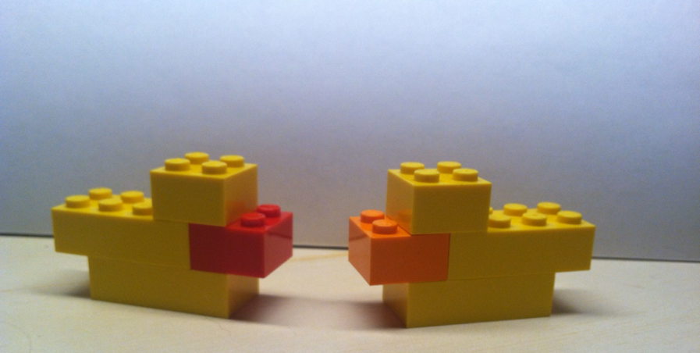
Next Time
Baby “Duckos”
Photo courtesy of BSCS
Can we recreate the pattern of traits we saw across generations in the dachshunds and pea plants by making our own animals?
Let’s find out!

