Slide 1
GENETICS Lesson 5a
Do the Dominant and Recessive Traits of Parents Always Result in Similar Patterns of Trait Variation in Offspring? Why or Why Not?

Slide 2
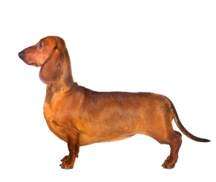
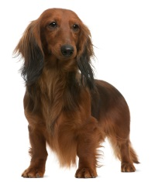
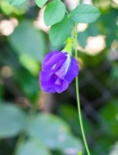
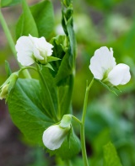
Generation 2 Traits in Other Organisms
Pea Plants
Dachshunds
Photo courtesy of Pakpoom Phummee | Dreamstime.com
Photo courtesy of Maksym Surovtsev | Dreamstime.com
Photo courtesy of © Oxilixo | Dreamstime.com
Photo courtesy of © Isselee | Dreamstime.com
Number of Individuals 100 200 300 400 500 600 700 800 900
 | Purple White
Number of Individuals 10 20 30 40 50 60 70 80 90
 | Short Hair Long Hair

Slide 3
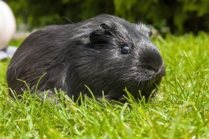
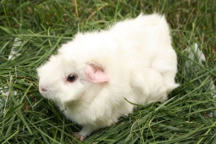
Generation 2 Traits in Other Organisms
Guinea Pigs
Parakeets
Photo courtesy of Belizar | Dreamstime.com
Photo courtesy of Blueelephant | Dreamstime.com
Photo courtesy of Pixabay.com
Photo courtesy of Pixabay.com
Number of Individuals 20 40 60 80 100 120 140 160 180
 | Black White
Number of Individuals 10 20 30 40 50 60 70 80 90
 | Green Blue

Slide 4
Lesson Focus Questions
Do the dominant and recessive traits of parents always result in similar patterns of trait variation in offspring? Why or why not?

Slide 5
GENERATION 1:
Parents’ Alleles
Mom has a red bill. Dad has an orange bill.
MOM’s Alleles DAD’s Alleles
B B b b
Possible Alleles for Offspring
Bb
Bb
Bb
Bb
Each offspring in Generation 1 has a ________ bill.

Slide 6
GENERATION 2:
Parents’ Alleles
Mom has a red bill. Dad has a red bill.
MOM’s Alleles DAD’s Alleles
B b B b
Possible Alleles for Offspring
BB
Bb
bB
bb
Red Bill
Red Bill
Red Bill
Orange Bill
What bill color do you think each offspring will have?

Slide 7
Mom has a red bill. Dad has a red bill.
MOM’s Alleles DAD’s Alleles
B b B b
Mom’s Alleles
B b
Possible Alleles for Offspring:
BB = 1 Bb = 2 bb = 1
B
BB
Bb
Possible Traits for Offspring:
BB = Red = 1
Bb = Red = 2
bb = Orange = 1
Punnett Square
Dad’s Alleles
3
b
Bb
bb

Slide 8
The Punnett Square: Follow-Up
Describe in your own words how the Punnett square can help explain why all those different organisms had second-generation offspring in a pattern of three dominant traits to one recessive trait (a 3:1 ratio).
In your description, include the science ideas you’ve learned so far about inheritance and trait variation.

Slide 9
Today’s Focus Questions
Do the dominant and recessive traits of parents always result in similar patterns of trait variation in offspring? Why or why not?
Turn and Talk: Discuss these questions with a partner. Then write your best answer in your notebook. Use what you’ve learned about chromosomes, genes, alleles, and dominant and recessive traits.
Hint: Think about the animation that showed the different ways parents’ alleles can combine to result in trait variations in the offspring.

Slide 10
Next Time
Tomorrow you’ll apply what you’ve learned about the patterns in traits by using a Punnett square to identify possible allele combinations and traits in three different scenarios.

