Slide 1
Submitting Writing for Online Tutoring

Slide 2
Step 1: Decide what kind of help you need.
Do you need help with the overall structure or flow of your essay, or with any major sections of your essay?
Then you need Global (Content) help.
Do you need help with grammar, mechanics, punctuation, citation, word choice, or other sentence-level concerns?
Then you want Grammar/Mechanics help.
Do you not know what you need help with, or want a tutor to look over your paper and give you three main areas to work on?
Then you need General help.

Slide 3
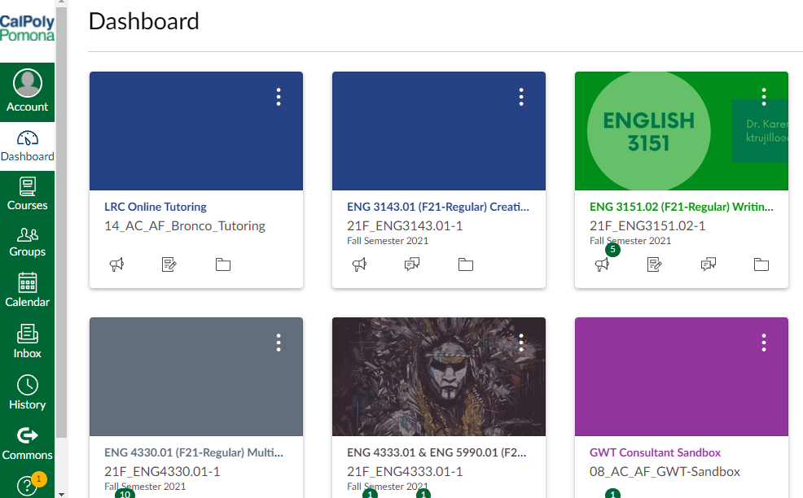
Step 2: Go to Canvas
On your Canvas Dashboard click on LRC Online Tutoring.

Slide 4
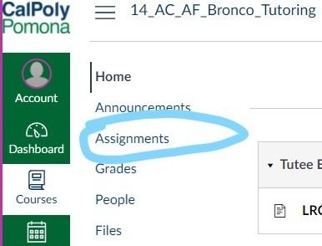
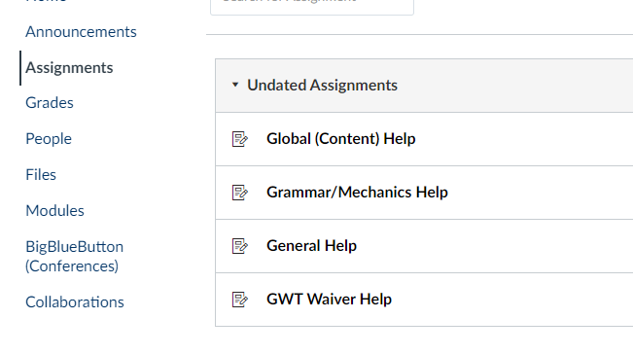
Step 2: Cont.
Next click on Assignments.
Afterwards you will have 3 options to submit your paper to: Global, Grammar/Mechanics, and General.

Slide 5
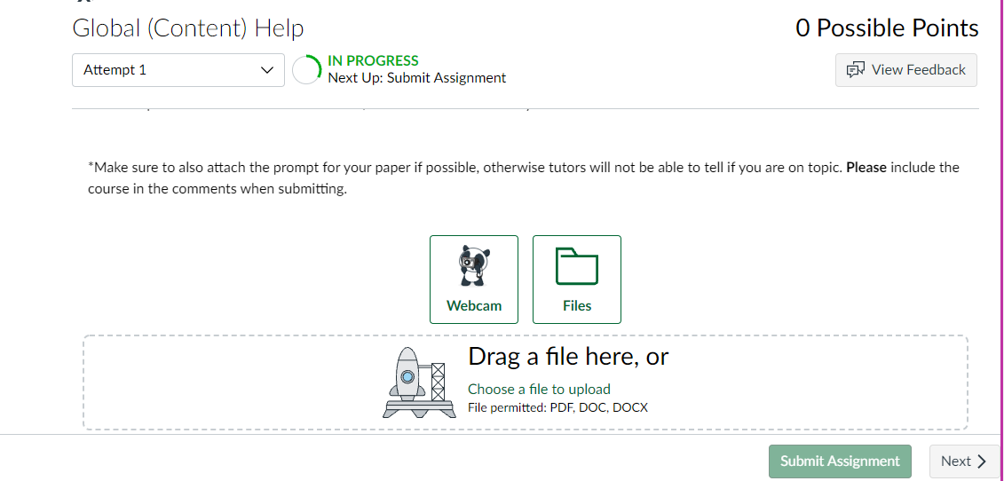
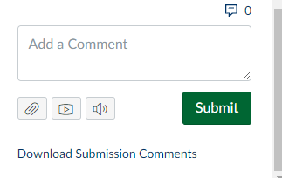
Step 3: Submit to Canvas
Click one of the 3 options
Attach paper file
After you hit submit, mention (in the comment box) three areas in which you would like feedback.
Make sure to also attach the prompt for your paper if possible, otherwise tutors will not be able to tell if you are on topic.

Slide 6
Done!
No Zoom Meeting needed!
Please note: The LRC provides tutoring to ALL students on campus. Your paper will be returned to you within 24-72 hrs so be sure to plan accordingly!
Thank you so much for using the LRC Online Tutoring!

