Slide 1

LEAN Overview
Continuous Improvement at CPP!

Slide 2
What is LEAN?
LEAN is a continuous improvement model that focuses on enhancing the activities that generate the most value for customers.
The goal of LEAN is to eliminate waste and improve efficiency by streamlining processes and eliminating non-value-added activities.
LEAN stands for:
Lose
Excess
And
Nonsense
LEAN practices include:
Doing more of what already works
Getting rid of wasteful processes
Avoiding tiny losses - Improvement is not about doing more things right, but about doing fewer things wrong
Measuring backward - Make decisions based on what has already happened, not on what you want to happen

Slide 3

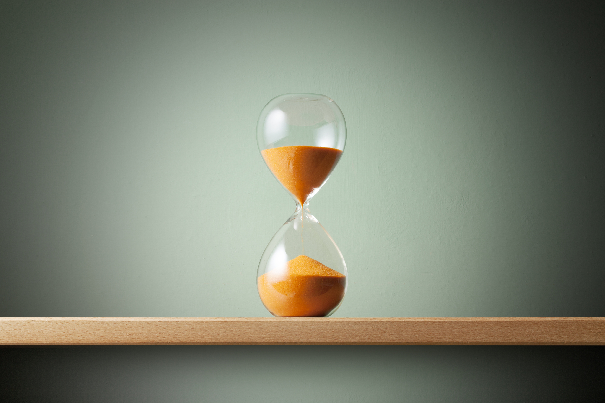

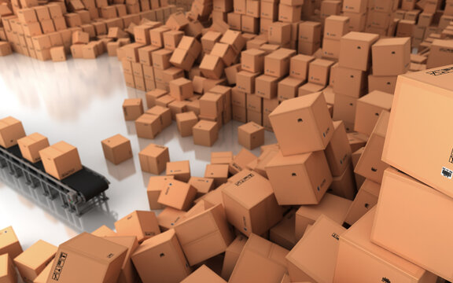
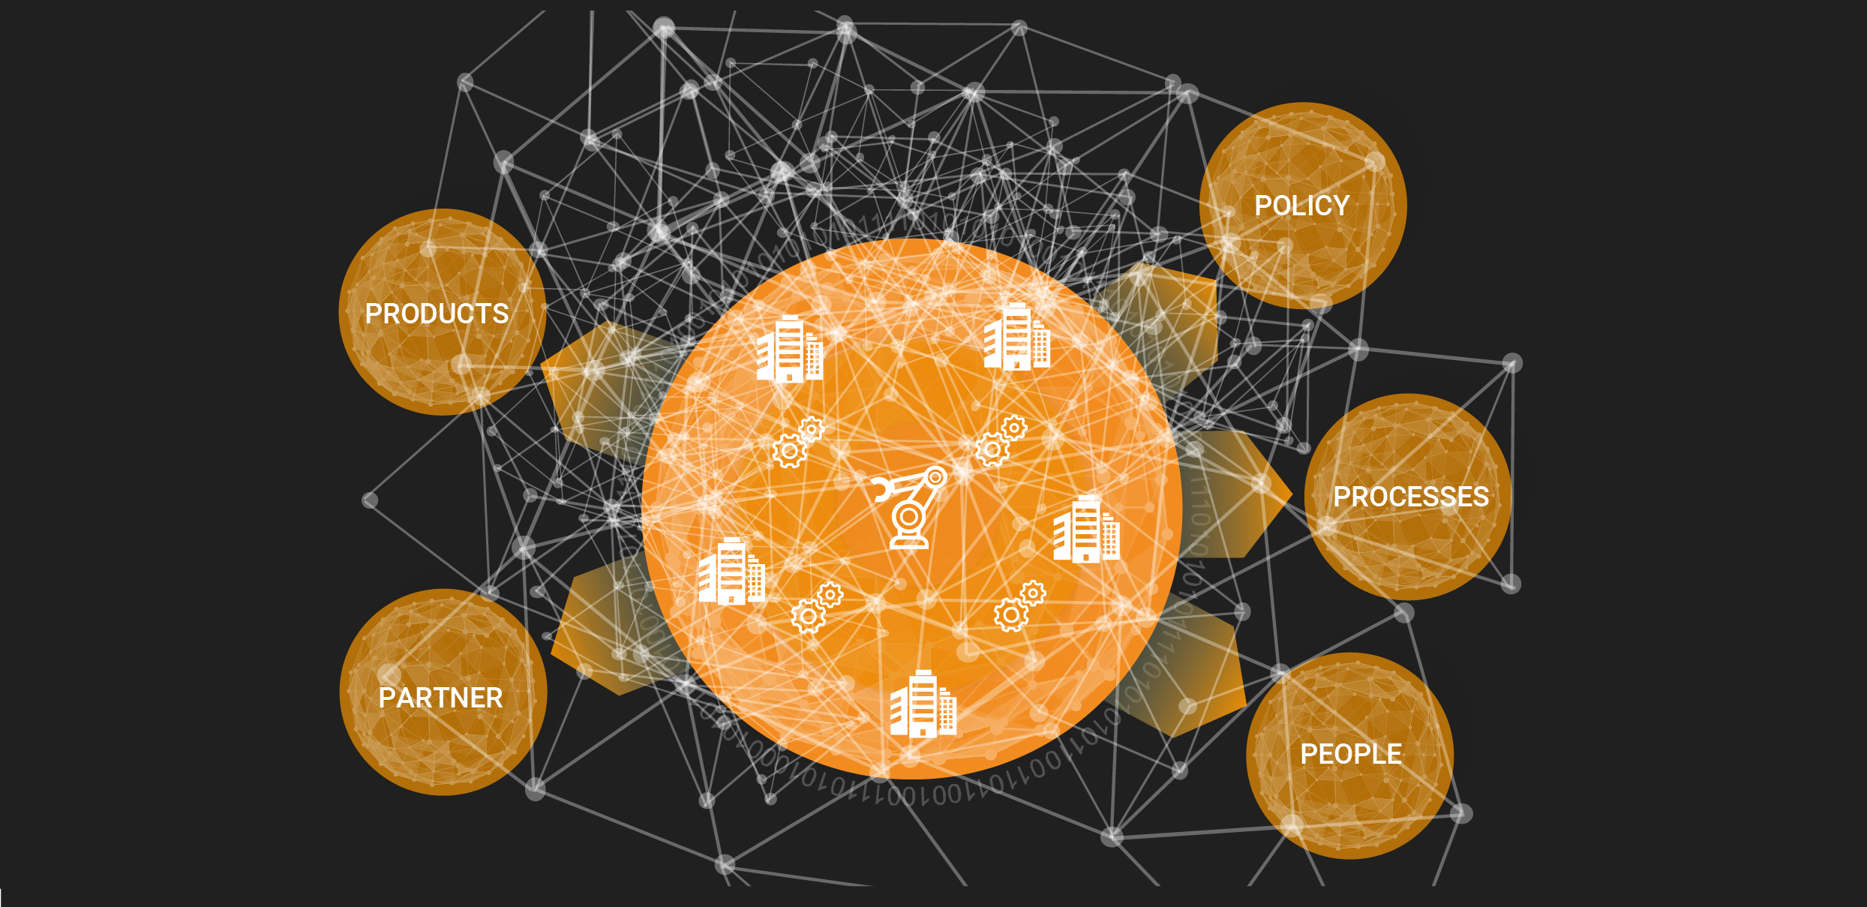

Types of Waste in Processes
Overproduction
Wait Times
Over-Processing
Excess Inventory
Complexity
Underutilized Employees

Slide 4
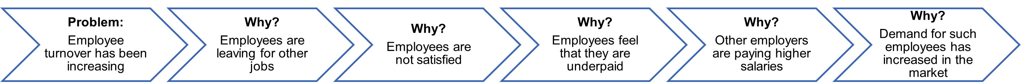
Define-Measure-Analyze-Improve-Control
One approach to LEAN thinking is DMAIC which stands for Define, Measure, Analyze, Improve, and Control.
Define Phase
This phase answers the question, What problem would you like to fix?
During this phase, we identify what our customers value and then define the problem, as well as the scope of our project.
Measure Phase
This phase answers the question, How does the process currently perform?
During this phase, we create a current state map of the process and conduct baseline measures.
Analyze Phase
This phase answers the question, What is causing the problem?
During this phase, we conduct a Root Cause Analysis, otherwise know as the 5 Whys, to find the underlying causes of a problem.
Improve Phase
This phase answers the question, How will the team mitigate the root causes of the problem?
During this phase, we can create a Future State Map describing the high-level steps needed to address the root cause of the problem.
The map should represent 6-12 months into the future, as you strive towards the ideal state.
Control Phase
This phase answers the question, How do you sustain the improvement?
During this phase, we monitor trends and maintain metrics to ensure that we are upholding the standards of the improved process.
Root Cause Analysis AKA 5 Whys:
Problem: Employee turnover has been increasing
Why? Employees are leaving for other jobs
Why? Employees are not satisfied
Why? Employees feel that they are underpaid
Why? Other employers are paying higher salaries
Why? Demand for such employees has increased in the market

Slide 5
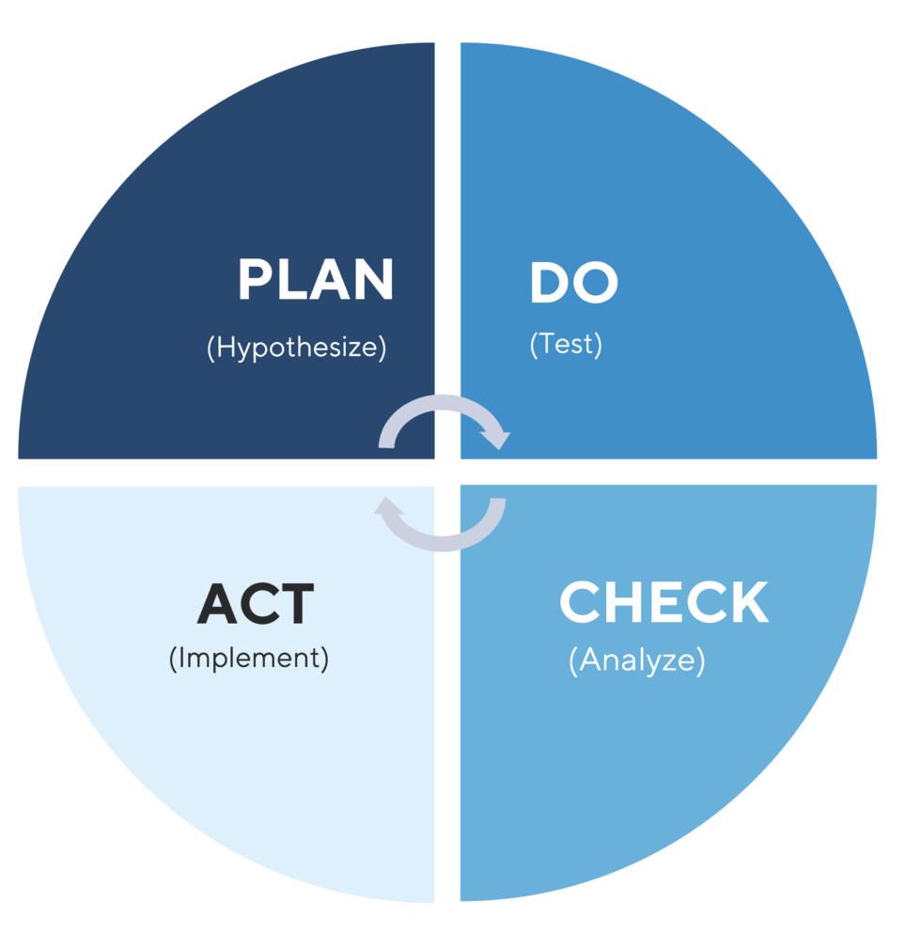
Plan-Do-Check-Act
Another approach to LEAN thinking is PDCA which stands for Plan, Do, Check, and Act.
Plan Phase
This is the brainstorming and planning phase.
During this phase, we identify an opportunity for improvement and create an action plan for change.
Do Phase
This is the testing solutions phase.
During this phase, we implement the change on a small scale to objectively measure its effectiveness.
Check Phase
This is the phase where we verify the effectiveness of the change.
During this phase, we use data to analyze the results of the change and determine whether it made a difference.
Act Phase
This is the phase where we implement the solution.
If the change has been effective, we implement it more broadly and continue to assess the results.

Slide 6
Benefits of Continuous Improvement
LEAN thinking has multiple benefits.
Increased Efficiency and Productivity
Constantly identifying areas where your processes can be improved leads to a more streamlined workflow that cuts down on wasted time and resources.
Improved Employee Engagement and Relationships
When employees feel like they are a part of a continuous improvement process, they are more engaged and invested in the success of the company.
Reduced Waste
By eliminating defects and streamlining processes, you can improve the quality of your product or service.
Reduced Costs
By streamlining your process, you may be able to reduce the amount of inventory you need on hand. And by identifying errors early, you can avoid the cost of fixing them later.
Improved Customer Satisfaction
When you eliminate waste and defects, you end up with a product or service that is more likely to meet customer expectations.
Reduced Cycle Time
One of the benefits of making small improvements is that you can get your product or service to the market faster and start seeing results sooner.
Agility and Adaption to Change
Continuous improvement helps you build a system that makes it easier to test out new ideas and quickly implement changes.

Slide 7
Congratulations!!
You have now been introduced to LEAN thinking.

