Slide 1
AMM Graduating Classes
Graduation Day Each Year
1997-Present

Slide 2
1st Class - Melanie Syphred, Renay Adame, Danielle Ingram, April Defoort (4)

Slide 3
Sharon Koay, Yvonne Guerrero, Renee Saenz, Kathy Sarreal, Lilliana Carillo, Annette Garcia(4)

Slide 4
Charis Hampton, ?, Cassandra Buckley, Lima Nabi, Janine Ourique, Dr. Regan, Wendy Chen, Ruth Saa, Mary Beatson, Prof. Tracy Shawna Friis, Dennis Tan, Jenny Ean, Rubi Etrata-Merced (12)

Slide 5
Dr. Regan, Claudia Meza, Prof. Tracy, Patcheree Merrill, Kelly Karsten, Trenise Bates, Tami Churchill, ?, ?, Salvatrice Mauro, Cindy Yu, Claudia Cuz (15)

Slide 6
Winter 2001 -4, Spring 2001 – 6, Summer 2001 – 5, Fall 2001 – 7 (22)

Slide 7
Winter 2002 – 5, Spring 2002 – 11, Summer 2002 – 1, Fall 2002 – 6 (23)

Slide 8
Winter 2003 – 1, Spring 2003 – 8, Summer 2003 – 3, Fall 2003 – 5 (17)

Slide 9
Winter 2004 – 7, Spring 2004 – 14, Summer 2004 – 3, Fall 2004 - 7 (31)

Slide 10
Winter 2005 – 6, Spring 2005 – 10, Summer 2005 – 6, Fall 2005 -9 (31)

Slide 11
Winter 2006 – 2, Spring 2006 – 16, Summer 2006 – 6, Fall 2006 – 10 (34)

Slide 12
Winter 2007 – 6, Spring 2007 – 24, Summer 2007 – 10, Fall 2007 – 11 (51)

Slide 13
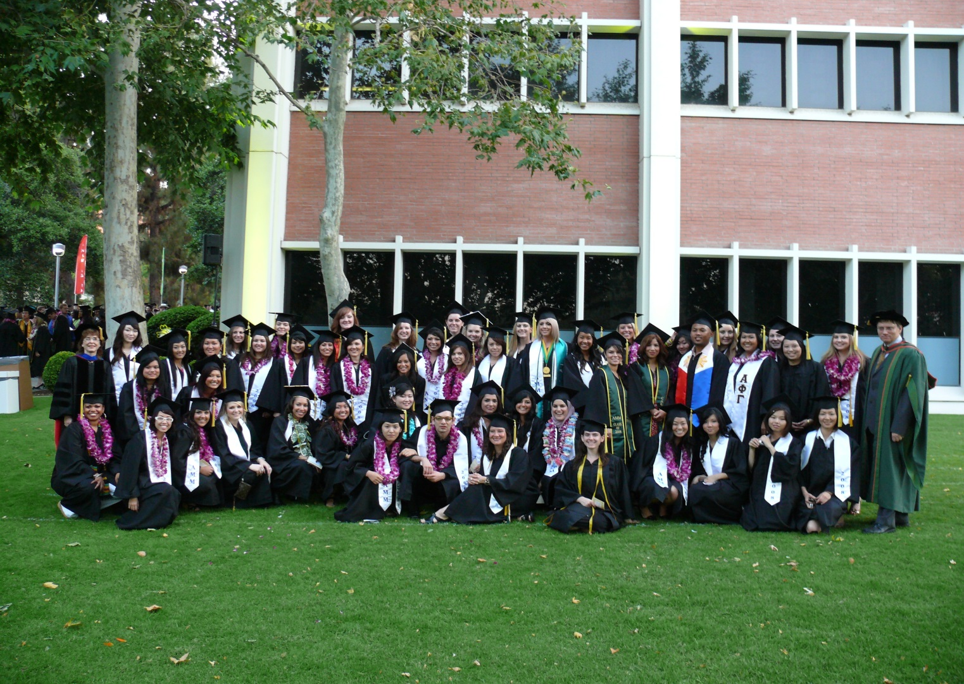
Winter 2008 – 9, Spring 2008 – 26, Summer 2008 – 9, Fall 2008 – 12 (56)

Slide 14
Winter 2009 – 9, Spring 2009 – 26, Summer 2009 – 7, Fall 2009 – 12 (54)

Slide 15
Winter 2010 – 2, Spring 2010 – 21, Summer 2010 – 11, Fall 2010 – 12 (46)

Slide 16
Winter 2011 – 6, Spring 2011 – 51, Summer 2011 – 10, Fall 2011 – 15 (82)

Slide 17
Winter 2012 – 7, Spring 2012 – 29, Summer 2012 – 2, Fall 2012 – 13 (51)

Slide 18
Winter 2013 – 4, Spring 2013 – 33, Summer 2013 – 4, Fall 2013 – 15 (56)

Slide 19
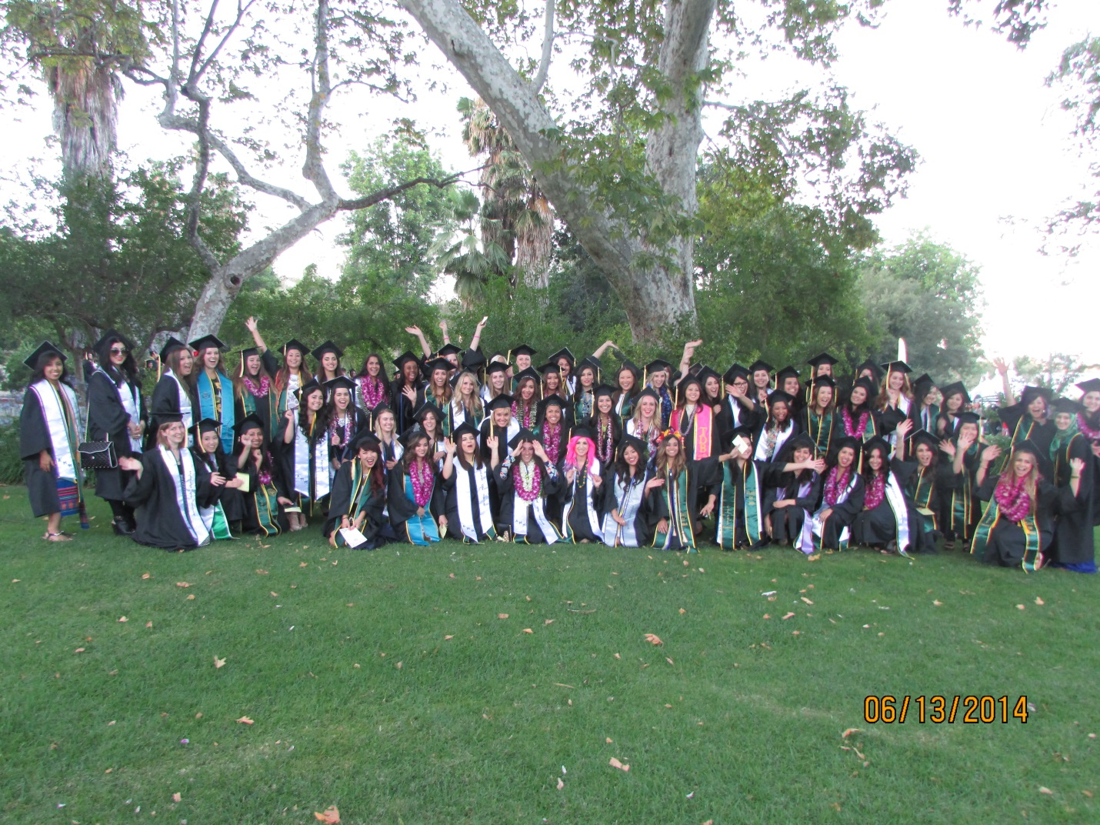
Winter 2014 – 17, Spring 2014 – 54, Summer 2014 – 5, Fall 2014 – 11 (87)

Slide 20
Winter 2015 – 11, Spring 2015 – 44, Summer 2015 – 12, Fall 2015 – 3 (70)

Slide 21
Winter 2016 - ?, Spring 2016 - ?, Summer 2016 - ?, Fall 2016 - ?

Slide 22
1997 - 2015
746 AMM graduates
How many more in 2016?

