Slide 1
DICAS 3.x Overview & application Workshop
Guide to the NEW DICAS – starting Spring 2023
Dr. Kiresich, RD
Dr. Isom, RD

Slide 2
Pathway to Becoming an RD/RDN
Masters Degree (starting January/2024)
DPD classes from an accredited university
1000 hours of supervised practice
Various internship types available (see next slide)
Registration exam
Continuing education units (75 every 5 years)

Slide 3
Types of Internships
Traditional Internship
Coordinated Internship
Combined
Future Graduate/Graduate Program (FG/GP – used to be called FEM)
Distance Internship
Individualized Supervised Practice Program
Notes:
Internships vary on types as well as:
Emphasis
Full time vs. part time
Degree or credit toward a degree
Reputation
Pass rate
Location
Cost
Length of rotations
Requirements
Start and stop dates
Preceptors

Slide 4
Traditional
Apply as a separate program, even if you already attend the university
Program arranges all rotations and coordinates with all preceptors
Program also arranges all contracts
Set time to start and end
Majority accept applications in February only
DICAS
Smaller amount take fall applications
Will likely require you HAVE a Master’s Degree or WILL COMPLETE a Master’s Degree within the timeframe of the internship program

Slide 5
Coordinated or Combined
Acceptance into the program guarantees you supervised practice
Check requirements, typically apply SEPARATELY to each part: (1) the graduate degree and (2) the DI (DICAS)
Must meet entry requirements for both
Program also provides a degree
Loma Linda University (BS, MS, MPH) – NO DICAS
USC Leonard Davis School of Gerontology (MS)
Fresno State – MS
Long Beach State - MS
VA Greater Los Angeles – option (MPH, MS)
CSU Northridge - MS

Slide 6
GP Future Graduate or Graduate Program
Acceptance into the program guarantees you supervised practice and Degree completion
These program have competencies in BOTH didactic Dietetics Practice & supervised practice
= classes and internship
These may or may not require the DPD to be complete
If they DO NOT require DPD Verification, the prerequisites are extensive
Examples of GP
Iowa State University MPP
Utah State University MDA
University of the Pacific: MCN
Berkeley Master in Nutritional Sci and Dietetics

Slide 7
GP Future Graduate or Graduate Program
Acceptance into the program guarantees you supervised practice and Degree completion
These program have competencies in BOTH didactic Dietetics Practice & supervised practice
= classes and internship
These may or may not require the DPD to be complete
If they DO NOT require DPD Verification, the prerequisites are extensive
Examples of GP
Iowa State University MPP
Utah State University MDA
University of the Pacific: MSCN
Berkeley Master in Nutritional Sci and Dietetics

Slide 8
Distance
Administered in one location, but allows you to obtain most or all your supervised practice where you live
Often intern is responsible for finding own preceptors
Student must be proactive to secure (all) clinical preceptors in S. Cal
Unless they already have contracts – contact internship directly for a possible list of local preceptors
Generally, allows for more flexibility than other internships
Often have many more openings for interns (15 vs. 60)
Some distance programs are not accepted in some states

Slide 9
ISPP Individual Supervised Practice Program
Open to People with doctorates without verification statements
OR students who have applied to internships through DICAS and had at least 1 non-match.
You are NOT eligible if you decline a match!
Each ISPP will have different requirements.
May need to find your own preceptors
NEW – may not be eligible for the Spring ‘24 cycle as programs transition to EITHER:
1) providing/coordinating with Masters
2) requiring a Master’s Degree for admission

Slide 10
Applying for Dietetic Internships
Step 1: Review the complete list of dietetic internships and make a list of programs that you want to learn more about.
https://www.eatrightpro.org/acend/accredited-programs/accredited-programs-directory
Location
Traditional or Coordinated
Number of applicants received
Number of applicants accepted
Minimum GPA required
Average GPA of current students
Length of program
Part-Time vs. Full-Time
Concentration or Specialty
Rotations
Tuition – Student Financial Aid Accepted?
GRE required?
Other program requirements
Interview required?
AllAccessDietetics.com

Slide 11
Where to apply
Review your WANTS, program components, and your Qualifications
DI: Cost, Financial Aid Available, Location, Format (Distance, combined, etc), timeline, type of degree, entry requirements
You: GPA, Experience, $$, Time-available, mobility, interests

Slide 12
DICAS application Preview
z

Slide 13
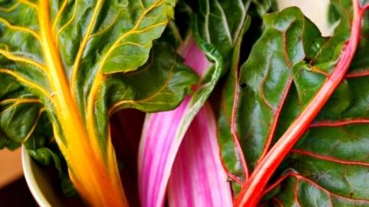
New DICAS portal
OPENS
July – Please start!
Website
https://dicas.liaisoncas.com/applicant-ux/#/login
Help Center
https://help.liaisonedu.com/DICAS_Applicant_Help_Center

Slide 14
Compare
NEW DICAS
Old DICAS
Due Date
VARIES by program
Central Time Zone (midnight)
Coursework
Enter ALL CLASSES
Due Date
Feb 15
Central Time Zone (midnight)
Coursework
Only DPD classes

Slide 15
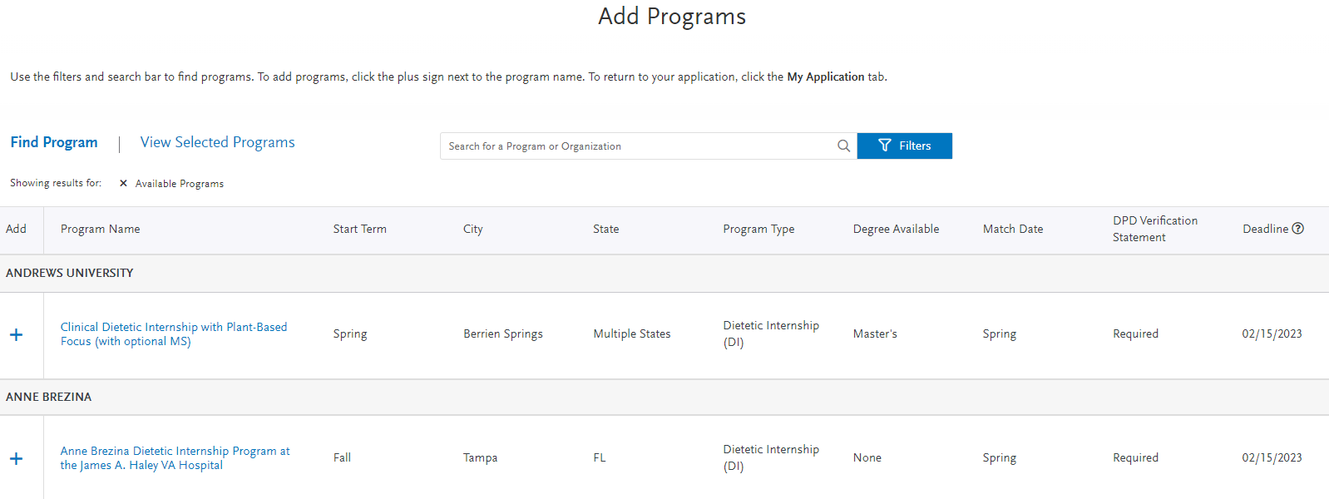
Add programs FIRST

Slide 16
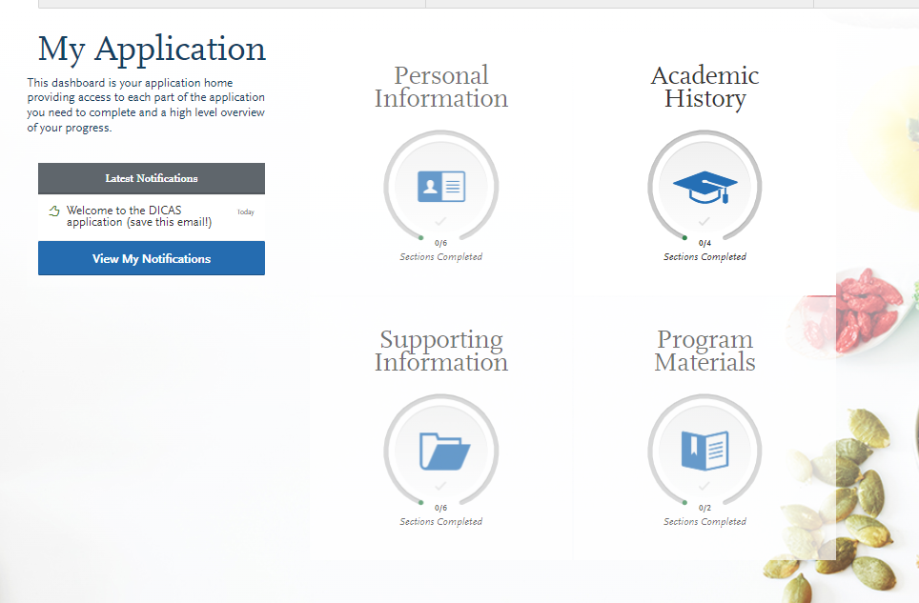
My Application

Slide 17
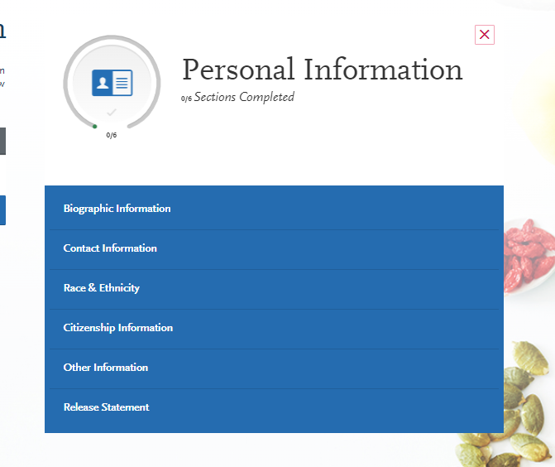
Personal Information

Slide 18
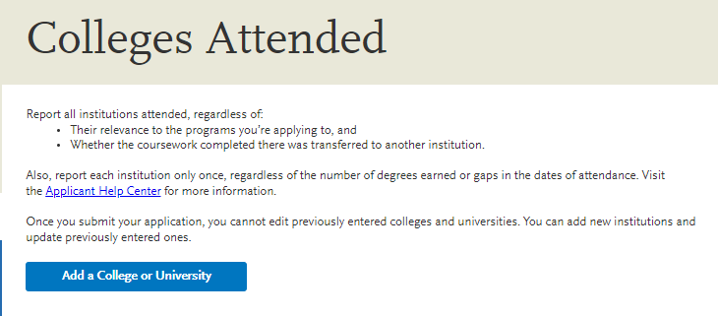
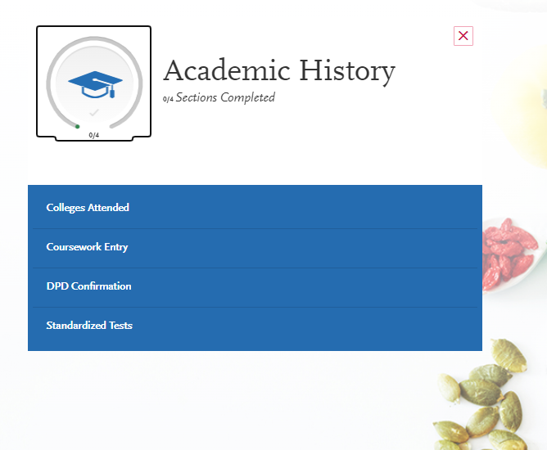
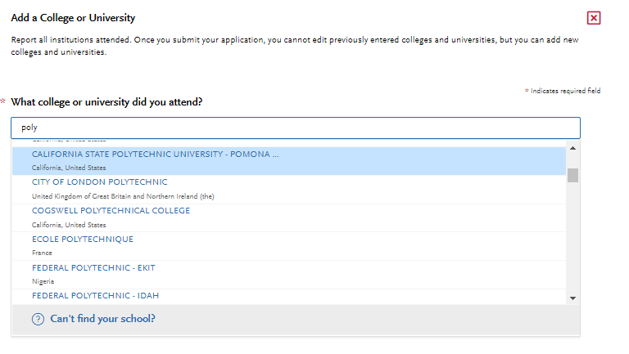
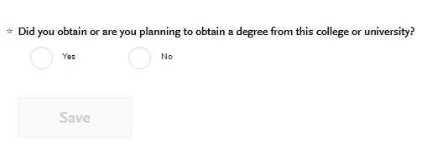
Academic History

Slide 19
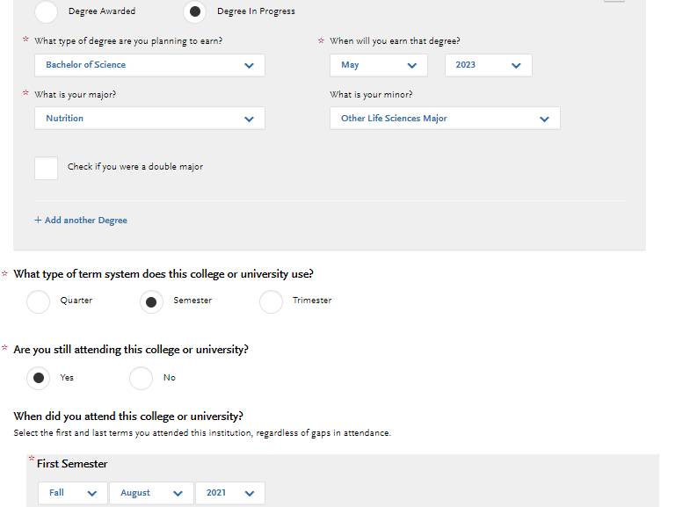
Details about EACH college
z

Slide 20
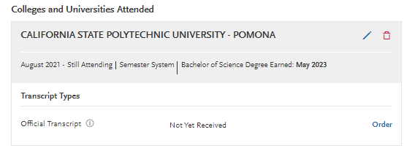
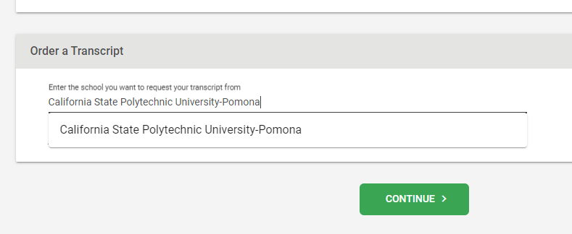
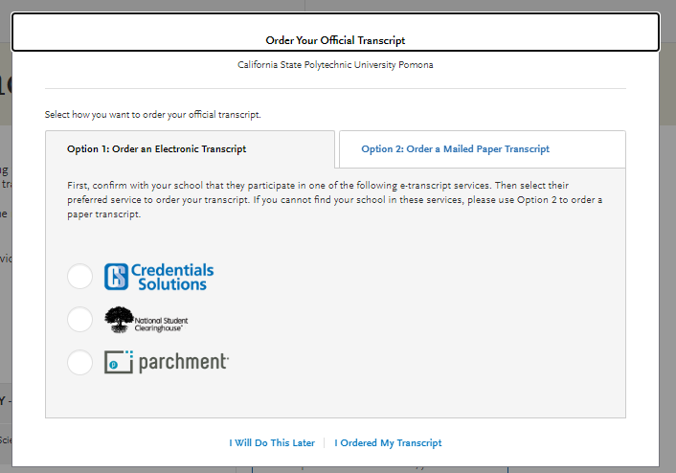
Transcripts

Slide 21
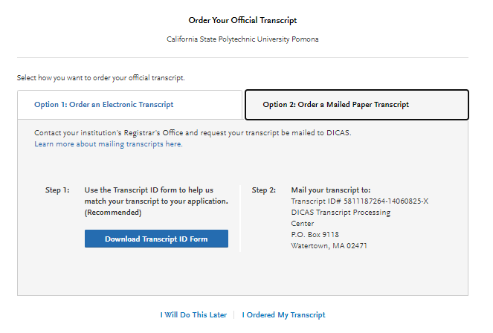
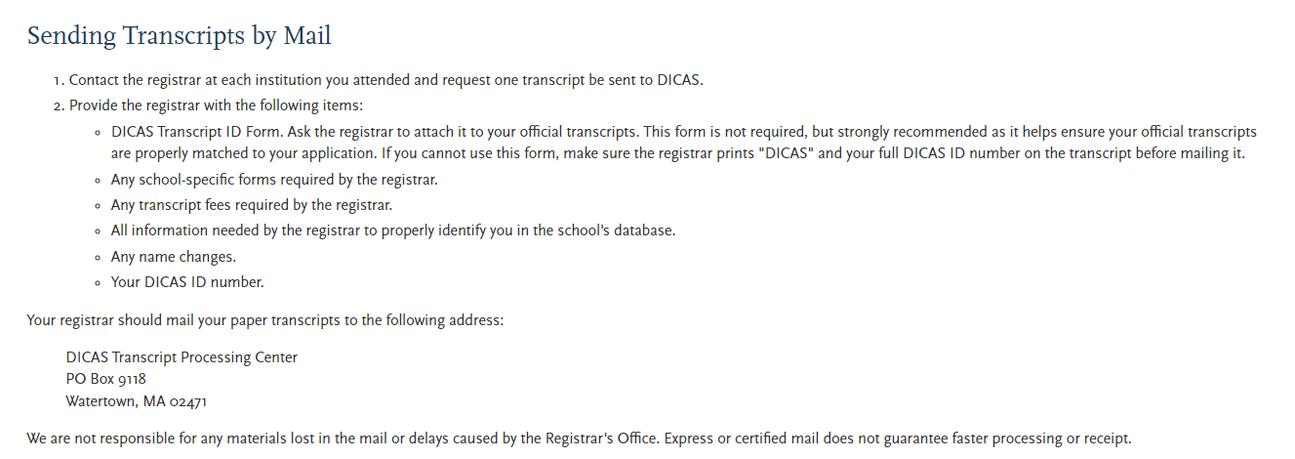
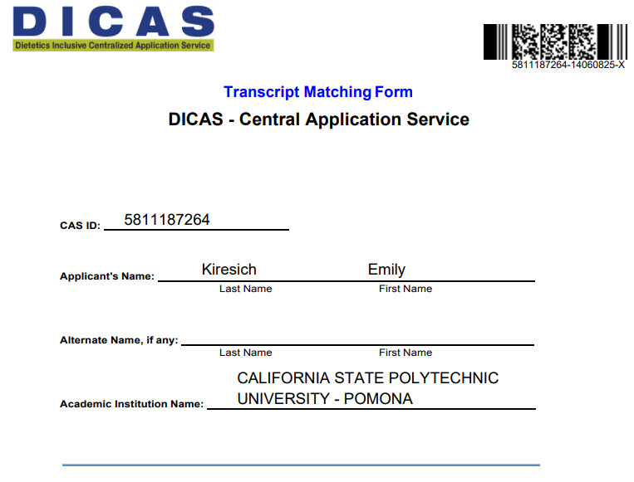
If your school does not use: Credential Solutions, National Student Clearing House, or Parchment

Slide 22
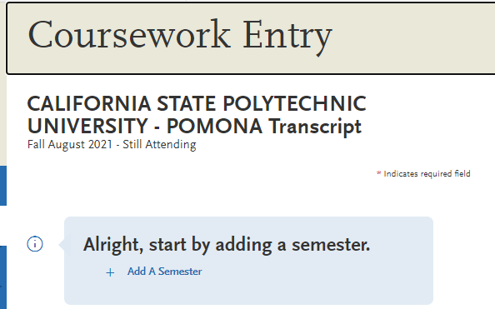
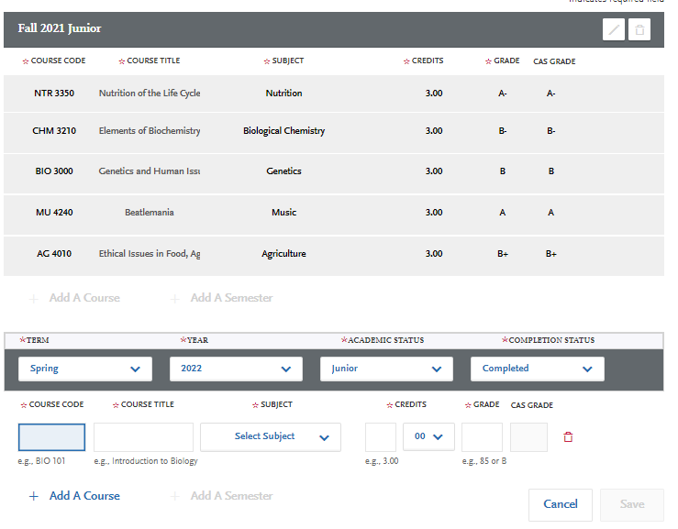
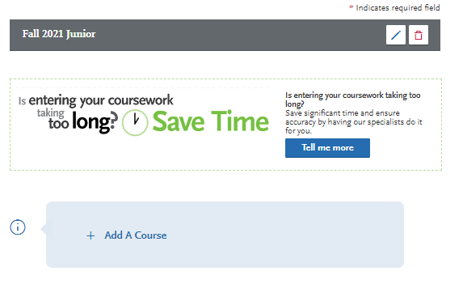
Coursework
Enter EVERY SINGLE CLASS for EVERY School

Slide 23
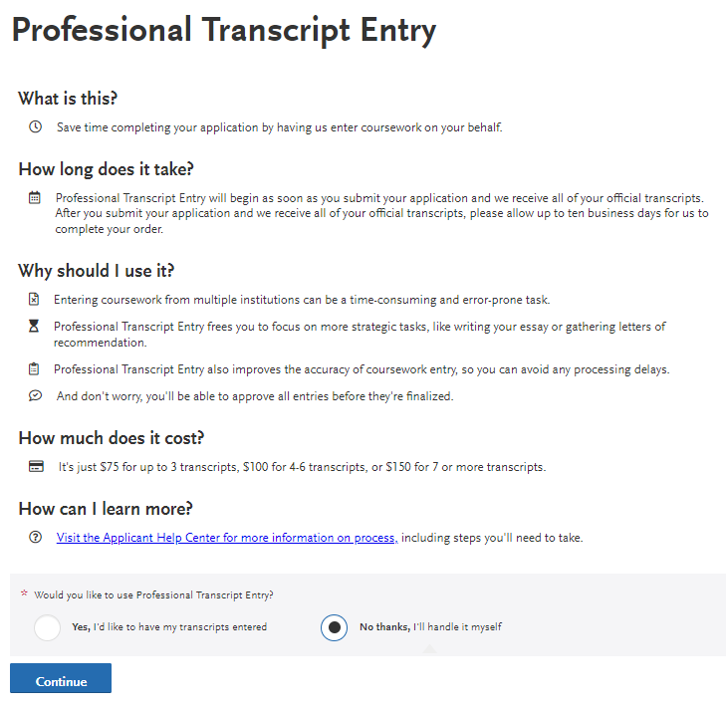
You can pay for someone else to do it
z

Slide 24
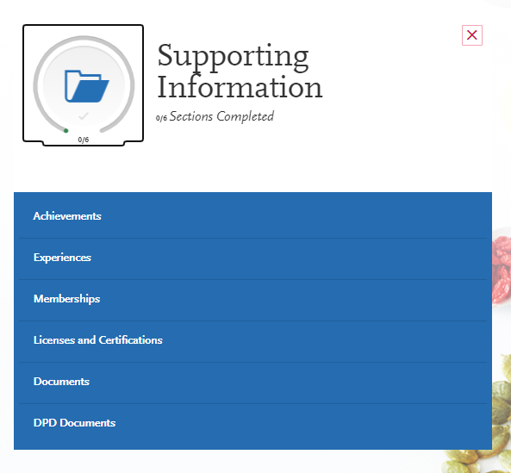
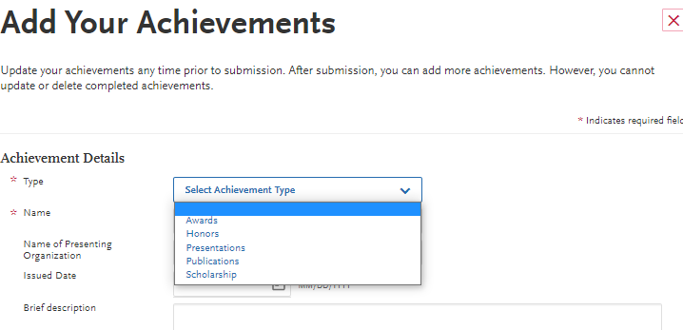
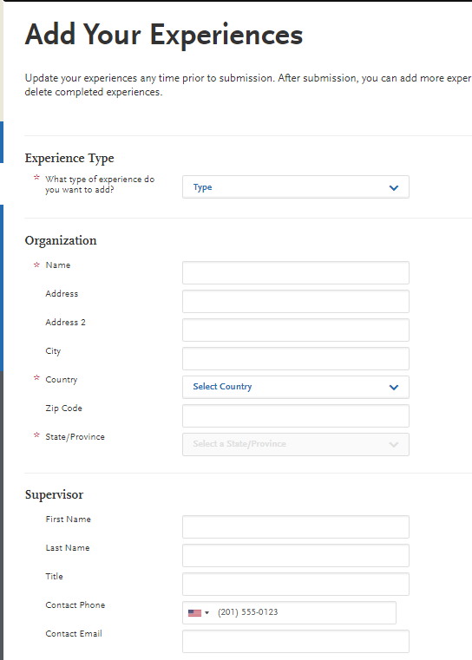

Slide 25
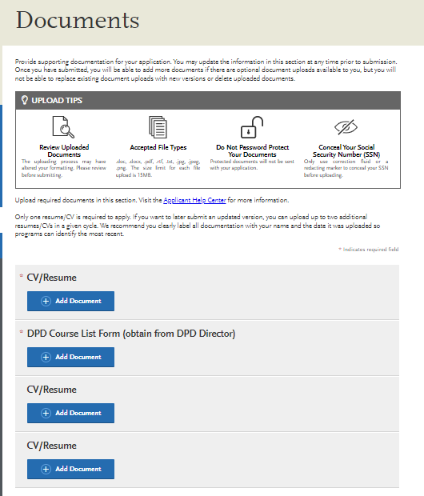
Document uploads
DPD Course list found on CPP DPD Website by YEAR
Your catalog year is one of the following:
the year you started at CPP or
the year you declared Dietetics as the option, or
The year you selected between the year you started and now
You can check your Bronco Direct

Slide 26
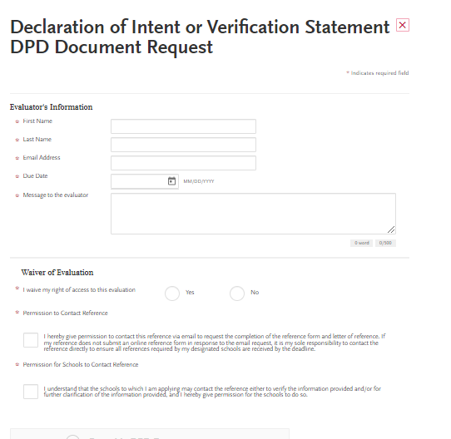
Declaration of Intent or Verification Statement Evaluator: Emily Kiresich Email: dpd@cpp.edu Due Date: you need to put the date your application(s) due

Slide 27
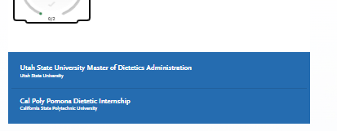
Program-Specific Information
z

Slide 28
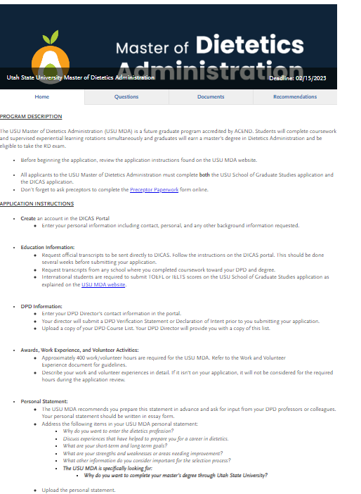
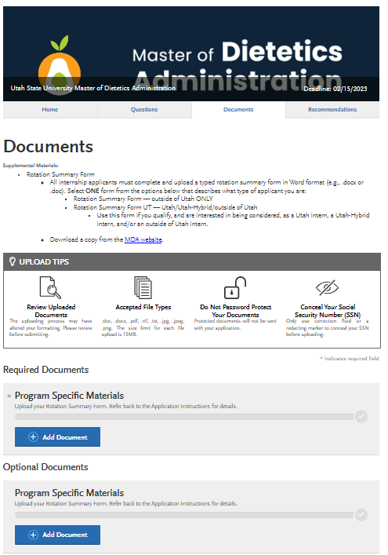

Slide 29
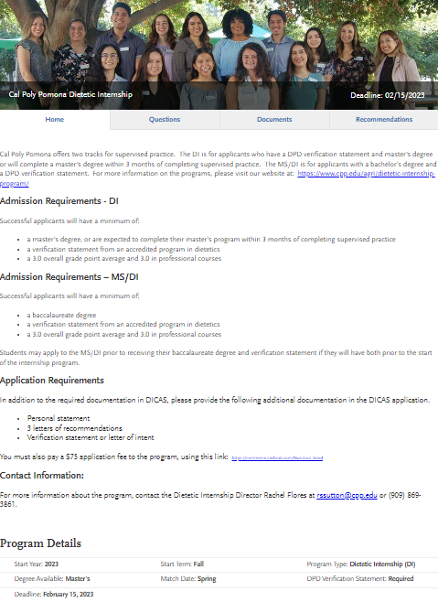
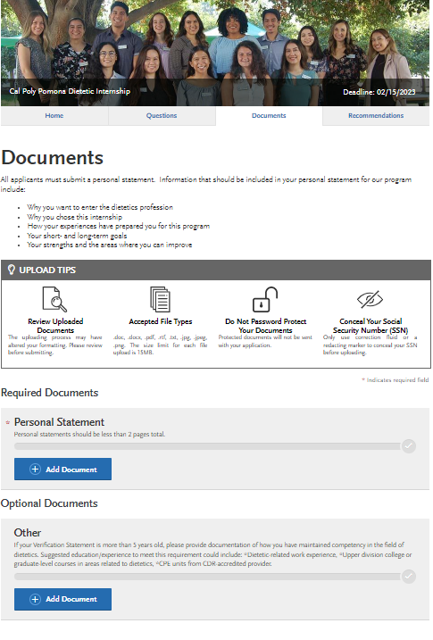

Slide 30
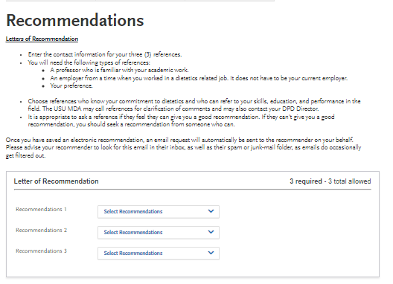
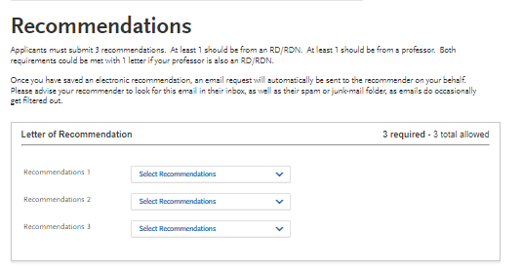
Letters of Recommendation

Slide 31
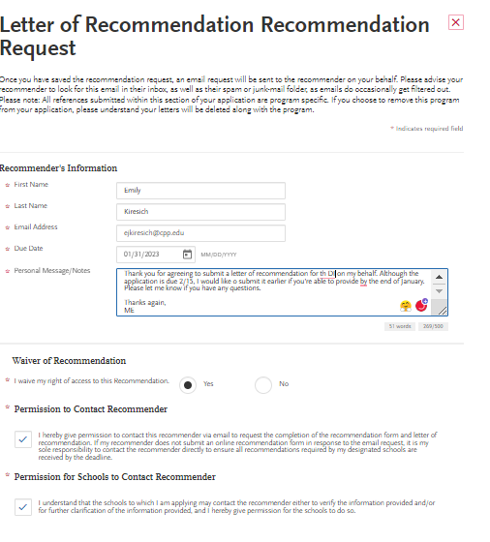
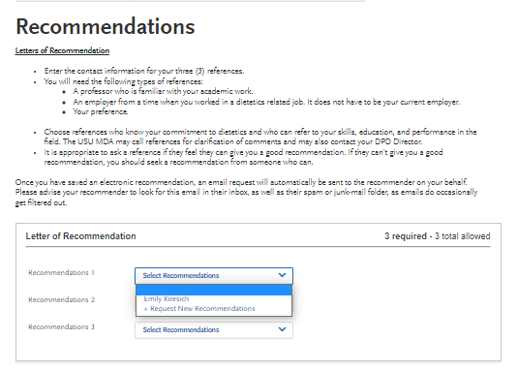

Slide 32
Who do you ask?
Check the requirements of the program. Could be RD’s/employeers, instructors, DPD Director, friends (rare)
Request your letters EARLY:
give 3-4 weeks, request before the end of Fall semester if possible
Ask – when they say YES provide:
Resume
unofficial transcripts
List short and long-term goals
List of programs to which you’re applying
& DICAS only or also letters for a Master’s program
Maybe – your personal statement *to help them write a good letter

Slide 33
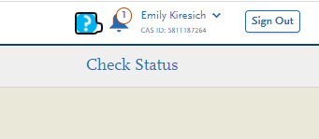
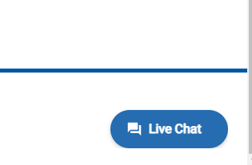
Getting Help

Slide 34
$50 for 1 + $25 for each additional program Apply to 4 programs = $125 Apply to 2 programs = $75
z

Slide 35
Key Points
DPD Classes = DPD course list, pending availability on website, available on Dietetics Canvas, if neither email dpd@cpp.edu
Transcripts = ‘printer’ icon, but include DICAS paper with request to be sent directly to DICAS, not from you
Verification Statement vs. Declaration of intent
Use email dpd@cpp.edu
Letters of Recommendation – ask before you leave for Winter break if possible
Supplemental materials – differ per internship, will not be able to upload until AFTER you designate programs
COST

Slide 36
A Word About Computer Matching
Programs with open positions will be posted on the D&D Digital Web site the day following Appointment Day. Applicants who do not receive a computer match must not contact any program with open positions until the day following Appointment Day. In addition, please do not ask your Didactic Program Director to inquire about programs with open positions until the day programs with open positions are posted. This allows the DI programs time to confirm acceptance from their matched applicants and determine the process they will use to fill open positions.

Slide 37
A Word About Computer Matching (how it works)
Dietetic Internship Matching Process: The matching process uses both the applicant and the DI program’s ranking to create the final class list. First, the D&D Matching algorithm removes internship rankings of applicants that did not list them and vice versa. D&D the looks at the matching window of the applicant’s ranked preferences and matches it to the DI programs. After the applicant ranks and saves their internship choices and the D&D matching algorithm matches the applicants and the programs, the applicant will check “Matching Results” on match day to see where he or she got matched.

Slide 38
Improving Your Internship Application
Experience
If you plan to take any time between graduation and DICAS - working as diet aide or taking the DTR exam
Work or volunteer:
Hospitals
School Food Service
Corporate Wellness Programs
Healthy City Programs
Nutrition Entrepreneurs
Student Health Centers
Farmer’s Markets
Other Options:
Consider the Certified Dietary Manager (CDM) Certification
Work for Women, Infants, and Children (WIC) as a nutritionist
Explore Fitness Specializations:
Certified Personal Trainer (CPT)
Group Fitness Instructor Certifications
With a fitness specialization, you may work in hospital or rehab clinics, fitness centers, or grade school athletics.
Health Promotion:
Health educators can work for health departments, schools, and community or non-profit organizations.
Consider a Graduate Degree:
Master of Science, Master of Public Health, or Master of Business Administration

Slide 39
Improve your Internship Application
Honors & Awards (highlight these)
Still time to apply for awards and scholarships
Apply for Scholarships
Certifications
ServSafe
CPR

Slide 40
Improve your Internship Application
Have a GREAT Personal Statement
https://www.allaccessdietetics.com/dietetic-internship-personal-statement-checklist/
https://www.nutritionjobs.com/how-to-write-a-winning-dietetic-internship-personal-statement

Slide 41
Improve your Internship Application
Demonstrate Leadership
Volunteer Opportunities
On and off campus orgs
FN Forum
PhiU
ED Club
Others?! (STEM, Cultural or personal interest)
CA Academy Local Districts
Inland District
LA Region
Orange County District

Slide 42
DTR
z
The steps for the DTR exam process are as follows:
please order and have a set of sealed Official Transcripts mailed directly to me from the Cal Poly Registrar's Office to my address listed below. OR email an official copy to dpd@cpp.edu Note: The date that your BS degree was conferred must appear at the top of the first page of the Official Transcripts.
Emily Kiresich, PhD, RD
Director, Didactic Program in Dietetics
Department of Nutrition and Food Science
Don B. Huntley College of Agriculture
California State Polytechnic University, Pomona
3801 West Temple Avenue
Pomona, CA 91768
Pay the $25 nonfundable DTR exam processing fee via E-Market https://commerce.cashnet.com/Nutrition_Food
Upon received the transcript and the payment, I will email you to schedule an appointment to complete the additional required paperwork via Zoom

Slide 43
Thank you
Questions:
dpd@cpp.edu

Slide 44
Resources
Where to search for internships
https://www.eatrightpro.org/acend/accredited-programs/accredited-programs-directory
Applicant Guide to Supervised Practice (AGSP) – in Dietetics Canvas page or email dpd@cpp.edu
DICAS overview (https://www.eatrightpro.org/acend/students-and-advancing-education/dietetic-internship-match-students/video-for-dietetic-internship-centralized-application-service)
– VIDEO from ACEND website https://www.eatrightpro.org/-/media/eatrightpro-files/acend/program-directors/april-2022-computer-matching-calendar.pdf?la=en&hash=077BC181B6090D4F355C9F0FEAF0E478827D5963

Slide 45
More Resources
Personal Statement tips (for this and the one below we can provide some links/resources like those available at CPP)
How can you 1) answer the questions/prompts while 2) highlighting some of your best assets and 3) explain any issues with your application (if needed) – such as some low grades, gap in work/school, etc, and 4) what’s memorable and unique about you.
https://www.allaccessdietetics.com/dietetic-internship-personal-statement-checklist/
https://www.nutritionjobs.com/how-to-write-a-winning-dietetic-internship-personal-statement
Resume Tips (https://www.cpp.edu/career/student/job-search/resumes-and-cover-letters.shtml)
DnD Digital
(https://www.eatrightpro.org/acend/students-and-advancing-education/dietetic-internship-match-students/dnd-instructional-video-applicants) – VIDEO from Academy

